Slide 1
DEPARTMENT OF ORTHODONTICS distalization of molar

Slide 2
content
Introduction
Extraoral appliance - Headgear
Intraoral appliance - Herbst appliance - Jasper jumper - Forsus - Pendulum appliance - NiTi coil spring - K loop molar distalizing appliance - Jones jig - Lip bumper

Slide 3
INTRODUCTION
In 1982 William Kingsley - first dentist to achieve correction of Class II molar relation to Class I by means of headgear.
Later Oppenheim used occipital anchorage for moving maxillary teeth distally into correct relationship without disturbing mandibular teeth.

Slide 4
Gould (1957) first to discuss about unilateral distalization of molars with extra-oral force.
Graber T-M. (1969) extracted the maxillary II molar and distalized the first molar to correct class II div.1

Slide 5
In 1999, A Modified Hilgers Pendulum appliance was introduced, known as the “M-Pendulum appliance”

Slide 6
INDICATIONS
End on molar relationship with mild to moderate space requirement.
Lack of space for eruption of premolars due to mesial migration of permanent first molars
Good soft tissue profile
Borderline cases
Mild to moderate space discrepancy with missing 3rd molars/2nd molars not yet erupted

Slide 7
Class-II subdivision cases requiring unilateral distal molar movement
Anchorage loss during active orthodontic treatment

Slide 8
CONTRAINDICATIONS
Retrognathic profile
Vertical growth pattern
3rd molars have erupted or close to eruption
Skeletal or Dental open bite
Patients with severe arch length tooth size discrepancy.

Slide 9
Correction of Class II malocclusion by non extraction approach can be achieved by both intraoral and extraoral forces.
Molar Distalization method is one of the methods to correct Class II malocclusion which involves, distalization of molars by using extraoral or intraoral forces.
Notes:
COMPLIANCE OF THE PATIENT

Slide 10
Intraoral appliance > Extraoral appliance to achieve distal molar movement, reason - minimal patient cooperation.
Design of IOA - two elements: active unit ---- distalize the maxillary molars and anchorage one that countervail for the reciprocally acting force system.

Slide 11
DISTALIZATION
Extraoral
(Headgear)
Intraoral
1. Intermaxillary (herbst appliance, jasper jumper, adjustable bite corrector
2. Intramaxillary (pendulum appliance, distal jet)

Slide 12
INTERMAXILLARY APPLIANCE
Rigid intermaxillary appliance
Herbst appliance
Biopedic appliance
Flexible intermaxillary appliance
Adjustable bite corrector
Hybrid
Eureka spring
Rito appliance
Mandibular anterior repositioning appliance
Functional mandibular advancer
Bite fixer
Gentle jumper
Forsus nitinol flat spring
Forsus fatigue resistant device
Ribbon jumper
Twin force bite corrector
Jasper jumper

Slide 13
INTRAMAXILLARY APPLIANCE
FLEXIBLE PALATALLY POSITIONED DISTALIZATION FORRCE SYSTEM
Pendulum appliance
FLEXIBLE BUCCALLY POSITIONED DISTALIZATION FORRCE SYSTEM
FLEXIBLE BUCCALLY & PALATALLY POSITIONED DISTALIZATION FORCE SYSTEM
Piston appliance
Distal jet appliance
Keles slider
Nance appliance with NiTi coil spring
Jones jig
Repelling magnet
NiTi wires
Nance appliance with NiTi coil spring
NiTi coil spring
RIGID PALATALLY POSITIONED DISTALIZATION FORCE SYSTEM
Veltri’s distalizer
HYBRID APPLIANCE
First class appliance
TRANSPALATAL ARCHES FOR MOLAR ROTATION/DISTALIZATION
Stainless steel TPA
New distalizer
P-Rax molar distalizer
Prefabricated TPA
Palatal rotation arch

Slide 14
headgear
The two types of extraoral forces were the
occipital force (high-pull headgear) and
cervical force (low-pull headgear).
Notes:
Headgear has two parts - facebow applied to the first molar - neckstrap/headcap

Slide 15
Selection of headgear 1. anchorage location --- high pull headcap---- superior and distal force on the teeth and maxilla cervical neck strap---- inferior and distal force on the teeth and skeletal structure
Notes:
The more the signs of vertically excessive growth pattern the higher the direction of pull and vice versa

Slide 16
2. headgear attachment to the dentition----- facebow attached to headgear tube in first molar - facebow attached to a removable splint or functional appliance
Notes:
unless the line of force is through its center of resistance, rotation of the jaw (the skeletal equivalent of dental tipping) will occur.
This allows vertical force to be directed against all the maxillary teeth
Control of the line of force relative to the maxilla is easier when a splint covering all the teeth is used to apply the headgear force.
The facebow is usually attached to the splint in the premolar region so that the force can be directed through the center of resistance of the maxilla , which is estimated to be located above the premolar roots.
Distal tipping of the maxillary incisors is likely to occur, however, because the distal component of the force is delivered to these teeth.

Slide 17
3. Bodily movement or tipping of the teeth
Notes:
the center of resistance for a molar is estimated to be in the midroot region, force vectors above this point should result in distal root movement.
Forces through the center of resistance of the molar should cause bodily movement, and vectors below this point should cause distal crown tipping.
The length and position of the outer headgear bow and the form of anchorage (i.e., headcap or neckstrap) determine the vector of force and its relationship to the center of resistance of the tooth.

Slide 18
Notes:
High-pull headgear (headcap) to the first molar. To produce bodily movement of the molar (no tipping), the line of force (black arrow) must pass through the center of resistance of the molar tooth.
This will produce both backward and upward movement of the molar.
Note that the line of force is affected by the length and position of the outer bow, so a longer outer bow bent up or a shorter one bent down could produce the same line of force.
If bow length or position produces a line of force above or below the center of resistance dashed red), the tooth will tip with the root or the crown, respectively, going distally because of the moment that is produced.

Slide 19
Notes:
Cervical headgear(neckstrap) to the first molar.
Again, bodily movement is produced by an outer bow length and position that place the line of force through the center of resistance of the molar; with a lower direction of pull, the tooth is extruded as well as moved backward.
Note that the outer bow of a facebow used with cervical traction nearly always is longer than the outer bow used with a high-pull headcap.
If the line of force is above or below its center of resistance, the tooth will tip with the root or crown, respectively, going distally as indicated by the dashed arrows.

Slide 20
Notes:
High pull headgear to a short facebow inserted into a maxillary splint
With all the teeth splinted it is possible to consider the maxilla as a unit and to related the line of force to the centre of resistance of the maxilla
As with the headgear force against the first molar, the relationship of the line of force to the centre of resistance of the maxilla determine the rotational effect on the maxilla

Slide 21
Occipital force
High-pull (occipital force) headgear traction force - ------- exerted above the occlusal plane ---- producing both distalizing and intrusive effects.
High pull ---- applied to upper first molars by means of a facebow with the outer bow of the same length of the inner bow.
Inner bow ----- passive to the molar tubes;
Outer bow ----- bent upward so that the point of force application and the line of force lay above the upper molar center of resistance
Notes:
Occipital force was used in all those cases where molar vertical control was important.
Malocclusions with dental openbite tendencies, hyperdivergent skeletal patterns, and biomechanical systems that tended to extrude upper molars were some of the more common clinical conditions that might require a high-pull headgear.

Slide 22
Appliance ------ adjusted to produce a force system that tended to incline the molar roots distally and intrude upper molars.

Slide 23
Cervical force
In cervical gear ------ force exerted from below the occlusal plane and had extrusive as well as distalizing effects.
Facebow with outer bow longer than the inner bow and bent upward so that both the point of force application and the line of force lay above the upper molar center of resistance.
Notes:
Cervical force was used in cases involving a dental deep bite and a skeletal hypodivergent pattern or, generally, when vertical control of the upper molars was not crucial.

Slide 24
Clinical management of headgear
As a Class Il molar relationship is corrected, the relative forward movement of the lower arch will produce a crossbite tendency unless the upper arch width is expanded.
This must be taken into account from the beginning of treatment.
The inner bow should be expanded by 2 mm symmetrically so that when it is placed in one tube, it rests just outside the other tube.

Slide 25
The patient will need to squeeze the inner bow as it is inserted to make it fit the tubes, thus providing the appropriate molar expansion
Extraoral forces had to be about 150 g per side
worn at least 12 to 14 hours a day
For the patient’s safety, the neck pad and the occipital cap had to have breakaway traction units.

Slide 26
Uses of palatal bar - Distalization - Rotation - Expansion or constriction - Vertical control - Torque - Anchorage increase

Slide 27
Removable distalizing plate
The removable distalizing plate was used to continue distalization of the upper molars when a “super Class I” relationship could not be obtained using only Palatal bars and headgear.
This plate was designed to apply a gentle, constant force of approximately 30 g to the upper first permanent molars with minimal reaction on the upper front teeth.
Notes:
However, its forces might tend to incline molar crowns distally and extrude the molars.
For this reason, it always had to be used in conjunction with an extraoral force to control molar roots, ensure vertical control, and thus obtain the desired distal bodily movement of the molars.

Slide 28
Three parts
The active part: two 0.028-inch stainless steel distalizing springs with arms that lay against the mesial surface at the gingival level of the upper first permanent molars
The retention part: an anterior 0.017- × 0.025-inch arch covered by a labial screen and having two Adams clasps on the first premolars or the first deciduous molars

Slide 29
iii. The anterior bite plane: disclusion aids in the distal movement of the upper molars.
Notes:
The active part: two 0.028-inch stainless steel distalizing springs with arms that lay against the mesial surface at the gingival level of the upper first permanent molars
The retention part

Slide 30
Clinical management
Worn 24 hours a day except for meals and hygiene. It always had to be used with the extraoral force to control molar roots and obtain a distal bodily movement.
The springs had to be very lightly activated.
An activation of 2.0 to 2.5 mm per side gave approximately 30 g of distal force either bilaterally
Notes:
The arm of the spring had never to be bent buccally around the molars because this prevented spontaneous lateral movement of the molars.

Slide 31
HERBST APPLIANCE
Emil Herbst in 1905, originally designed the appliance and was later popularised by Pancharz. .
In 1989, John R Valant used the same appliance and observed 10mm of increase in the arch length.
Notes:
Rigid intermaxillary

Slide 32
It controls the direction of mandibular growth and also has the ability to inhibit maxillary growth in the sagittal direction.
The dental changes include distalization of the maxillary molars and mesial movement of the mandibular molars and incisors
Notes:
Pancherz noted that substantial rebound immediately post treatment hence suggested its use in early permanent dentition when changes are more localised to the protrusion of mandible and not in mixed dentition because it can produce max posterior dental intrusion, it provides better result when used in pt with normal or slightly long ant facial height

Slide 33
Notes:
Can be banded (original design) or cast splint
Banded herbst appliance upper and lower framework

Slide 34
It is a rigid intermaxillary appliance
Telescopic mechanism - tube - plunger - 2 pivots - 2 locking screws
Notes:
bilateral telescopic mechanism attached to orthodontic bands on the maxillary first permanent molars and mandibular first premolars, which maintains the mandible in a continuous protruded position
A more recent version of the Herbst appliance was developed by Pancherz, in which the bands are replaced by cast splints (cast splint Herbst design), which fit precisely and cover the teeth in their lateral segments, fabricated from chromium-cobalt and cemented with glass ionomer cement to the teeth
Each telescopic mechanism consists of a tube and a plunger which it together, two pivots, and two locking screws.
The pivot for the tube is soldered to the maxillary first molar band and the pivot for the plunger to the mandibular first premolar band.
The tubes and plungers are attached to the pivots with locking screws and can freely rotate around their point of attachment
The upper pivots should be positioned distally on the molar bands and the lower pivots mesially on the premolar bands. In addition, the plunger should be as long as possible to prevent its slippage out of the tube
If the plunger is too short it may slip out of the tube when patients opentheir mouth wide.

Slide 36
Advantage: - requires less pt compliance
Disadvantage - breakage

Slide 37
JASPER JUMPER
In 1987, James J. Jasper made an appliance which was identical to the herbst device.
Flexible intermaxillary appliance
The appliance comprises of two vinyl coated auxillary springs attached to banded upper and lower fixed appliances.
In the posterior region, the springs are fixed to maxillary first molars and anteriorly to mandibular archwire.
Notes:
It attempts to restrict the mandibular lateral movements that occur with herbst appliance

Slide 38
Transpalatal bar and lower lingual arch are used for anchorage.
This appliance is similar to Herbst appliance it controls the direction of mandibular growth and also has the ability to inhibit maxillary growth in the sagital direction.
This appliance also causes molar distalization and mesial movement of mandibular dentoalveolar segment

Slide 39
The appropriate size of the Jasper Jumper is determined by guiding the mandible in centric relation and measuring the distance between the mesial of the maxillary first molar headgear tube and the point of insertion to the mandibular arch at the distal of the small plastic beads, adding 12 mm.

Slide 40
2 parts - force module ----- flexible 7 lengths available (26-38 mm)
- anchor parts
Notes:
To determine the correct length of the module, the distance between the mesial of the upper permanent molar tube and the point of insertion to the mandibular arch is measured and 12mm is added to give the appropriate length of the jumper

Slide 41
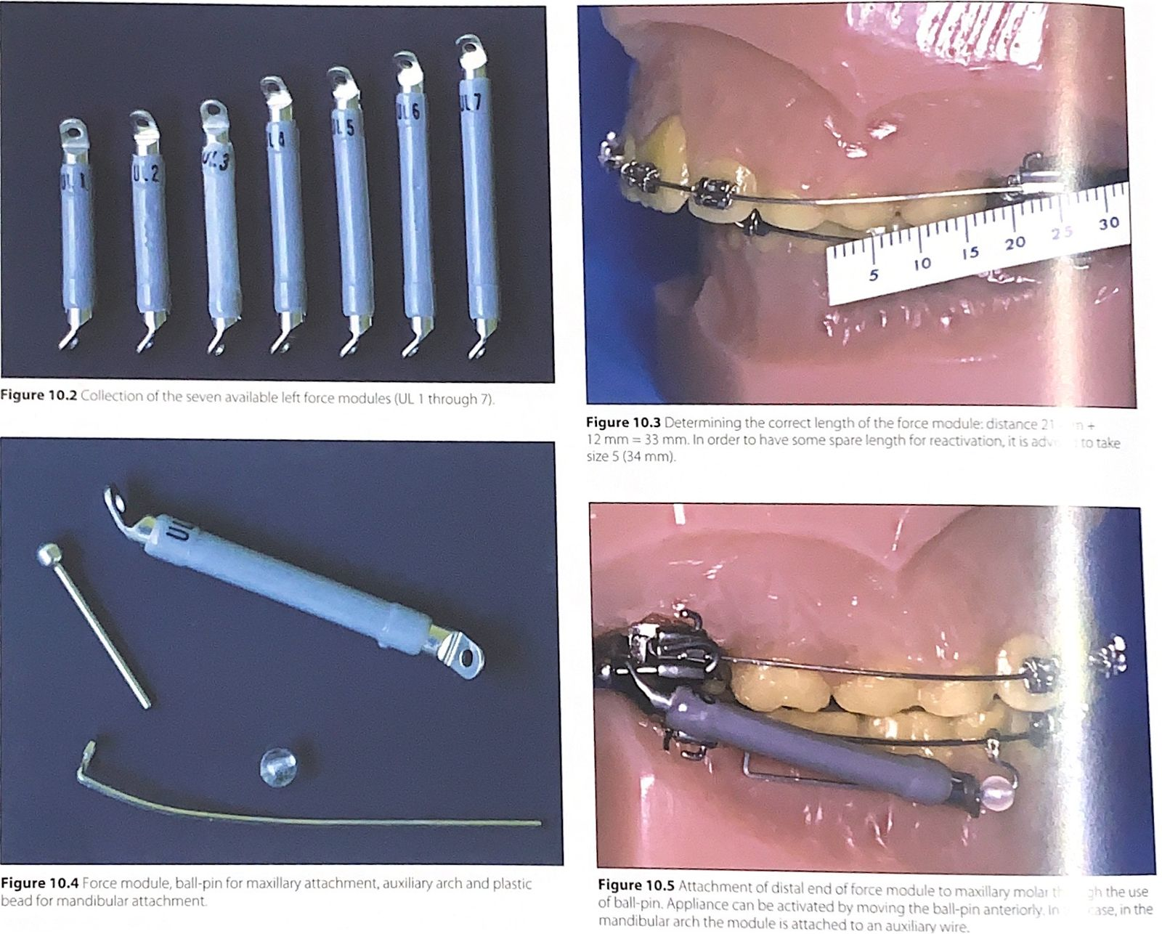

Slide 42
The force module is anchored to the upper headgear tube with a ball-pin passing through the upper hole of the jumper and through the distal end of the headgear tube.
A small plastic bead is slid onto the archwire to provide an anterior stop, followed by the lower end of the jumper, and then the arch is ligated in place
A light, continuous force

Slide 43
FORSUS
FORSUS NITINOL FLAT SPRING - flexible intermaxillary appliance which keeps the mandible in a continuous protruded position - 0.5 x 3.0 mm springbar (45% nickel, 55% titanium) covered with a transparent plastic coating and with its bent ends attaching to bands and archwires.

Slide 44
attached to the headgear tubes of the maxillary first molar bands and to the mandibular archwire distal to the canine bracket.
Moreover, a stainless steel ball stop can be placed on the archwire to create a mesial stop for the Forsus Spring.

Slide 45
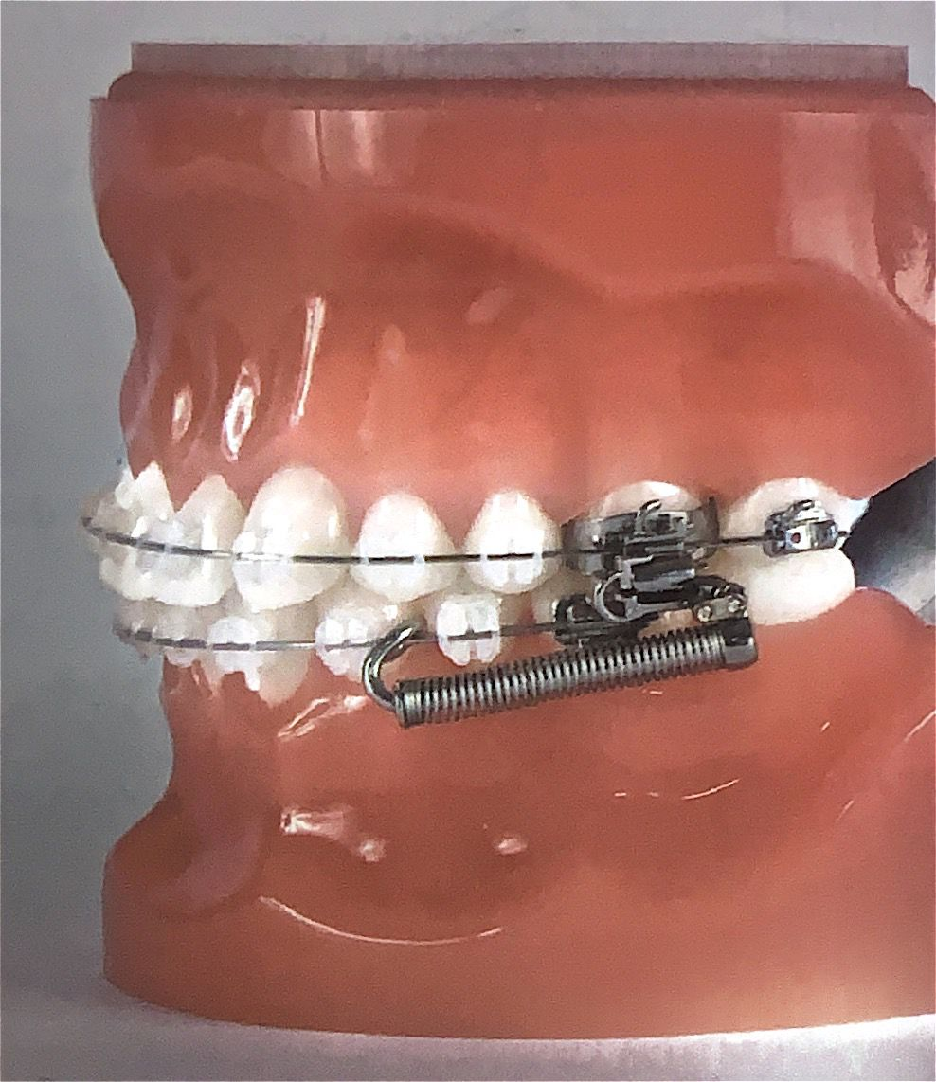

Slide 46
The length of the spring is determined by the distance between the mesial surface of the maxillary first molar headgear tube and the distal surface of the mandibular canine bracket plus 10-12 mm ,when the patient has closed in habitual occlusion
The appliance is reactivated by adding crimpable stops on the bypass archwire 5 mm mesial to the spring or distal to the stainless steel ball stop.
Notes:
(4 mm for play,4 mm for the headgear tube and 4-5 mm for the activation

Slide 47
FORSUS FATGIUE RESISTANT DEVICE
hybrid appliance designed to address the problem of fatigue failure and consists of a three-piece telescopic spring device.
attached to the maxillary first molar headgear tube with an L-shaped ball-pin and to the mandibular archwire
a direct push rod is incorporated in the device, which permits direct attachment to the mandibular archwire.

Slide 48
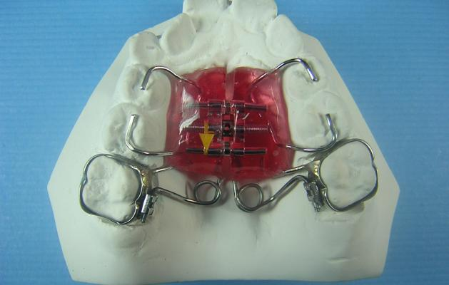
T-rex design of pend-x appliance

Slide 49
Patients should be informed not to open their mouth widely due to the risk of disengagement.
Notes:
The Forsus Fatigue-Resistant Device has also been used instead of the Bite Fixer springs in the Class Il spring appliance, described above. This version is known as the crossbow appliance.

Slide 50
Palatal bar
Introduced by R. H. Goshgarian as an anchorage appliance.
Notes:
PB is made of a 0.036-inch stainless steel (spring temper) wire, doubled back at the ends to be inserted in a 0.036- × 0.072-inch horizontal lingual sheath, which is soldered to molar bands
lingual sheaths have an 8-degree mesial offset that facilitates insertion and removal of the PB, preventing blocking behind premolars after molar rotation.
A distal latching indent and a gingival hook help to tie

Slide 51
The PB incorporates a small “U-shaped” Coffin loop, which is positioned generally toward the mesial for two reasons - to make the PB more comfortable and - to incline molar roots distally because of forces exerted by tongue during speech and swallowing anterior to the center of resistance (CR) of molars.
The loop is left distal if intrusive force is desired posterior to the center of resistance to tip molar crowns distally
Notes:
Distalization is the only unilateral activation of the PB.
It can be used in two clinical situations:
when, in a malocclusion, there is a Class II molar relationship on one side and the other side is normal or
when both upper molars must be distalized and the patient does not want to wear headgear.

Slide 54
PENDULUM APPLIANCE
In 1992, Higlers introduced this appliance which comprised of a Nance acrylic button for anchorage, 0.032'' TMA swinging springs which transfers force to maxillary molars and a lingual sheath of 0.036" in which the TMA spring is inserted.
Notes:
Activation of this device is done extra orally, the spring should be parallel to midsagital plane when the device is place inside the mouth.

Slide 55
Intramaxillary appliance
The force applied on each side is nearly 200-250gms which creates a movement of 5mm within 3-4 months of period.

Slide 56
Notes:
Acrylic nance button on anterior palate
Serves for anchorage and attachment for two posteriorly extending arms
In passive state these arms extend posteriorly parallel to midpalatal suture
Springs are activated by attaching their free ends into lingual sheath on the molars and a distalizing component of the force is created.
Distalization generated by PA is rapid and 1-2 mm space is created within 6 weeks of insertion
Activation of this device is done extra orally, the spring should be parallel to midsagital plane when the device is place inside the mouth.

Slide 57
Modification of pendulum appliance
Hilgers palatal expander
Pend-X appliance
Mayes’ pendulum appliance
M- pendulum appliance
K-pendulum appliance
Bipendulum and Quad pendulum appliance

Slide 58
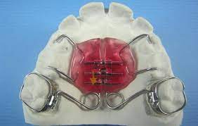
Pend -X

Slide 59
NiTi COIL SPRING
Integral part of active units of distalization appliances
Consists of modified nance button retained through extension wires soldered to maxillary first premolar bands
active unit consists of a 0.014 × 0.037" NiTi Open Coil Spring placed buccally onto a stainless steel sectional wire connecting the first premolar and first molar bands.

Slide 60
A force of approx. 225gms is produced
Gianelly et al used NiTi Superelastic Coils which exerted a distalization force of 100 g by a compression of 8-10 mm.
another method of activation, by placement of a sliding lock in front of the coils and compressing the coils by moving the lock 10 mm posteriorly before fixing in position.

Slide 62
JONES JIG
It was developed by Jones and White in 1992
The appliance consists of - active unit ---- positioned buccally ----- having active arms or jig----- incorporates NiTi open coil spring - anchorage unit---- a modified Nance device attached to the first premolar or deciduous second molar using heavy round wire and a light wire passing throught the molar tube

Slide 63
The open coil spring exerts 70-75gms of force which causes molar distalization of 2.5-2.8mm.

Slide 65
K loop molar distalizing apppliance
A K-Ioop to provide the forces and moments and a Nance button to resist anchorage
K loop 0.017”x 0.025” TMA wire with each loop 8mm long and 1.5 mm wide
Legs of appliance bent down 20°
Notes:
" TMA wire can be activated twice as much as stainless steel before it undergoes permanent deformation.
A loop made of TMA also produces less than half the force of one made with stainless steel.
The 20° bends in the appliance legs produce moments that counteract the tipping moments created by the force of the appliance, and these moments are reinforced by the moment of activation as the loop is squeezed into place.

Slide 66
Wire marked at mesial of molar tube and distal of premolar bracket
Stops are bent 1mm mesial to mesial mark and 1mm distal to distal mark
Notes:
Each stop should be well defined and about 1.5mm long.
These bends help keep the appliance away from the mucobuccal fold, allowing a 2mm activation of the K-loop
The 20° bends in the appliance legs produce moments that counteract the tipping moments created by the force of the appliance, and these moments are reinforced by the moment of activation as the loop is squeezed into place.
Thus, the molar undergoes a translatory movement instead of tipping

Slide 67
REACTIVATION SEQUENCE
1
2
Open loop 1mm at 1
Open loop 1mm at 2
Open at 3 to regain 20 ° bend of mesial and distal legs
After 2mm reactivation
Notes:
For additional molar movement, the appliance is reactivated 2mm after six to eight weeks.
In most cases, one reactivation, producing a total of as much as 4mm of distal molar movement, is sufficient

Slide 68
Lower arch
gained with the lip bumper.
it lay in front of the lower incisors and give support to the lower lip, improving lip competence, which was an important factor in mandibular growth.

Slide 69
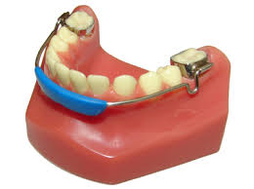

Slide 70
Lip bumper
It works by altering the equilibrium between cheeks, lips and tongue and by transmitting forces from perioral muscles to the molars where it is applied
various purposes:
Molar anchorage
Therapy of habits
Space gaining in the lower arch
Notes:
tubes have a 4-degree mesial offset to facilitate insertion and a stepout to prevent gingival impingement.

Slide 71
Clinical management
worn 24 hours a day and should be removed only for meals and hygiene
If the appliance has been well fitted, a red line can be seen on the inside of the cheeks and the lower lip where the wire runs.
If the lip bumper is too distant from the teeth, ulcers may appear

Slide 72
SEGMENTAL ALVEOLAR CORTICOTOMY TO ENHANCE UPPER MOLAR DISTALIZATION
To accelerate dental movement and improve is efficacy, and to reduce the appearance of undesired phenomena such as root resorption, loss of vitality and relapse of the corrections carried out
The segmental alveolar corticotomy , limited to upper 1st molar and 2nd premolar helped acceleraqte distalizaton of upper molars and promoted a bodily movement with less need of anterior anchorage

Slide 73
CONCLUSION
Timing of molar distalization: - the recommended time for maxillary molar distalization is either during mixed or late mixed dentition, before the eruption of 2nd molar
Rate of distalization: - 0.75-1mm/month
Notes:
‘Anchorage loss; - for every 4mm of molar distalization 1mm anterior anchorage is lost
Anchorage loss: the force applied to move molar distally utilises premolar as an anchorage the consequence is mesial movement of anterior teeth, an increase in anterior crowding, labial movement of maxillary incisors and their buccal tipping

Slide 74
Molar distalization is one of the fundamental approaches for nonextraction therapy, especially in class II malocclusion cases. Many methods have been utilized to achieve molar distalization, including extraoral app and intraoral appliances
Although the first molars can be even after the eruption of the second molars, they are easier to move before the second molars erupt.

Slide 75
If a significant amount of distal movement is required in a young patient, one might even consider extracting the second molars.
Assuming the third molars are of good size and shape and the second molars are extracted in time, the third molars will drift and erupt into proper occlusion.

