Slide 1
DEPARTMENT OF ORTHODONTICS PRENATAL AND POSTNATAL GROWTH OF MAXILLA

Slide 2
CONTENT
1-INTRODUCTION
2-PRENATAL DEVELOPMENT OF MAXILLA
EMBRYONIC DEVELOPMENT
DEVELOPMENT OF PALATE
ANOMALIES RELATED TO FACE, LIP AND PALATE

Slide 3
CONTENT
3-POST NATAL DEVELOPMENT OF MAXILLA AND PALATE
DISPLACEMENT
PRIMARY DISPLACEMENT
SECONDARY DISPLACEMENT
REMODELING
GROWTH AT SUTURES

Slide 4
INTRODUCTION
GROWTH DEFINITIONS:
ACCORDING TO “TODD” –GROWTH IS AN INCREASE IN SIZE.
THE SELF MUTIPICATION OF LIVING SUBSTANCE – “JX HUXELY”
CHANGE IN MORPHOLOGICAL PARAMETER ,WHICH IS MEASURABLE- “MOSS”

Slide 5
EMBRYONIC PHASE
PRENATAL PERIOD
(FROM CONCEPTION TILL BIRTH)
POSTNATAL PERIOD
PERIOD OF OVUM
EMBRYONIC PERIOD
FETAL PERIOD
FROM BIRTH TILL DEATH

Slide 6
PRE NATAL PERIOD

Slide 7
ANATOMY OF MAXILLA
SECOND LARGEST BONE OF FACE
PAIRED BONE
PARTS-
BODY- LARGEST AND PYRAMIDAL IN SHAPE
FOUR PROCESSES- FRONTAL , ZYGOMATIC, ALVEOLAR, PALATINE

Slide 8
PROCESSES OF MAXILLA

Slide 9
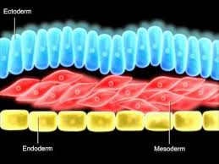
EMBRYONIC PERIOD
DURING THE PRE EMBRYONIC PERIOD , THE CELLS THAT WILL EVENTUALLY GIVE RISE TO ALL STRUCTURES OF THE BODY DIFFERENTIATE INTO THREE GERM LAYERS.
DURING THIS STAGE (GASTRULATION), BILAMINAR EMBRYONIC DISK IS CONVERTED INTO TRILAMINAR DISK.GASTRULATION OCCYRS DURING THE THIRD WEEK AFTER FERTILIZATION.
THIS TIME PERIOD IS SOMETIMES CALLED THE TRILAMINAR DISK STAGE.

Slide 10
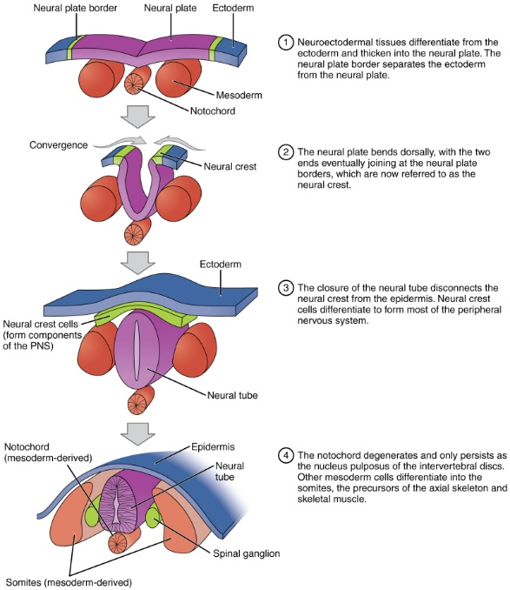
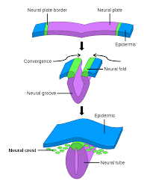
THE CARTILAGE AND BONES OF MAXILLA FORM FROM NEURAL CREST CELLS THAT ORIGINATED IN THE MID AND HINDBRAIN OF THE NEURAL FOLDS.
THESE CELLS MIGRATE VENTRALLY TO FORM THE MANDIBULAR AND MAXILLARY FACIAL PROMINENCES WHERE THEY DIFFERENTIATE INTO BONE AND CONNECTIVE TISSUE.

Slide 11
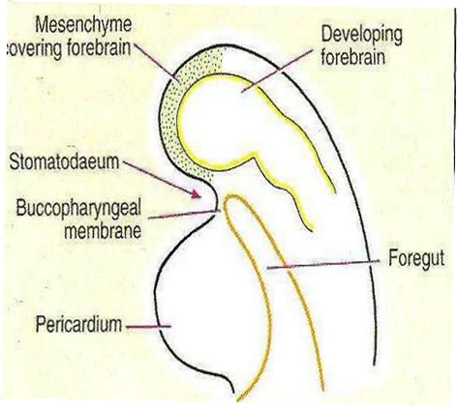
EMBRYONIC DEVELOPMENT
AROUND 4th WEEK OF IU LIFE DEVELOPING BRAIN AND PERICARDIUM FORM FROM TWO PROMINENT BULGES ON VENTRAL ASPECT OF EMBRYO CORRESPONDING TO THE DEVELOPING BRAIN
BELOW THE BULGE A SHALLOW DEPRESSION FORM WHICH CORRESPONDS TO THE PRIMITIVE MOUTH CALLED STOMODEUM.
THE FLOOR OF STOMODEUM IS FORMED BY BUCCOPHARYNGEAL MEMBRANE WHICH SEPARATES THE STOMODEUM FROM FOREGUT

Slide 12
AROUND 4th WEEK OF IU LIFE FIVE BRANCHIAL ARCHES FORM IN THE REGION OF FUTURE HEAD AND NECK, EACH OF THESE ARCES GIVE RISE TO MUSCLES , CONNECTIVE TISSUE,SKELETAL AND NEURAL COMPONENTS OF THE FUTURE FACE.
THE 1st BRANCHIAL ARCH (MANDIBULAR ARCH) PLAYS AN IMPORTANT ROLE IN THE DEVELOPMENT OF NASO MAXILLARY COMPEX.
THE MESODERM COVERING DEVELOPING FOREBRAIN PROLIFERATES DOWNWARD THAT OVERLAPS THE UPPER PART OF STOMODEUM ,THIS DOWNWARD PROJECTION IS CALLED FRONTO NASAL PROCESS.

Slide 13
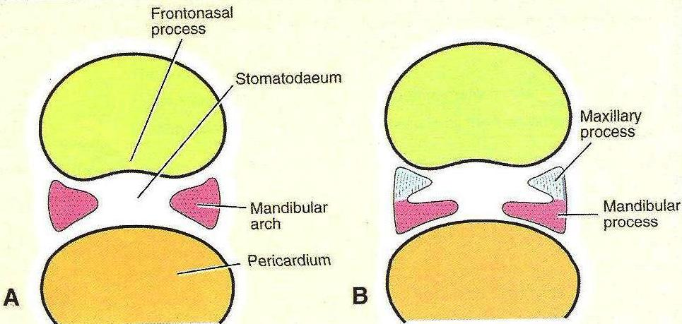
THE STOMODEUM IS THUS OVERLAPPED SUPERIORLY BY FNP AND LATERALY BY MANDIBULAR ARCH.
THE MANDIBULAR ARCH GIVES OFF A BUD FROM ITS DORSAL END CALLED THE “MAXILLARY PROCESS”. THIS GROWS VENTRO- MEDIALY TO THE MANDIBULAR ARCH WHICH IS NOW C/AS MANDIBULAR PROCESS
THE ECTODERM OVERLYING THE FNP SHOWS B/L LOCALIZED THICKENINGS ABOVE THE STOMODEUM. THESE ARE CALLED NASAL PLACODES. THESE NASAL PLACODES SOON SHINK AND FORM NASAL PITS.

Slide 14
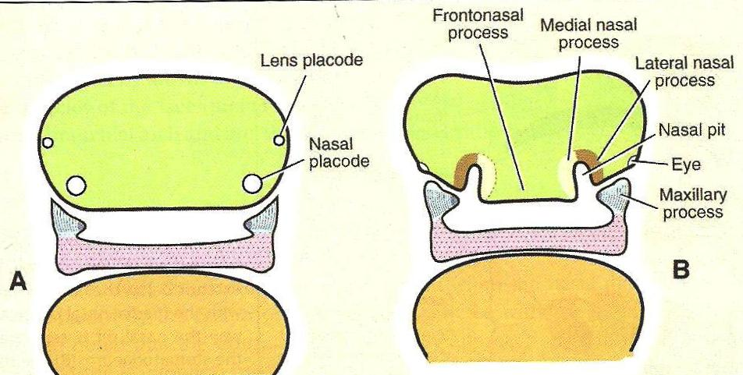
THE FORMATION OF THESE NASAL PITS DIVIDED THE FNP INTO TWO PARTS:
MNP(MEDIAL NASAL PROCESS)
LNP(LATERAL NASAL PROCESS)
THE MEDIAL NASAL PROCESS OF BOTH SIDES TOGETHER WITH FNP GIVE RISE TO MIDDLE PORTION OF NOSE,ANTERIOR PORTION OF MAXILLA AND PRIMARY PALATE.
AS THE MAXILLARY PROCESS BECOME NARROW SO THAT THE TWO NASAL PITS COME CLOSER. THE LINE OF FUSION OF THE MAXILLARY PROCESS AND THE MNP CORRESPONDS TO NASOLACRIMAL DUCT.

Slide 15
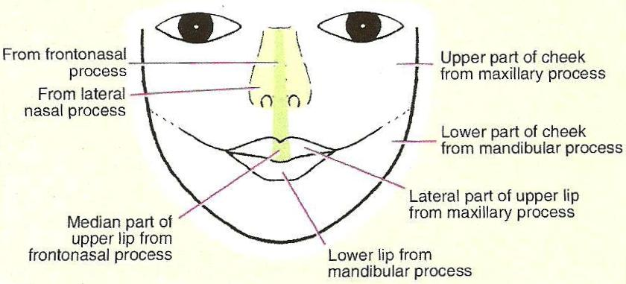
THE TWO MANDIBULAR PROCESSES GROW MEDIALLY AND FUSE TO FORM THE LOWER LIP AND LOWER JAW
AS THE MAXILLARY PROCESS UNDERGOES GROWTH THE FNP BECOMES NARROW SO THAT NASAL PITS COME CLOSER.
THE LINE OF FUSION OF MAXILLARY PROCESS AND MNP CORRESPONDS TO THE NASOLACRIMAL DUCT

Slide 16
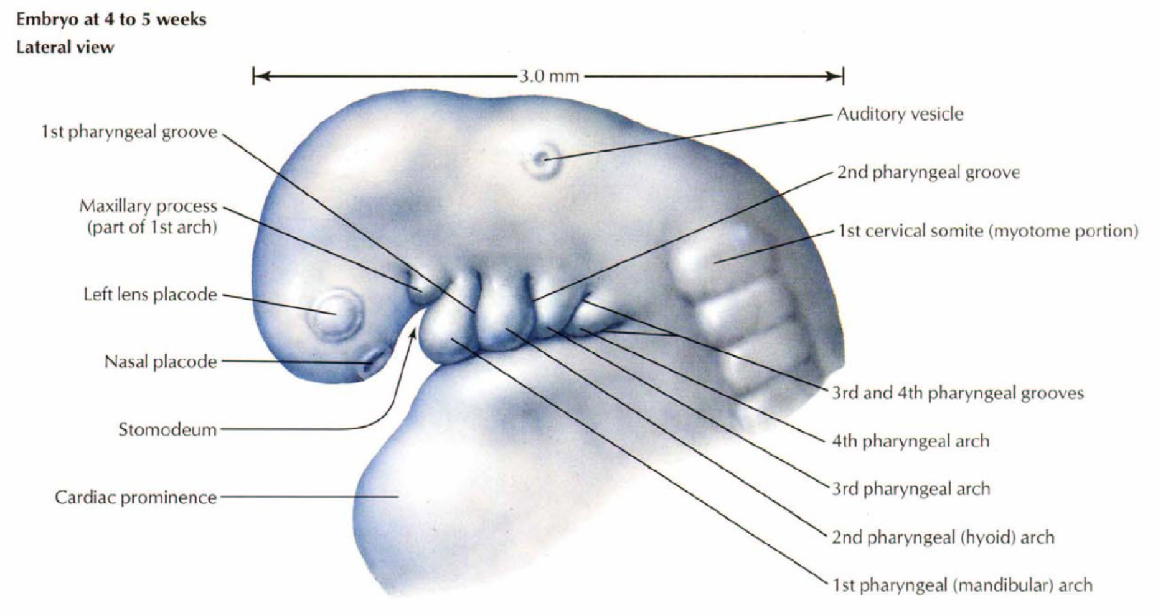
P
PHARYNGEAL ARCHES ARE LAID DOWN ON LATERAL ASPECT OF CRANIAL MOST PART OF FOREGUT WHICH LIES IN CLOSE APPROXIMATION WITH THE STOMODEUM.
INETIALLY ,THERE ARE 6 PHARYNGEAL ARCHES BUT 5tH USUALLY DISAPPEARS AS SOON AS IT FORMED AND SEPARATED BY BRANCHIAL GROOVES.

Slide 17
DERIVATIVES OF FACIAL COMPONENTS
Frontonasal prominence
forms the:
Forehead and the bridge
of the nose
Frontal and nasal bones

Slide 18
DERIVATIVES OF FACIAL COMPONENTS
Maxillary prominences form the:
Upper cheek regions and most of the upper lip
Maxilla, zygomatic bone & secondary palate
Mandibular prominences fuse and form the:
Chin, lower lip, and
lower cheek regions
Mandible
The lateral nasal prominences form the alae of the nose

Slide 19
DEVELOPMENT OF PALATE ( PALATOGENESIS)
PALATOGENESIS BEGINS BETWEEN 6– 12 WEEK
MOST CRITICAL PERIOD -6 TO 9 WEEK
THE MEDIAN NASAL SWELLINGS ENLARGES, GROW MEDIALLY AND MERGE WITH EACH OTHER IN THE MIDLINE TO FORM THE INTERMAXILLARY SEGMENT.

Slide 20
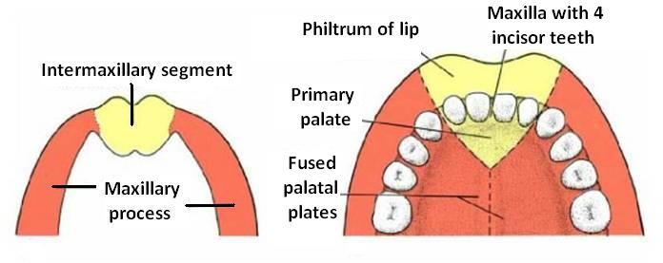
INTERMAXILLARY SEGMENT
INTERMAXILLARY SEGMENT GIVES RISE TO:
PHILTRUM OF LIP
PREMAXILLARY PART OF THE MAXILLA, THAT BEARS THE UPPER INCISORS AND ASSOCIATED GUMS.
PRIMARY PALATE( REGION OF THE HARD PALATE JUST POSTERIOR TO THE UPPER INCISORS)

Slide 21
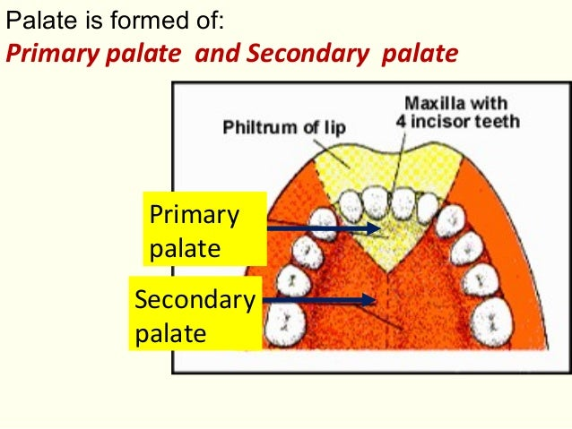
PRIMARY PALATE
BEGINS TO DEVELOP EARLY IN THE 6th WEEK FROM THE DEEP PART OF INTERMAXILLARY SEGMENT, AS MEDIAN PALATINE PROCESS.
LIES BEHIND THE PEMAXILLARY PART OF THE PREMAXILLA.
FUSES WITH THE DEVELOPING SECONDARY PALATE.

Slide 22
SECONDARY PALATE
THE SECONDARY PALATE GIVES RISE TO THE HARD AND SOFT PALATE POSTERIOR TO THE INCISIVE FORAMEN.
THE SECONDARY PALATE ARISES FROM PAIRED LATERAL PALATINE SHELVES OF MAXILLARY PROCESS.
INITIALLY THE SHELVES ARE ORIENTED IN A SUPERIOR-INFERIOR PLANE WITH THE TONGUE INTERPOSED.LATER THE LATERAL PALATINE SHELVES BECOME ELONGATED AND THE TONGUE BECOMES REALTIVELY SMALLER AND MOVE INFERIORLY.
THIS ALLOWS THE SHELVES TO BECOME ORIENTED HORIZONTALLY,TO APPROACH ONE ANOTHER, AND FUSE IN THE MIDLINE.

Slide 23
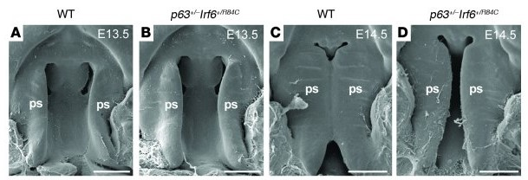
FUSION OF MAXILLA
ENTIRE PALATE DOES NOT CONTACT AND FUSE AT THE SAME TIME.
INITIALLY CONTACT OCCUR IN THE CENTRAL REGION OF THE SECONADRY PALATE POSTERIOR TO THE PREMAXILLA.
FROM THIS POINT, CLOSURE OCCURS BOTH ANTERIORLY AND POSTERIORLY.
THE MESIAL EDGES OF PALATAL PROCESSES FUSE WITH THE FREE LOWER END OF NASAL SEPTUM AND THUS SEPARATES THE TWO NASAL CAVITIES FROM EACH OTHER AND THE ORAL CAVITY.

Slide 24
ANOMALIES RELATED TO FACE, LIP AND PALATE
FACIAL CLEFTS
FAILURE OF EMBRYONIC FACIAL PROMINENCES TO FUSE PROPERLY
MAY BE U/L OR B/L
MAY INVOLVES
LIPS ONLY – CLEFT LIP
PALATE- CLEFT PALATE
BOTH LIP AND PALATE- CLEFT LIP AND PALATE
REGION OF NASOLACRIMAL GROOVE – FACIAL CLEFT

Slide 25
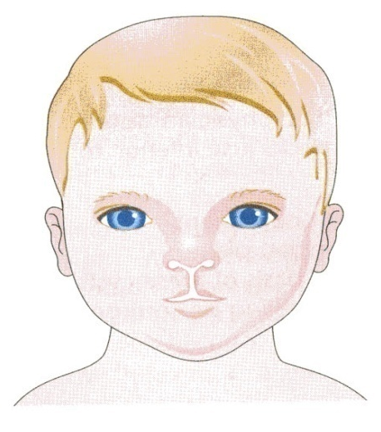
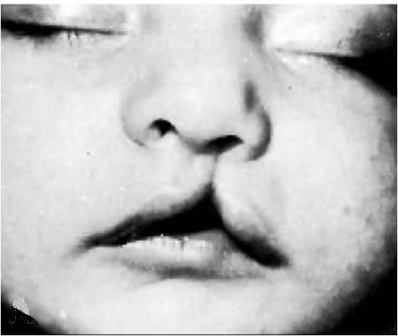
MEDIAN CLEFT LIP
MEDIAN CLEFT LIP RESULT FROM FAILURE OF MEDIAN NASAL PROMINENCES TO MERGE AND FORM INTERMAXILLARY SEGMENT.
UNILATERAL CLEFT LIP RESULTS FROM FAILURE OF THE MAXILLARY PROMINENCE TO MERGE WITH MNP ON THE AFFECTED SIDE.
UNILATERAL CLEFT LIP

Slide 26
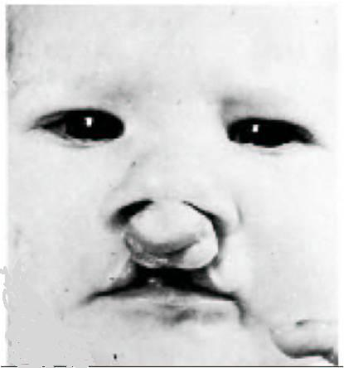
BILATERAL CLEFT LIP
RESULTS DUE TO FAILURE OF MAXILLARY PROMINENCES TO MEET AND UNITE WITH THE MEDIAN NASAL PROMINENCES ON BOTH SIDES.

Slide 27
CLEFT PALATE
CLEFT PALATE IS RESULT OF FAILURE OF THE LATERAL PALATINE SHELVES TO FUSE WITH EACH OTHER , WITH THE NASAL SEPTUM , OR WITH THE PRIMARY PALATE.
CLEFT LIP AND PALATE ARE DISTINCT AND SEPARATE CONGENITAL ABNORMALITIES, BUT OFTEN OCCUR CONCOMITANTLY.

Slide 28
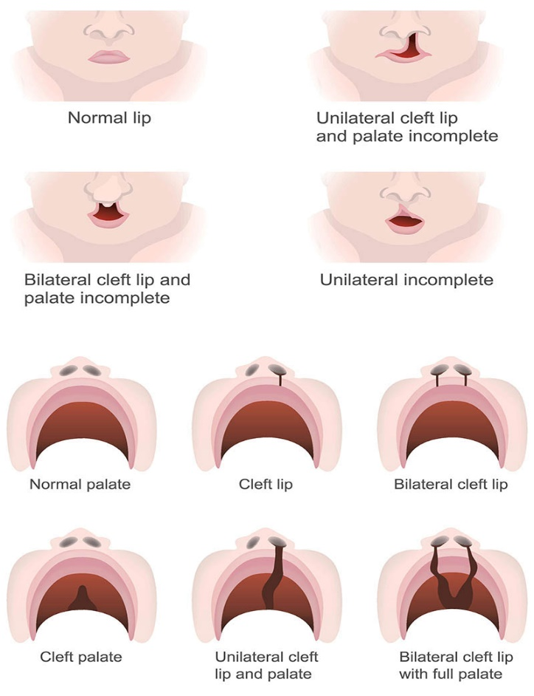
CLEFT PALATE
CP IS A CONDITION IN WHICH THE TWO PALATAL SHELVES ARE NOT COMPLETELY JOINED.
PROBLEM ASSOCIATED WITH CLCP-
EATING PROBLEM
EAR INFECTION
SPEECH PROBLEMS
DENTAL PROBLEM

Slide 29
OBLIQUE FACIAL CLEFT
RESULT FROM FAILURE OF THE MAXILLARY PROMINENCE TO FUSE WITH THE LATERAL NASAL PROMINENCE.
DEVELOPMENTAL ANOMALIES OF FACE

Slide 30
POST NATAL GROWTH OF MAXILLA
AT BIRTH, THE TRANSVERSE AND ANTEROPOSTERIOR DIMENSION ARE EACH MORE THAN THE VERTICAL DIAMETER.
GROWTH OF MAXILLA IS PURELY INTRAMEMBRANOUS OSSIFICATION THERE IS NO CARTILAGE REPLACEMENT.
THE GROWTH OF NASOMAXILLARY COMPLEX PRODUCED BY FOLLOWING MECHANISMS:
DISPLACEMENT
GROWTH AT SUTURES
SURFACE REMODELLING

Slide 31
DISPLACEMENT
MAXILLA IS ATTACHED TO THE CRANIAL BASE BY MEANS OF A NUMBER OF SUTURES.
THUS THE GROWTH OF CRANIAL BASE HAS A DIRECT BEARING ON NASO-MAXILLARY GROWTH.
DISPLACEMENT IS FURTHER DIVIDED INTO TWO TYPES- PRIMARY AND SECONDARY.

Slide 32
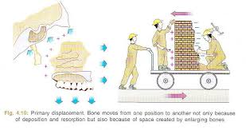
PRIMARY DISPLACEMENT
PRIMARY DISPLACEMENT IS SEEN WHEN MAXILLA GROWS ON ITS OWN, IT WILL BE IN FORWARD DIRECTION.
APPOSITION IN MAXILLARY TUBEROSITY REGION OCCURS TO LENGTHEN THE MAXILLA. THUS THERE IS BACKWARD GROWTH OF MAXILLA ORIGINALLY AT TUBEROSITY REGION. THIS BACKWARD THRUST RESULTS IN FORWARD DISPLACEMENT OF MAXILLA.
ENLARGEMENT OF BONE DUE TO SINUS FORMATION WITHIN THE BONE ALSO DISPLACES THE MAXILLA FORWARDS.

Slide 33
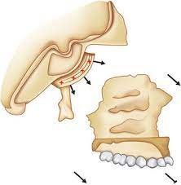
SECONDARY DISPLACEMENT
OCCURS DUE TO GROWTH OF MIDDLE CRANIAL FOSSA.
IN THIS , THE GROWTH OF ADJACENT STRUCTURE INFLUENCES THE MAXILLARY GROWTH. MIDDLE CRANIAL FOSSA GROWS UP AND FORWARDS AND PASSIVE DISPLACEMENT OF NASO-MAXILLARY COMPLEX OCCURS IN DOWN AND FORWARD DIRECTION.
AN IMPORTANT GROWTH MECHANISM DURING EARLY YEARS OF LIFE(2-6 YR).

Slide 34
REMODELING
REMODELING IS THE DIFFERENTIAL GROWTH ACTIVITY INVOLVING SIMULTANEOUS DEPOSITION AND RESORPTION ON ALL THE INNER AND OUTER SURFACE OF THE BONE.

Slide 35
SURFACE REMODELING
MASSIVE SURFACE REMODELING BY BONE DEPOSITION AND RESORPTION BRINGS ABOUT, INCREASE IN SIZE, CHANGE IN SHAPE OF THE BONE AND FUNCTIONAL RELATIONSHIP.
RESORPTION OCCURS ON THE LATERAL SURFACE OF THE ORBITAL RIM LEADING TO LATERAL MOVEMENT OF THE EYEBALL, TO COMPENSATE THIS RESORPTION ,THERE IS BONE DEPOSITION ON THE EXTERNAL SURFACE OF THE LATERAL RIM.

Slide 36
SURFACE REMODELING
DURING FETAL PERIOD , THE EXTERIOR SURFACE OF THE ENTIRE MAXILLA , INCLUDING IT’S ANTERIOR PART, REMAIN DEPOSITORY TO PROVIDE FOR INCREASING ARCH LENGTH IN CONJUCTION WITH THE DEVELOPMENT OF THE TOOTH BUDS AND THEIR SUBSEQUENT ENLARGEMENT.
RESORPTION OCCURS ON THE ALVEOLAR LINING SURFACE SURROUNDING EACH OF TOOTH BUDS.
MAXILLARY ARCH THUS LENGTHENS HORIZONALLY IN POSTERIOR AND ANTERIOR DIRECTION.
IN POST NATAL FACE ANTERIOR (LABIAL) SURFACE OF MAXILLARY ARCH BECOME RESORPTIVE TO PRODUCE DOWNWARD GROWTH MOVEMENT OF THE MAXILLARY ARCH AND PALATE.

Slide 37
SURFACE REMODELING
BONE RESORPTION ON THE LATERAL WALL OF THE NOSE LEADS TO AN INCREASE IN THE SIZE OF THE NASAL CAVITY.
POSTERIOR AND INFRAORBITAL SURFACES OF MAXILLA PROPER ARE DEPOSITORY – IN PRENATAL AND POST NATAL LIFE.
DEPOSITION ON THE MAXILLARY TUBEROSITY PROGRESSIVELY INCREASE THE MAXILLA IN HORIZONTAL DIRECTION .
THE EXTERNAL SURFACE OF THE FRONTAL PROCESS OF MAXILLA IS DEPOSITORY – IN PRENATL AND POST NATAL LIFE.

Slide 38
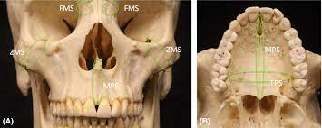
GROWTH AT SUTURES
THE MAXILLA IS CONNECTED TO THE CRANIUM AND CRANIAL BASE BY A NUMBER OF SUTURES WHICH INCLUDE;
THE NASO-MAXILLARY SUTURE
THE FRONTO-MAXILLARY SUTURE
THE ZYGOMATICO-TEMPORAL SUTURE
THE ZYGOMATICO-MAXILLARY SUTURE
THE PTERYGO-PALATINE SUTURE

Slide 39
GROWTH AT SUTURES
THESE SUTURES ARE ALL OBLIQUE AND MORE OR LESS PARALLEL TO EACH OTHER WHICH ALLOW THE DOWNWARD AND FORWARD REPOSITION OF THE MAXILLA AS THE GROWTH OCCURS AT THESE SUTURES.
THIS LEAD TO OPENING UP OF SPACE AT THE SUTURAL ATTACHMENT.
NEW BONE IS FORMED ON EITHER SIDE OF THE SUTURE, HENCE A TENSION RELATED BONE FORMATION OCCURS AT THE SUTURES.

Slide 40
Maxillary growth
THE AMOUNT AND DIRECTION OF THE MAXILLARY GROWTH CAN BE DISCUSSED UNDER FOLLOWING HEADING-
MAXILLARY HEIGHT
MAXILLARY WIDTH
MAXILLARY LENGTH

Slide 41
MAXILLARY HEIGHT
RESORPTION ON THE NASAL FLOOR AND SIMULTANEOUS APPOSITION ON THE PALATAL SHELVES OF THE MAXILLARY BONE.
NASAL CARTILAGE IS THE PRIMARY CARTILAGE,IT HAS GENETIC DETERMINED GROWTH. GROWTH OF NASAL CARTILAGE PUSHES THE MAXILLA DOWNWARD.
MAXIMUM AMOUNT OF VERTICAL GROWTH TAKES PLACE BETWEEN AGE OF 5 TO 15 YRS. GROWTH OF THE ALVEOLAR PROCESS IN DOWNWARD DIRECTION- ERUPTIVE MECHANISM OF TEETH CONTRIBUTES MAINLY FOR IT.

Slide 42
MAXILLARY WIDTH
GROWTH IN THE MEDIAN SUTURE.
GROWTH INCREASE AT THE MEDIAN SUTURE WILL BE MAXIMUM AT THE TIME OF PUBERTY.
SURFACE APPOSITION(DEPOSITION) ON THE ZYGOMATIC PROCESS WILL CONTRIBUTE TO THE INCREASE IN MAXILLARY WIDTH.

Slide 43
MAXILLARY LENGTH
THE LENGTH IS INCREASED BY APPOSITION IN THE MAXILLARY TUBEROSITY AND ALSO ACCELERATED BY THE SUTURAL GROWTH IN THE PTERYGOPALATINE SUTURES.

Slide 44
Thanks

