Slide 1
Theories of Growth and Development

Slide 2
CONTENTS:
Introduction
Bone Remodelling Theory
Genetic Theory
Sutural Theory
Cartilaginous Theory/Nasal septal Theory
Enlow’s growth equilibrium Theory
Van Limborgh’s multifactorial Theory
Servosystem/cybernetic theory/alexandre petrovic
Functional matrix hypothesis

Slide 3
INTRODUCTION
It is true that growth is strongly influenced by genetic factor as well as by the environment in the form of nutritional status, degree of physical activity, health and illness and a no of similar factors.
Because a major part of the need for orthodontic treatment is created by disproportionate growth of the jaw, in order to understand the etiological process of malocclusion and dentofacial deformity, it is necessary to learn how facial growth is influenced and controlled.
Exactly what determines the growth of the jaw, however ,remains unclear and continues to be the subject of intensive research.

Slide 4
BONE REMODELLING THEORY BY BRASH(1930)
This theory states that bone grows only by interstitial growth .the principal tenets of this theory are:
Bone grows only by apposition at the surface.
Growth of jaws takes place by deposition of bone at the posterior surfaces of the maxilla and mandible this is described as Hunterian growth.
Calvarial growth occurs via deposition of bone on the ectocranial surface of the cranial vault and resorption of bone endocranially.
Bone remodelling theory postulated that the craniofacial skeletal growth takes place by bone remodelling – Selective deposition and resorption of bones at its sutures.

Slide 5
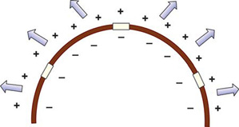
Diagrammatic representation of the remodelling theory of craniofacial growth using cranial vault as a model

Slide 6
THE GENETIC THEORY(1941)-BRODIE
The genetic theory simply stated that genes determine and control the whole process of craniofacial growth.
This theory proposed that the skull growth was controlled by genetic factors and was pre-planned.
Genes determine overall growth control and the persistent pattern of facial configuration is under tight genetic control.

Slide 7
CON TRADICTION: If the face were under rigid genetic control,it would be possible to predict features of children from cephalograms of parents.
LIMITATIONS: Unable to explain the role of environment & epigenetic factors.
Primary genetic control can determine only certain features but it doesnot have complete influence on growth.

Slide 8
SICHERS HYPOTHESIS (SUTURAL DOMINANCE)-1947
Sicher deducted from the many studies using vital dyes that the sutures were causing most of the growth.
He said that the primary events in sutural growth is the proliferation of the connective tissue between the two bones.
If the sutural connective tissue proliferates it creates the space for appositional growth at the borders of the two bones” replacement of the proliferating connective tissue was necessary for functional maintenance of the bones.

Slide 9
He felt that the connective tissue in sutures of both the nasomaxillary complex and vault produced forces which seperates the bones,just as the synchondroses expanded the cranial base and the epiphyseal plates lengthened long bones.
He treated mandible differently like a bent long bone which grew at both the ends.
He proposed that the mandible grew both by interstitial growth(like long bones) and by apposition growth (at its periosteal covering).
Growth of the mid face via sutural expansion of the circummaxillary sutures ,which forces the midface downward and forward.

Slide 10
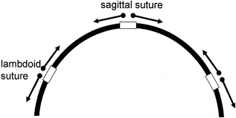
Increase in the size of the cranial vault takes place via primary growth of bone at the sutures,forces the bones of the vault away from each other
Growth of the mid face takes place via intrinsically determined sutural expansion of the circummaxillary sutures system,which forces the mid face downward and forward
Mandibular growth takes place via intrinsically determined growth of the cartilage of the mandibular condyle,which pushes the mandible downward and forward
SCHEMATIC REPRESENTATION OF THE SUTURAL THEORY OF CRANIOFACIAL GROWTH USING THE CRANIAL VAULT AS A MODEL

Slide 11
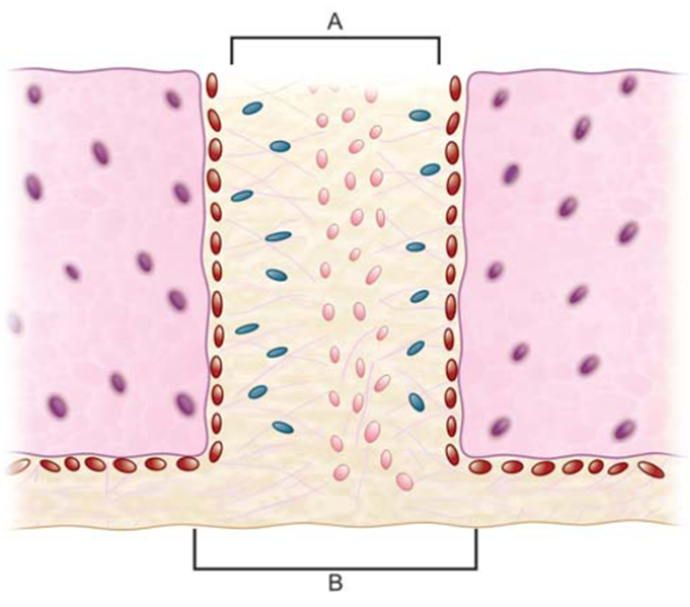
KOSKI (1968) stated there are two different views regarding the structures of sutures
The first school of thought (Sicher and Weinnman) considers sutures as a three layered structure,A connective tissue between the two bones
The second school of thought (Pritchard, Scott and Girgis, 1956) sees the suture as a five layer structure,Each bones at the sutures having its own two layer of periosteum on both sides and the intervening fifth layer between these periosteal layers
A schematic illustration of the two different views on the structure of the suture. ‘A’ represents the three-layer concept; ‘B’ the five-layer concept

Slide 12
EVIDENCES AGAINST SUTURAL THEORY
Trabecular pattern in the bones at the sutures changes with age ,indicating the changes in the direction of growth.it cannot be accepted that sutures will have the necessary information for altering growth.
Growth does not continue after transplantation of an area of suture to another location . This shows lack of innate potential of sutures.
Sutures is a tension adapted tissue and any unusual pressure on suture initiates bone resorption rather than bone deposition.
Subcutaneous autotransplantation of the zygomaticomaxillary sutures in the guinea pigs has not been found to grow(Watanabe M Laskin).

Slide 13
CONCLUSION
Present evidences indicates sutures as adaptive growth sites rather than growth centres.
Hence growth in sutural area is secondary to functional needs.
Sutural tissue have no tissue separating forces and they are not comparable to growth centres.

Slide 14
SCOTTS HYPOTHESIS(NASAL SEPTUM),1947 CARTILAGE AS A DETERMINANT OF CRANIOFACIAL GROWTH
According to the nasal septum theory ,sutures play little or no role in the growth of the craniofacial skeleton,sutures are considered as merely passive ,secondary and compensatory sites of bone formation and growth.
After recognizing the importance of the cartilaginous part of the head,nasalcapsule,mandible and cranial base in prenatal growth,scott felt that this carilagenous development was under tight genetic control and was of the opinion that they continued to dominate postnatal facial growth.
Scott concluded that nasal septum is mostly active and vital for craniofacial growth both prenatally and postnatally.

Slide 15
Latham elaborated on Scott's ideas about the nasal septum and maxillary growth, emphasizing the role of the septo-premaxillary ligament beginning from the prenatal period till 3 or 4 years of life.
He felt the maxillary sutures began as sliding joints adapting to initiating growth forces elsewhere,
but later manifest increasing osteogenesis, contributing to the main displacing force at the free surfaces. Thus, he combines ideas of Scott, Sicher, and Moss.

Slide 16
He described a ligament extending from the nasal septal cartilage to the anterior premaxillary region, which he termed the septopremaxillary ligament.
He proposed that this distinct connection is an important relationship, particularly before birth, between midfacial and nasal septal growth. This theory is called the nasal septum theory of craniofacial growth

Slide 17
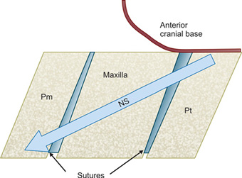
Growth of the nasal septum cartilage pushes the midface downward and forward relative to the anterior cranial base ,this result in a separation of the mid facial suture system,which then fills in via secondary,compensatory sutural bone growth.
Schematic representation of the nasal septum theory of craniofacial growth

Slide 18
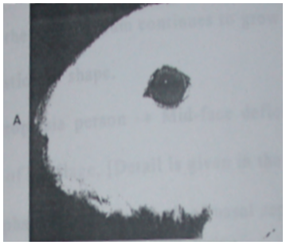
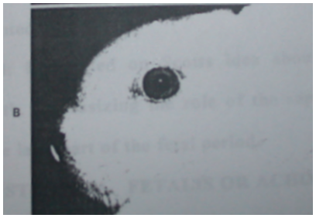
Experiment by Burdi , Petrovic , Baume, Latham (1965,1967-1968,1968,1972) respectively
EXPERIMENT on rabbit snout concluded that deformity of snout after resection of nasal septum was the result of lack of growth

Slide 19
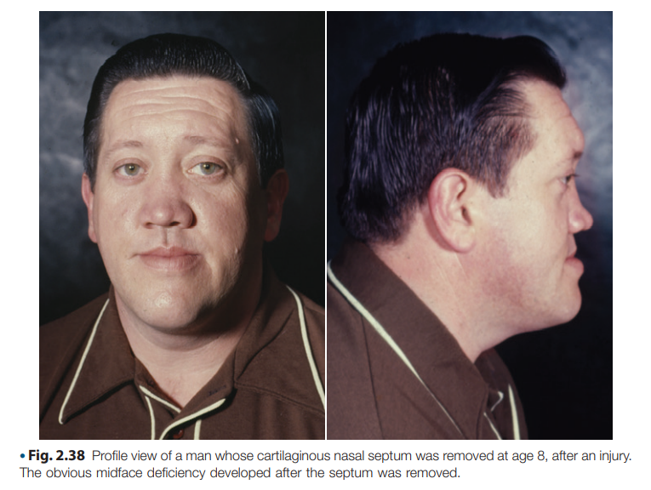

Slide 20
EVIDENCES SUPPORTING THEORY
Experimental studies on rats and rabbits showed retarded mid face development when nasal septal cartilage was extripated.
Many bones grow by cartilaginous growth in which a precursor cartilage is replaced by bone
Steinler,kvinslaw compared the increase in size of autotransplanted nasal septum in subcutaneous abdominal wall in rats,all the autotransplanted nasal septum showed increase in height and length and they retained the shape ,this suggests that nasal septum has intrinsic growth potential.

Slide 21
EVIDENCES AGAINST THE THEORY
MOSS and BLOONBERG (1968) BRIGIT THILANDER(1970) found only slight deformity after extirpation of septal cartilage .
They also concluded that septal cartilage provides only mechanical support for the nasal bones and is not a primary growth center.
Studies showed that there are excellent chances that condylar process would regenerate to approx. its original size after trauma.
Moss stated that malformation in snout following excision of nasal septum is due to trauma following surgery.

Slide 22
CONCLUSION
At present ,nasal septum theory is still accepted as a reasonable explanation for craniofacial growth.
Nasal septum may be important for anteroposterior growth of face because of endochondral growth process occurring at its posterior border.
It is not regarded as an active contributor to vertical growth and development of face.

Slide 23
VAN LIMBORGH’S COMPROMISE THEORY
Van Limborgh put forward a multifactorial theory in 1970.
According to Van Limborgh the 3 popular theories of growth were not satisfactory, yet each contains elements of significance that cannot be denied.
He listed the essential elements of 3 hypothesis and put forward the multi-factorial theory

Slide 25
Van Limborgh proposed 5 distinct types of controlling factors of growth:
Intrinsic Genetic Factors: are inherent within the skull tissue.
Local Epigenetic Factors: are genetically determined influences originating from adjacent structures such as brain, eyes etc.

Slide 26
General Epigenetic Factors: genetic factors determining growth from distant structures. E.g.: Sex hormones, growth hormone, etc.
Local Environmental Factors: are non-genetic factors from local external environment. E.g.: Habits, muscle force, etc
General Environmental Factors: general non-genetic influences from external environment such as oxygen, nutrition etc.

Slide 27
EXPANDING ‘V’ PRINCIPLE- ENLOW
The ‘v’ principle is an important facial skeletal growth mechanism since many facial and cranial bones have ‘v’ configurations or shaped regions.
With remodeling process ‘v’ moves away from the tip and enlarges simultaneously leading to its growth and movement.
This increase in size and simultaneous movement is called EXPANDING ‘V’ PRINCIPLE

Slide 28
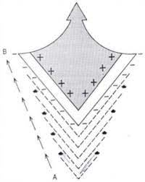
Bone deposition occurs on the inner side of the v and resorption occurs on the outer surface of v,bone moves in the direction towards the wider end of v

Slide 29
Simultaneously deposition takes place at the ends of the two arms of the V ,resulting in its widening
These growth shifts and changes involve corresponding and sequential remodelling adjusments to maintain the same shape of that particular bone e.g ,base of the mandibular body, coronoid ,condylar process ,palate, follows the growth of V principle.

Slide 30
FUNCTIONAL MATRIX THEORY-MELVIN MOSS
INTRODUCTION
If neither bone nor cartilage was the determinant for growth of the craniofacial skeleton , it would appear that the control would have to lie in the adjacent soft tissues .
Melvin Moss and his co-workers in 1960s developed the form and function concept into the "functional matrix hypothesis".

Slide 31
Definition
The functional matrix hypothesis claims that the origin, form, position, growth and maintenance of all skeletal tissues and organs are always secondary, compensatory and necessary responses to chronologically and morphologically prior events or processes that occur in specifically related non- skeletal tissues, organs or functioning spaces

Slide 32
MOSS said that head and neck region consist of number of functions which are relatively independent
1.Digestion
2.Respiration
3.Speech
4.Olfaction
5.Balance
6.Vision
Each function is carried out by a group of soft tissues which are supported and/or protected by related skeletal elements. Soft tissues and skeletal element related to a single function are termed FUNCTIONAL CRANIAL COMPONENT

Slide 33
Functional Component
SKELETAL UNIT
MICRO MACRO
FUNCTIONAL MATRIX
PERIOSTEAL
CAPSULAR

Slide 34
Functional Matrix
Refers to all the soft tissues and spaces that perform a given function
Two types of functional matrics :
Periosteal matrix: - corresponds to immediate local environment typically muscles, blood vessels and nerves.
All periosteal matrices act homogenously by means of osseous deposition and resorption.
muscles are attached either into the skeletal tissue or indirectly by fusion with the outer fibrous layer of the periosteum.

Slide 35
Functioning muscles influence developmental changes in the form of skeletal tissues to which they are attached. This is achieved through muscle–bone interface.
Sim and Kelly suggested that osseous blood flow modifies to osseous metabolism changes priorly. They further observed that resorption site had increased blood flow and depositary areas are poorly vascularized.
The periosteal matrices stimulation causes growth of the microskeletal units. They act to alter the size, shape of both of the bones. The growth process that occurs due to periosteal matrix stimulation is called ‘transformation’

Slide 36
Explanation
Coronoid process and Temporalis muscle
Coronoid process does not grow itself first and thus provide a platform upon which the temporalis muscle can alter its function.
Experimental removal of the mammalian temporalis muscle, or its denervation, invariably results in an actual decrease in size and shape of coronoid process.

Slide 37
Capsular matrix :- defined as the organs and spaces that occupy the broader anatomical complex.
Includes organ such as brain and globes of the eyes, as well as actual spaces such as oropharynx and nasopharynx
Each capsule is an envelope which contains a series of functional cranial component, skeletal units and their related functional matrices and is sandwiched between two covering layers.

Slide 38
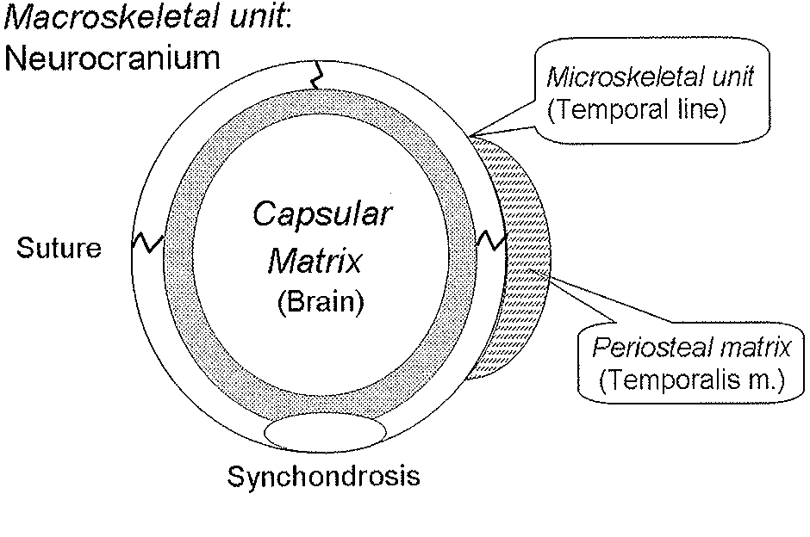
Primary growth of the capsular matrix(brain) results in a stimulus for secondary growth of the sutures and synchondroses, leading to overall enlargement of the neurocranium (macroskeletal unit)

Slide 39
Orofacial capsule : the skin and mucosa form this limiting layer.
Each capsule surrounds and protects a capsular functional matrix.
The human oronasopharyngeal space increases in size from the third month of pregnancy. This volumetric increase produces a compensatory increase in the size of the orofacial capsule
As the capsule enlarges, both the periosteal matrices along with the respective skeletal units are passively and secondarily translated to a new position in space

Slide 40
capsular matrices indirectly act upon macroskeletal units or on entire functional cranial component.
They do not alter the size or shape of the skeletal units; instead they change their location in space. This type of growth process is called "translation"

Slide 41
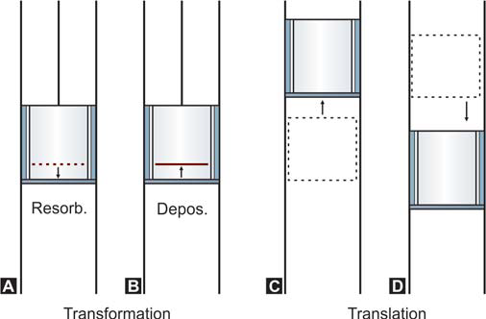
Diagrammatic representation of transformation
(A, B) and translation (C, D). Note in transformation
there is change in size or shape whereas in translation there
is change in position

Slide 42
Neurocranial capsule : consists of skin and duramater
it is the volume of the total neural mass which is morphogenetically significant.
capsule surrounds and protects a neuro cranial functional matrix.
As the capsule enlarges, the whole of the included and enclosed functional components, i.e the periosteal matrices and the microskeletal units are carried outward in a totally passive manner.

Slide 43
SKELETAL UNIT
Refers to all bony structure that support the functional matrix.
There are two types of skeletal units:
1. Microskeletal,
2. Macroskeletal units.

Slide 44
Microskeletal unit :- when bone comprised of several contiguous skeletal units .
Functional variations in the periosteal matrices may be expressed within the microskeletal unit
The possible interaction between periosteal matrix and microskeletal unit includes—temporalis-coronoid process, masseter, medial pterygoid-gonial angle, teeth-alveolar bone
The change in size and shape of microkeletal units occurs independently of the changes in spatial position. Moss uses two terms for this: ‘transformation’ or ‘intraosseous growth”

Slide 45
Macroskeletal unit :Macroskeletal units are made of the core of maxilla , mandible and neurocranium
The capsular matrix expansion causes the macroskeletal unit to passively change the position. This process is called translational growth.
The overall skeletal growth is a combination of changes in microskeletal and macroskeletal units due to stimulation of periosteal and capsular matrices respectively. This total growth change is termed "interosseous growth

Slide 46
SERVOSYSTEM THEORY- PETROVIC
The last major theory of craniofacial growth to emerge, the servosystem theory, was developed by Alexandre Petrovic.
Petrovic’s research came to focus on the nature of cartilage growth in the craniofacial complex, and especially of the growth of the secondary cartilage of the mandibular condyle.

Slide 47
Petrovic and colleagues demonstrated that the growth of the mandibular condyle is highly adaptive and responsive to both extrinsic systemic factors and local biomechanical and functional factors.
He and his colleagues also demonstrated that the growth of the primary cartilages of the craniofacial complex, such as the cranial base and nasal septum, was influenced significantly less by local epigenetic factors.

Slide 48
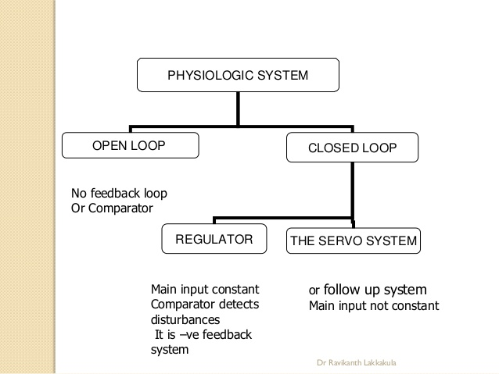

Slide 49
Servosystem theory is based on CYBERNETIC CONCEPT.
Weiner defines cybernetics as the science of control and communication in the animal and machine.
Cybernetic concept states that everything affects everything and living organisms never operate in open loop mechanism.
In open loop mechanism the input/stimulus leads to a response and there in no feedback or regulation.
If a physiologic system is designed to maintain a specific correspondance between inputs and outputs inspite of disturbances is called closed loop system.

Slide 50
Closed loop system is of two types:
Regular system: in which main input is constant.
Servosystem/ follow up system: in which main input varies.
The servosystem theory is characterized by the following two principal factors:
(1) The hormonally regulated growth of the midface and anterior cranial base, which provides a constantly changing reference input via the occlusion.
(2) The rate-limiting effect of this midfacial growth on the growth of the mandible.

Slide 51
Growth of the mandibular condyle and of the sutures may be affected directly and indirectly by systemic hormones.
Growth of these structures is clearly more compensatory and adaptive to the action of extrinsic factors, including local function as well as the growth of other areas of the craniofacial complex.
Petrovic says that condylar growth can be modified therapeutically or in response to functional requirements.

Slide 52
The major strength of the servo system theory is that it provides a road map for future research and experimentation.
It is difficult to explain the growth of most parts of body with servosysytem theory.
It is more useful as a research tool.

Slide 53
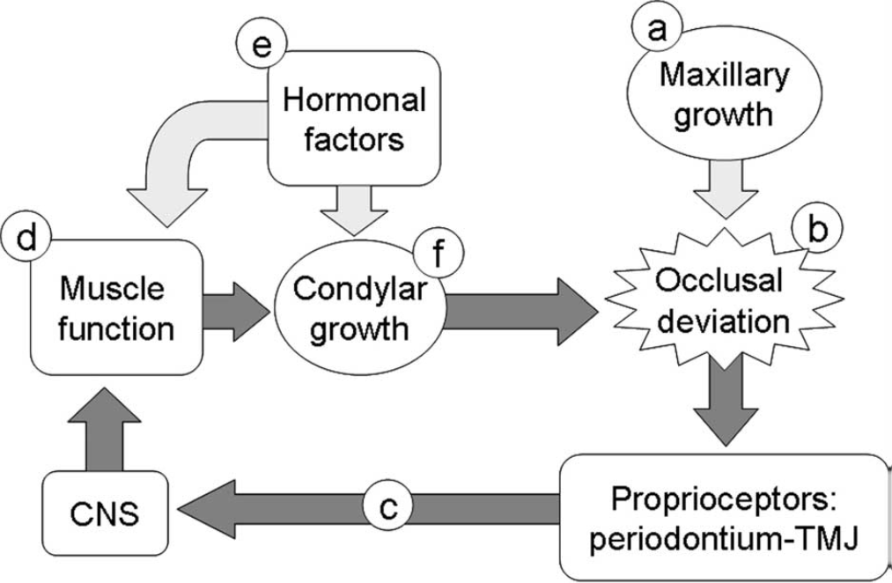
Anterior growth of the midface (a)results in a slight occlusal deviation between the maxillary and mandibular dentitions (b).Perception of this occlusal deviation by proprioceptors (c) triggers the protruder muscles of the mandible to become more active tonically (d) in order to reposition the mandible anteriorly. The muscle activity and the protrusion in the presence of appropriate hormonal factors (e) stimulate growth at the mandibular condyle (f

Slide 54
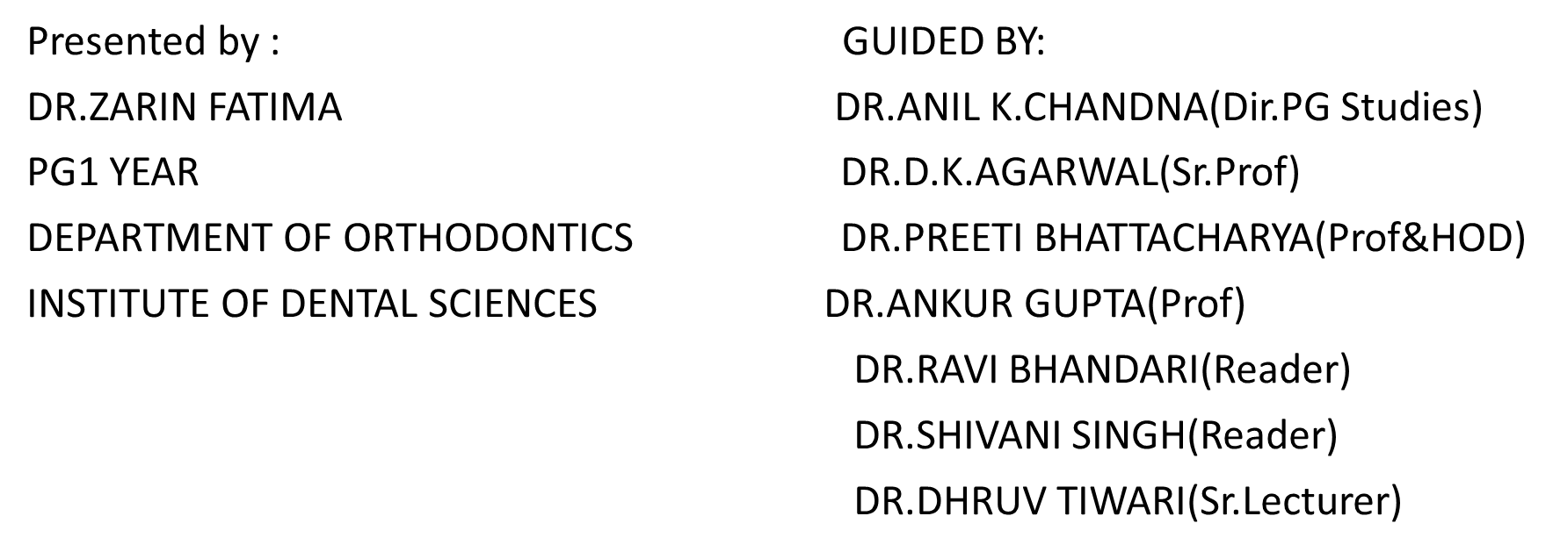
THE FUNCTIONAL MATRIX HYPOTHESIS REVISITED

Slide 55
NEED FOR REVISITED
FMH could not describe either how extrinsic, epigenetic Functional Matrix stimuli are transduced into regulatory signals by individual bone cells, or how individual cells communicate to produce coordinated multicellular responses.
Almost uniformly, experimental and theoretical studies of bone adaptation consider only the unicellular, unimolecular, or unigenomic levels.
Accordingly, their results and derivative hypotheses generally are not extensible to higher multicellular, tissue, levels.

Slide 56
CONSTRAINTS OF THE FMH
Initially, the FMH provided only qualitative narrative descriptions of the biologic dynamics of cephalic growth at the gross anatomic level and it had two explanatory constraints.
Methodologic constraint.
Hierarchial constraint

Slide 57
METHODOLOGIC CONSTRAINT
Macroscopic measurements, e.g., roentgenographic cephalometry was used.
It permitted only method-specific descriptions that cannot be structurally detailed.
This constrained was removed by technique of FINITE ELEMENT METHOD.

Slide 58
HIERARCHIAL CONSTRAINT
Even this version's descriptions did not extend "downward" to processes at the cellular, subcellular, or molecular structural domains.
Nor extend "upwards" to the multicellular processes by which bone tissues respond to lower level signals.
All prior FMH versions were "suspended" or "sandwiched" as it were, between these two hierarchical levels.
The FMH could not describe either how extrinsic, epigenetic FM stimuli are transduced into regulatory signals by individual bone cells, or how individual cells communicate to produce coordinated multicellular responses.

Slide 59
At present, no hypothesis provides a comprehensive, coherent and integrated description of all the processes and mechanisms involved in bone growth, remodeling, adaptation, and maintenance at all structural levels.
The newest FMH version, presented herein, transcends some hierarchical constraints and permits seamless descriptions at, and between, the several levels of bone structure and operation from the genomic to the organ level.

Slide 60
It does so by the inclusion of two complementary concepts:
Mechanotransduction that occurs in single bone cells
Bone cells are computational elements that function multicellularly as a connected cellular network

Slide 61
MECHANOTRANSDUCTION
All vital cells are "irritable" and respond to alterations in their external environment.
Mechanosensing processes enable a cell to sense and to respond to extrinsic loadings, by using the processes of mechanoreception and of mechanotransduction.
The former transmits an extracellular physical stimulus into a receptor cell
The latter transduces or transforms the stimulus's energetic and/or informational content into an intracellular signal

Slide 62
Mechanotransduction is one type of cellular signal transduction.
There are several mechanotransductive processes, eg.
Mechanoelectrical
Mechanochemical
Whichever are used, bone adaptation requires the subsequent intercellular transmission of the transduced signals

Slide 63
OSSEOUS MECHANOTRANSDUCTION
Loadings are continuously applied to bone tissues, tending to deform both extracellular matrix and bone cells.
When an appropriate stimulus parameter exceeds threshold values, the loaded tissue responds by the triad of bone cell adaptation processes.
Osseous mechanotransduction is unique in 4ways:
Most other mechanosensory cell are cytologically specialized,but bone cells are not.
Bone loading stimulus can evoke three adaptational responses,whereas nonosseous processes generally evoke one.
Osseous signal transmission is aneural ,whereas all other mechanosensational signals use some afferent neural pathway.
Evoked bone adaptational responses are confined with in each bone organ.

Slide 64
Osseous mechanotransduction translates the periosteal functional stimulus in to askeletal unit cell signal by two skeletal cellular mechanotrannsductive process:
IONIC
MECHANICAL

Slide 65
IONIC OR ELECTICAL PROCESSES
Ionic transport through the bone cell plasma membrane.
Intercellular transmission of the ionic or electrical signal that in ,turn computed by the operation of an osseous connected cellular network(CCN)
Network output regulates the multicellular bone cell responses.

Slide 66
STRETCH- ACTIVATED CHANNELS
Several types of deformation may occur in strained bone tissue.
One of these involves the plasma membrane stretch-activated (S-A) ion channels, a structure found in bone cells, in many other cell types, and significantly in fibroblasts.
When activated in strained osteocytes, they permit passage of a certain sized ion or set of ions, including K +, Ca 2+, Na +
Such ionic flow may, in turn, initiate intracellular electrical events.

Slide 67
ELECTRICAL PROCESSES
These include several, nonexclusive mechanotransductive processes, involving the plasma membrane and extracellular fluids.
ELECTROMECHANICAL
ELECTROKINETIC
ELECTRIC FIELD STRENGTH

Slide 68
ELECTROMECHANICAL
The osteocytic plasma membrane contains voltage-activated ion channels.
Transmembrane ion flow may be a significant osseous mechanotransductive process.
Such ionic flows generate osteocytic action potentials capable of transmission through gap junctions.

Slide 69
ELECTROKINETICS
Bound and unbound electric charges exist in bone tissue associated with the bone fluid(s) in the several osseous spaces or compartments.
These electrical effects are not piezoelectric but rather of electrokinetic (streaming potential) origin.
The SP is a measure of the strain-generated potiential (SGP) of convected electric charges in the fluid flow of deformed bone.
SGP of ±2mV can initiate both osteogenesis & osteocytic action potentials.

Slide 70
ELECTRIC FIELD STRNGTH
Bone respond to exogenous electric fields.
A significant parallel exists between the parameters of these exogenous electrical fields and the endogenous fields produced by muscle activity.
Bone responds to exogenous electric fields in the range of 1 to 10 µV/cm.

Slide 71
MECHANICAL PROCESSES
It is an alternative mean by which the periosteal Functional Matrix activity may regulate hierarchically low level bone cell genomic functions
The mechanical properties of the extracellular matrix influence cell behaviour.
Loaded mineralized bone matrix tissue is deformed or strained.
The basis of this mechanism is the physical continuity of the transmembrane molecule integrin
Extracellular organic matrix connect with intracellular with the cytoskeletol actin
The molecule in turn are connected are connected to nuclear membrane
Site of action of the mechanical lever chain initates aseries of intranuclear processes regulatory of genomic activity(cfos) gene.
.

Slide 72
2.THE ROLE OF AN OSSEOUS CONNECTED CELLULAR NEYWORK
All bone cells are extensively interconnected by gap junction forming osseous CCN(except osteoclast).
CCN STRUCTURE
Connexin 43 is the major protein .
Each osteocyte has ~80 cytoplasmic /canalicular processes(~15
Interconnect with similar processes of up to 12 neighboring cells.
Processes lie within canaliculi(mineralized bone matrix).
Small space between cell process plasma membrane and the canaliculr wall is filled with macromolecular complexes.

Slide 73
Gap junction connect osteocytes to periosteal and endosteal osteoblast.
Osteoblast are similarly interconnected laterally.
Vertically ,gap junction connect periosteal osteoblast with preosteoblastic cells which in turn are similarly interconnected.
CCN is a true syncytium.

Slide 74
NETWORK THEORY
Bone cell are organized in to 3layers
Initial input layer.
Final output layer.
Intermediate /hidden layer.
The operational processes are identical for all bone cell in all layers.

Slide 75
In initial layer these inputs represent the loadings.
Within each cell independently,all the weighted input are hen summed.
This sum is then compared with in the cell against threshold value.
If this value is exceeded ,an intracellular signal is generated i.e successful mechanotransduction.
This signal is then transmitted identically to all hidden layer cells (osteocytes).

Slide 76
Similar process of weighted signal summation, comparison and transmission occur in intermediate layers until final layer cells (osteoblast) are reached.
The output of these anatomically superficial cells determines the site, rate,direction, magnitude,and duration of the specific adaptive response.

Slide 77
WORKING OF CCN
Information is not stored discretely inCCN.
It is rather distributed across all parts of network and several types of information may be stored simultaneously.
CCN show oscillation i.e reciprocal signaling (feedback) between layers.
Gap junction permitting bidirectional flow of information .

Slide 78
STRAIN ATTRIBUTES
Bone responds best to dynamic rather static loading.
Frequency osteocytes may be physiologically tuned to the frequencies of muscle function.

Slide 79
ASSUMPTIONS
Bone cells are organized in two dimensions.
Bone loadings occur at discrete loci.
Gradient of strain are not considered.

Slide 80
A Skeletal CCN Display The Following Attributes
Developmentally
it is an untrained self-organised & self-adapting and epigenetically regulated system
Operationally
it is a stable, dyanamic system that exhibits oscillatory behavior permitting feedback
Structurally
an osseous CCN is non modular i.e. permits discrete processing of differential signals

Slide 81
CONCLUSION:
The addition to the FMH of the concepts of mechanotransduction and of computational bone biology offers an explanatory chain through the cellular and molecular levels to the bone cell genome.

Slide 82
THE GENOMIC THESIS:
According to this theory for the whole series of operations to be carried out, the order and site of synthesis and their co-ordination are all written down in the nucleic acid.

Slide 83
3.ODONTOGENIC Example of the Genomic/Epigenetic Dichotomy
Eg.- Chiclid fish are polyphyodont (have continuously replacing dental sets) and can exhibit pronounced dental phenotypic plasticity
When the fish are fed on hard-shelled mollusks, the replacing teeth are large and molariform
When soft food is fed, those teeth are gracile, conical, and non-molariform
Altered dental generations by alternating diet's consistency

Slide 84
Data from Chiclid fish helped to postulate:
Mechanical forces produce epigenetic signals
These signals control the expression of genomic products related to development of form, size & shape

Slide 85
THE GENOMIC THESIS
The genomic thesis holds that the genome, from the moment of fertilization, contains all the information necessary to regulate ( cause ,control , direct ):
The intranuclear formation and transcription of mRNA.
All the inter and intracellular processes of structurally more complex cells, tissues, organ and organismal morphogenesis
Genome also regulates the geometric attributes of cell ,tissue,organ,and organismal size ,shape ,amd location.

Slide 86
THE BIOLOGIC BASES FOR THE GENOMIC THESIS
The somatic cells of an individual metazoan inherit two classes of molecular information:
An identical diploid DNA and
2) The maternal cytoplasmic constituents of the egg . e.g., mitochondria, cytoskeleton etc.

Slide 87
The encoding 10% of the DNA exists in 2 families:
Pre-ponderant “house-keeping” genes
Non-abundant “structural” genes.
The house-keeping genes regulate the normal molecular synthesis of the agents involved in:
Common energetic activities of all the cells (metabolic and respiratory).
The specific activities of the special cell types (neurons, osteoblasts, ameloblasts etc.)

Slide 88
THE GENOMIC THESIS IN OROFACIAL BIOLOGY
A charecteristic article claims that prenatal craniofacial development is controlled by two interrelated, temporally sequential processes:
initial regulatory (homeobox) gene activity , followed by
regulatory molecular groups: Growth factor families Steroid/thyroid/retinoic acid super-family

Slide 89
Homeobox genes:
Coordinate the development of complex craniofacial structures.
Much of the regulation of the development of the skeletal and connective tissue of the face is dependent on a cascade of overlapping activity of homeobox genes
Regulatory molecules:
Alter the manner in which homeobox genes coordinate cell migration and subsequent cell interactions that regulate growth (modify Hox gene activity).

Slide 90
Orthodontic implications of genomic thesis:
Poorly coordinated control of form and size of structures, or groups of structures (e.g., teeth and jaws) by regulator genes explain the mismatches found in malocclusions and other dentofacial deformities.
" Single Homeobox gene can control the development of complex structures indicating that single genes can determine the morphology of complex structures, as the inheritance of jaw patterns" .

Slide 91
THE EPIGENETIC ANTITHESIS AND THE RESOLVING SYNTHESIS
BIOLOGICAL MECHANISM AND PROCESSESS DEFINED
Biological process is a series of action or operation that leads towards a particular result.
A mechanism is the fundamental physical or chemical process involved in or responsible for an action ,reaction or other natural phenomenon.

Slide 92
THE EPIGENETIC ANTITHESIS
GENE: The unit of heredity : one or more nucleic acid senquences incorporating information necessary for the generation of a particular peptide or RNA product.
The genomic thesis is denied because it is both reductionist and molecular.
The epigenetic antithesis dealing both process and mechanism ,seeking to clarify the causal chain between genome and phenotype.

Slide 93
WHAT IS EPIGENETICS?
Refers to the entire series of interactions among cells and cell products which leads to morphogenesis and differentiation.
Thus all cranial development is epigenetic by definition.

Slide 94
Epigenetic factors includes –
All extrinsic, extraorganismal, macroenvironmental factors impinging on vital structures (for example, food, light, temperature), including mechanical loadings and electromagnetic fields,
All of the intrinsic ,intraorganismal, biophysical,biomechanical,biochemical,and bioelectric micro environmental events occuring in and between individual cells, extracellular material and extracellular substances.

Slide 95
In terms of clinical orthodontics, and of the FMH, all therapy is applied epigenetics, and all appliances (and most other therapies) act as prosthetic functional matrices.
Clinical therapeutics includes a number of epigenetic processes, whose prior operations evoke a number of corresponding epigenetic mechanisms.

Slide 96
LOADING
Epigenetic process can evoke mechanism capable of modifying DNA.
Extrinsic musculoskeletal loading can rapidly change
Both articular cartilage intercellular molecular syntheses and mineralization.
Osteoblastic (skeletal unit)gene expression.
Musculoskeletal tissue loading inevitably deforms an extracellular matrix.
ECM regulates the formation,development,and maintenance of its cell that synthesize the ECM.

Slide 97
CELL-SHAPE CHANGES:
Tissue loading alter cell shape- deforms intracellular constitutents, including the cytoskeleton
Cell-shape change processes activate stretch-activated ion channels in cartilage and other mechanically initiated cell-signaling mechanisms
Cell-shape change lead to nuclear shape deformation- can directly cause a consequent alteration of the mechanisms of genomic activity.

Slide 98
EPIGENETIC CELL SIGNALLING PROCESSES:
Several loading processes regulate genomic expression.
With Cellular mechanoreception and mechanotransduction of the loading stimulus into an intercellular signal undergoes parallel processing within a connected cellular network of bone cells.

Slide 99
CHAINS OF INTRACELLULAR MOLECULAR LEVERS.
A second epigenetic cellular begins with deformation of the ECM.
This matrix has an epigenetic regulatory role in morphogenesis,integrin molecules that physically interconnect the several molecular components of the intracellular (cytoskeletal)and the extrcellular environment(for cartilage)
The form (size and shape)of the cytoskeleton may be physically controlled by a loadings.

Slide 100
RESOLVING SYNTHESIS
It argues that morphogenesis is regulated (controlled, caused) by the activity of both genomic and epigenetic processes and mechanisms.
Their integrated activities provide the necessary and sufficient causes of growth and development.

Slide 101
CONCLUSION:
There is no reason for conflict between the genomic and epigenetic hypotheses of ontogenetic regulation when it is perceived that they are interdependent, yet different, categories of necessary causes and that only their unity provides the sufficient condition for growth and development to occur.

Slide 102
THANK YOU

