Slide 1
DEPARTMENT OF ORTHODONTICS
Influence of oral functions and dentofacial development

Slide 2
cONTENT
Introduction
Maturation of oral function
Mouth breathing
Suckling
swallowing
Tongue thrusting
Speech
Chewing pattern

Slide 3
INTRODUCTION
The orofacial skeletal and dental development are totally linked with the development of orofacial functions.
The orofacial neuromuscular components in a newborn primarily function for fulfillment of the most basic needs of feeding, maintenance of the airway and gratification of emotional needs.

Slide 4
Maturation of these oral functions occurs from anterior to posterior, that is, at birth, lip functions develops relatively early, followed by posterior part of the tongue and lastly, the pharyngeal structures.

Slide 5
Maturation of oral function
The principal physiologic function of oral cavity are respiration, swallowing, mastication and speech.
Respiratory needs are a primary determinant of posture of the mandible and tongue.
At birth, if the newborn infant is to survive, an airway must be established within a very few minutes and must be maintained thereafter.
To open the airway, the mandible must be positioned downward and the tongue moved downward and forward away from the posterior pharyngeal wall.

Slide 6
An altered respiratory pattern, such as mouth breathing could change the posture of the head, jaw, and tongue.
Once an airway has been established, the new born infant’s next physiologic priority is to obtain milk and transfer it into the GI system . This is accomplished by two maneuvers: suckling and swallowing.

Slide 7
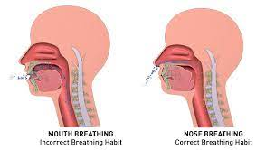
MOUTH BREATHING
Sassouni determined mouth breathing as a habitual respiration through the mouth instead of nose.
Mouth breathing is a form of breathing that replaces nasal breathing and it’s aetiology is complex.

Slide 8
etiology
Slim and finn classified mouth breathing in 1987 as:
Obstructive
Habitual
Anatomical
( Journal of IMBA, review article . The role of mouth breathing on dentition development and formation.)

Slide 9
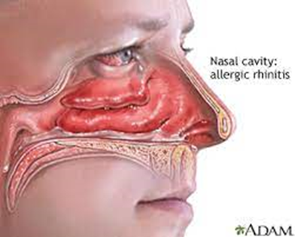
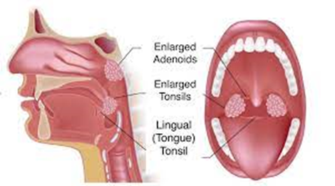
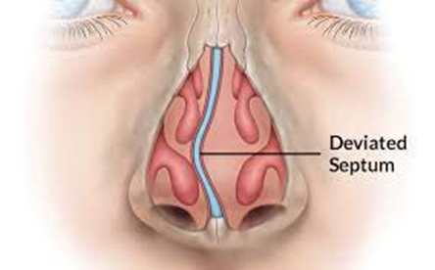
etiology
Enlarged adenoids
Deviated septum
Nasal polyp
Enlarge turbinates
Obstructive sleep apnea
Genetic predisposition.

Slide 10
pathogenesis
Changed position of tongue, jaws and head
Tongue occupying a back and lower position
Mandible drop down.
Disproportion between jaws and teeth.
Imbalance between masticatory and tongue muscles.
Adenoid facies or long face syndrome

Slide 11
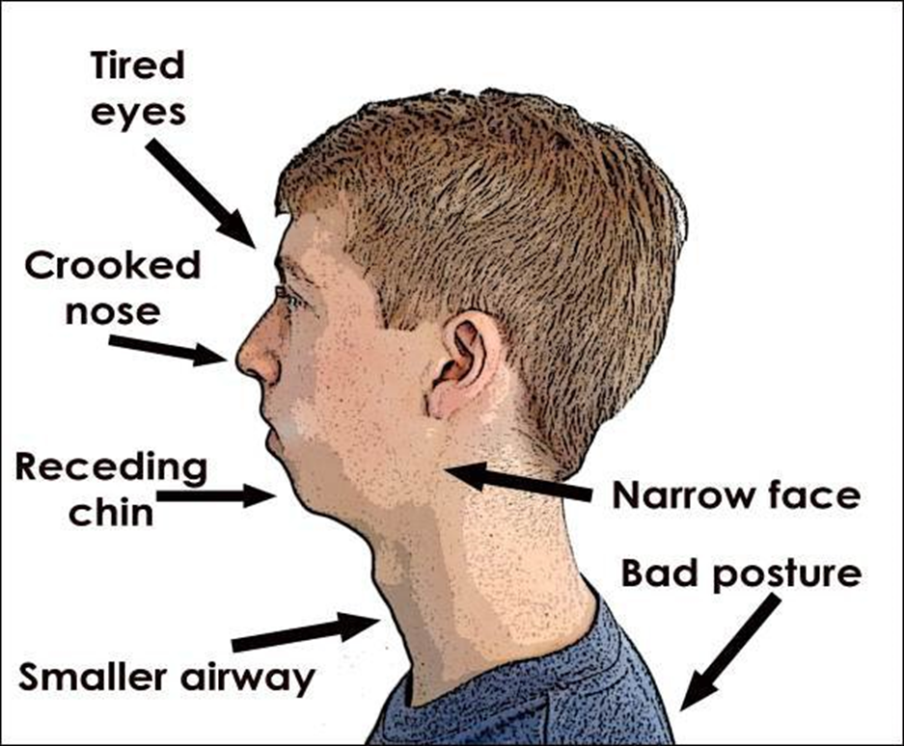
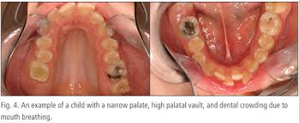
Clinical features of mouth breathing
The most obvious feature of mouth breathers is Adenoid face.
Narrow nostrils, transverse contraction of upper jaw, high arch palate, gummy smile associated with malocclusion of class II , or sometime class III, with high prevalence of posterior cross-bite and anterior open bite.
A not – insubstantial percentage of mouth breathing children have a deep bite.
( Journal of IMBA, review article . The role of mouth breathing on dentition development and formation.)

Slide 12
Clinical association
Mouth breathing is closely related to increased overjet, anterior and posterior crossbite, openbite and displacement.
Therefore, it is necessary to intervene early on aetiological factors of mouth breathing to prevent the development or worsening of malocclusion and, if already developed, to correct it by early orthodontic treatment.

Slide 13
suckling
Suckling is actually a nibbling action of the lips on the nipples of the mother’s breast that causes smooth muscle contraction of milk ducts to release the milk.
The tongue of the infant is so closely placed next to the lips and tunnelled so as to cause the milk to flow into the pharynx and oesophagus.
Suckling reflex and infantile swallow normally disappear during the first year of life.

Slide 14
Swallowing or deglutition
Swallowing is a series of coordinated voluntary, involuntary and reflex muscular activity that moves a bolus of food from the oral cavity through the oesophagus to the stomach.
Pattern-
Infantile (visceral) swallow
Adult/ mature swallow

Slide 15
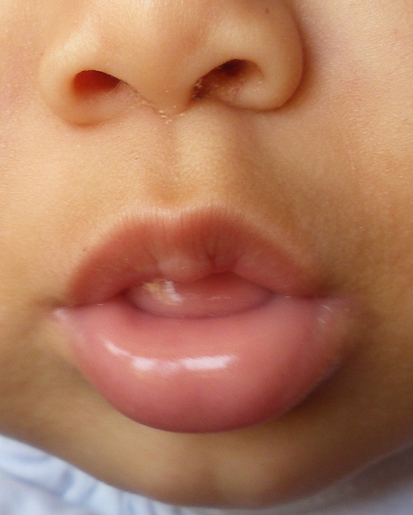
INFANTILE SWALLOW
It is characterized by a forward movement of the tip of the tongue during swallowing.
In the infantile swallow or visceral swallow the mandible is stabilize by placing the tongue forward and between the gum pads and by facial muscles that are innervated by the seventh cranial nerve.

Slide 16
CHARACTERISTICS OF INFANTILE SWALLOW
The jaws are apart, with the tongue between the gum pads.
the swallow is guided, and to a great extent controlled by sensory interchange between the lip and the tongue.

Slide 17
mature swallow
The teeth are together.
The mandible is stabilized by the contraction of mandibular elevators, which are primarily fifth CN muscles.
The tongue tip is held against the palate, above and behind the incisors.

Slide 18
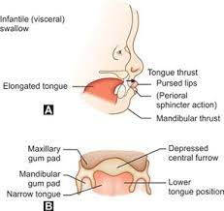
Transition from infantile swallow to mature swallow
The transition from infantile to adult swallow is gradual and demonstrates characteristics of both; lip contraction and tongue placement against the roof of the mouth which may or may not be present.
The transitional swallow may be seen in 3-10 years old children.

Slide 19
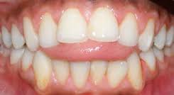
Tongue thrust swallowing
Tulley 1969 - states tongue thrust as the forward movement of the tongue tip between the teeth to meet the lower lip during deglutition, so that the tongue becomes interdental.
(TONGUE THRUST HABIT - A review .Singaraju Gowri sankar
Narayana Dental College and Hospital)

Slide 20
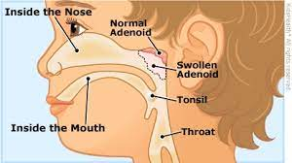
ANATOMIC FACTORS OF TONGUE THRUSTING
In macroglossia patient, pressure is exerted against the lingual surface of the teeth.
Adenoid and tonsils cause the tongue to be positioned anteriorly.
Tongue thrusting is an adaptive behaviour. If large spaces are present anteriorly in the upper and lower teeth, tongue try to move into these spaces.

Slide 21
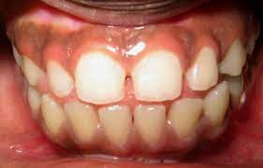
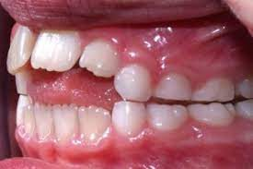
classification
simple tongue thrust
Complex tongue thrust
Lateral tongue thrust
Retained infantile swallow

Slide 22
SIMPLE TONGUE THRUST
It is defined as tongue thrust with a teeth together swallow. It is usually associated with the history of digit sucking. The features observed depends upon the duration, intensity and frequency of the habit.
Extra oral features -
1. Usually dolichocephalic face.
2. Increased lower anterior facial height
3. Incompetent lips

Slide 23
Intra oral features
1. Proclined, spaced and some times flared upper anteriors resulting in increased overjet.
2. Retroclined or proclined lower anteriors depending upon the type of tongue thrust.
3. Presence of an anterior open bite.
4. Presence of posterior crossbites.
5. The simple tongue thrust is characterized by a normal tooth contact during the swallowing act. They exhibit good intercuspation of posterior teeth in contrast to complex tongue thrust.
6. The tongue is thrust forward during swallowing to help establish an anterior lip seal. At rest the tongue tip lies at a lower level.

Slide 24
COMPLEX TONGUE THRUST:
It is defined as tongue thrust with a teeth apart swallow. It is usually associated with chronic nasorespiratory distress, mouth breathing, tonsillitis, and pharyngitis.

Slide 25
Features
The following features are seen :
1. Proclination of anterior teeth
2. Bimaxillary protrusion
3. combine contractions of the lip, facial and mentalis muscle.
4. The occlusion of teeth may be poor. Poor occlusal fit, no firm intercuspation.
5. Posterior crossbite

Slide 26
Lateral tongue thrust
Some patients usually develop into a habit by thrusting the tongue on to the lateral aspect.
Clinically lateral open bite can be seen.
It may be unilateral or bilateral
(TONGUE THRUST HABIT - A review .Singaraju Gowri sankar
Narayana Dental College and Hospital)

Slide 27
Retained infantile swallow
Predominant persistence of the infantile swallowing reflex after the arrival of permanent teeth.
The tongue thrust stongly between the teeth in front and on both sides.
Such patients may have inexpressive faces.
Patient demonstrate very strong contraction of the lips and facial musculature.

Slide 28
CLINICAL SIGNIFICANCE
Often self corrected by 8 or 9 yr of age .
Orthodontic interception is usually more successful than correction if intitiated during the early mixed dentition.
Treatment is generally not recommended when tongue thrust is present without malocclusion or speech problem.

Slide 29
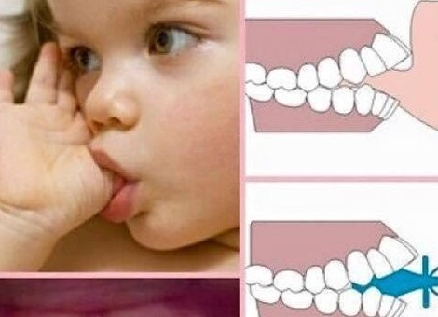
SUCKING HABITS
Thumb sucking is a behavior that can be grouped under a list of habits known as non–nutritive sucking habits.
Non-nutritive sucking habits are common in young children, and as they grow older, they tend to stop them. In most cases, this habit ceases spontaneously between 2 and 4 years of age.
Foster(1982): The term digit sucking is synonymous with finger sucking or thumb sucking. It is defined as the placement of the thumb or one or more fingers in various depths into the mouth.(Journal of Dental & Oro-facial Research Vol 10 Issue 2 Jul-Dec 2014 )
(Thumb Sucking.Denisse Staufert Gutierrez; Paola Carugno)

Slide 30
Sucking habits
continuation of non-nutritive habits beyond 4-5 years greatly hinders the development of normal orofacial function.
During finger sucking, mouth remains open, tongue is positioned forward and low in mouth, and abnormal pressure is generated by the contraction of the cheek muscles which causes imbalance in the intraoral force system.

Slide 31
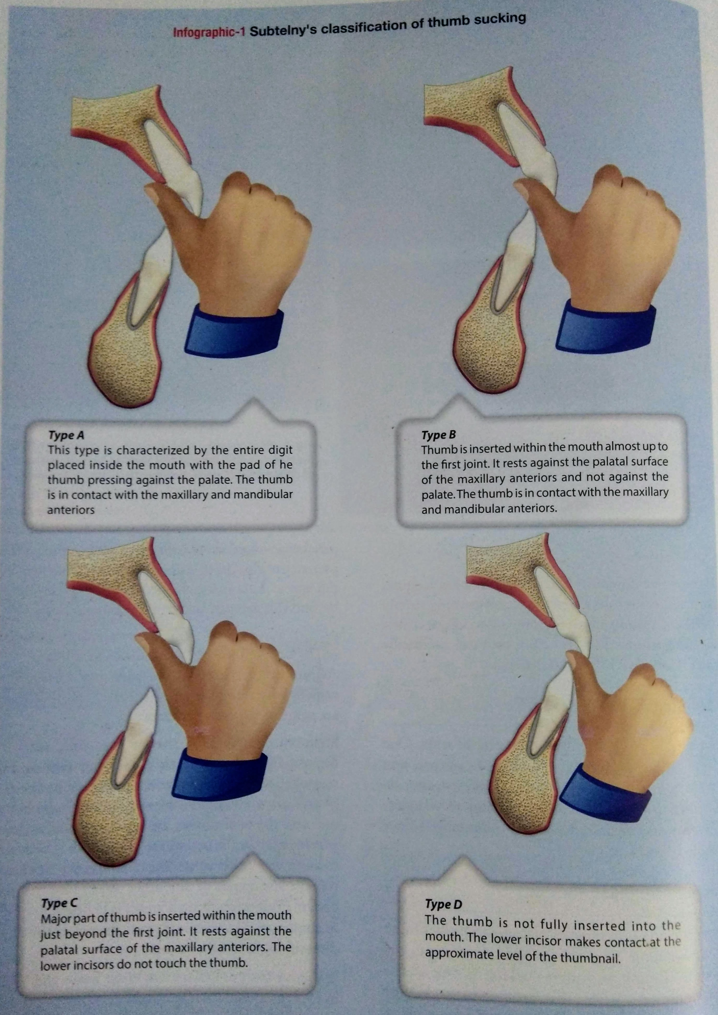
Types of thumb sucking
According to subtelny(1973)
Type a : whole digit is placed inside the mouth with the pad of thumb pressing over the palate, while at the same time maxillary and mandibular oral contact is present.
Type b : thumb is placed into the oral cavity and at the same time maxillary and mandibular contact is maintained.
Type c: thumb is placed into the oral cavity and contacts hard palate and maxillary incisors, but there is no contact with mandibular teeth.
Type d: only a little portion of the thumb is placed into the mouth.

Slide 32
Clinical finding
Johnson and Larson in an extensive review, noted that malocclusions produced by prolonged thumb sucking habits are characterized by
anterior open bites,
labial inclination of the maxillary incisors,
an increase in overjet
spacing of the maxillary incisors as shown in Figure

Slide 33
Clinical association
Other maxillary changes include:
an increase in arch depth
anterior displacement of the maxilla,
high palatal vaults, and narrowing of the inter-canine and inter-molar arch widths.
Class II canine and molar relationships and posterior cross bites have been observed in thumb-sucking individuals.
In the mandible increases in inter-canine arch widths have been detected, and the incisors may be labially or lingually inclined.

Slide 34
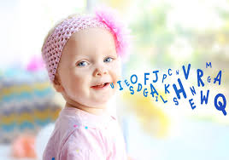
SPEECH
Speech unlike other orofacial functions like respiration, deglutition is a learned activity.
One of the key features is the low placement of larynx in human beings which enables the human vocal tract to achieve optimal resonance to produce different sound.

Slide 35
First speech sound are bilabial sound /m/, /p/, /b/.
Tongue tip consonants appear /t/, /d/.
The sibilant sounds /s/, /z/, come later and the last speech sound,/r/, which requires precise positioning of posterior tongue, often is not acquired until 4 or 5.

Slide 36
Clinical significance
Orthodontic treatment isn’t a magical cure for all speech challenges. However, for people working to correct speech disorders, orthodontics can offer life-changing solutions. And the advantages of orthodontic treatment are not limited to speech therapy alone.

Slide 37
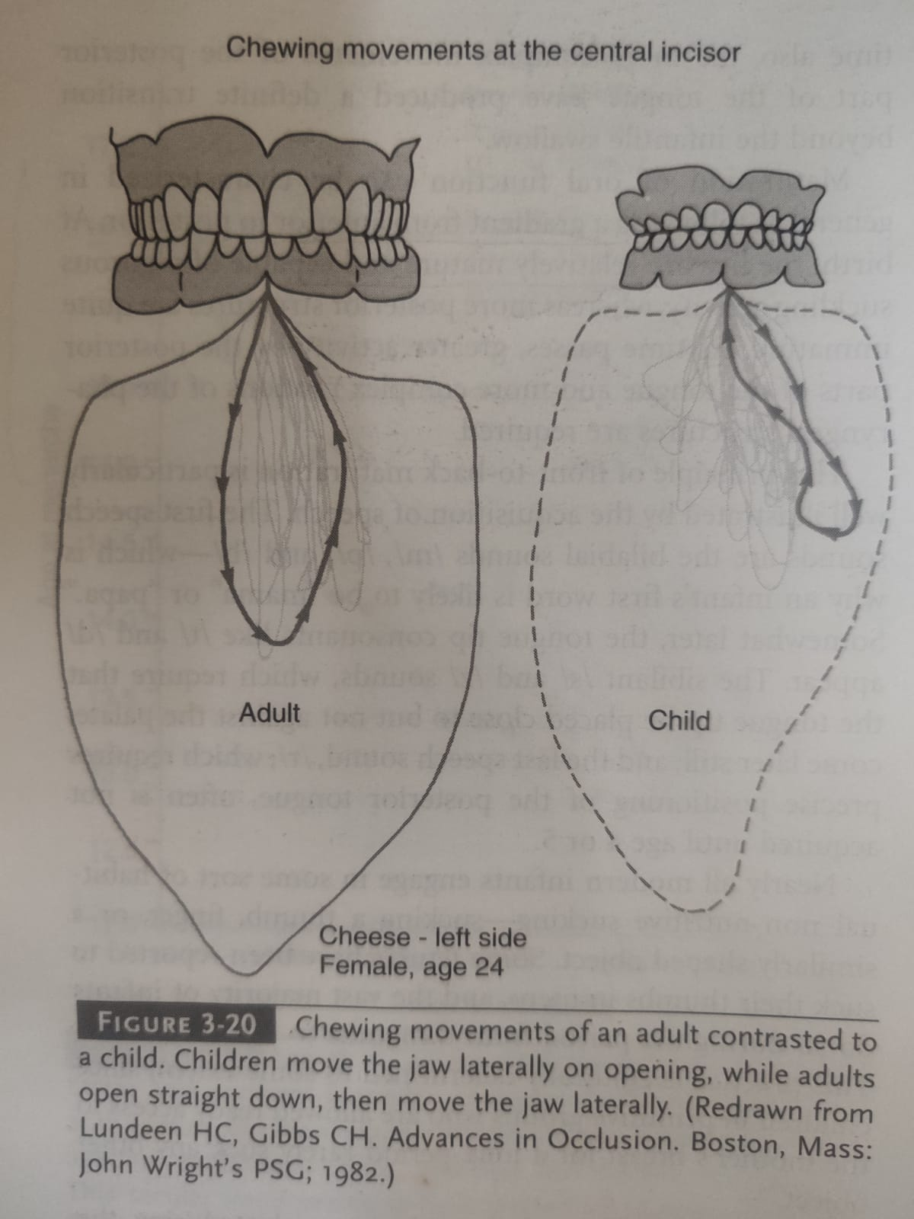
Chewing pattern
An adult typically open straight down, then moves the jaw laterally and brings the teeth into contact.
A child moves the jaw laterally on opening.
The transition from the juvenile to adult chewing pattern appears to develop in conjugation with eruption of the permanent canines, at about 12.

Slide 38
Clinical significance
Adults who do not achieve normal function of the canine teeth because of a severe anterior open bite retain the juvenile chewing pattern.

