Slide 1
RECENT ADVANCEMENT OF ARCH WIRE MATERIAL

Slide 2
CONTENT
INTRODUCTION
EVOLUTION OF ORTHODONTIC WIRES
PROPERTIES
STAINLESS STEEL WIRE
COBALT CHROMIUM ALLOY
NITI

Slide 3
INTRODUCTION
In orthodontics, wires and their multiple configurations are the primary source of the force delivery system.
Force system depends on the wire alloy composition, physical structure and appliance design.
The orthodontic arch wire is one of the most important active elements of the orthodontic armamentarium and thus requires special consideration.
In orthodontic language, arch wire refers to a wire secured to two or more teeth through fixed attachments to cause, guide or control orthodontic tooth movement.

Slide 4
EVOLUTION OF ORTHODONTIC WIRE
Early era. The correction of dental irregularities dates back to 400 BC by hippocrates with some kind of tying. Gold ligatures are the first ever reported wires in orthodontics. Noble metals such as gold, platinum and silver were used to manufacture wires because of their ductility, formability, biological safety and inertness in the oral environment.
Wires in the 1880s. The precursor of the orthodontic wire used in treatment in the late 1800s was the ‘arch bow’. The typical arch bow was a round threaded stiff wire drawn from a nickel–silver or platinum–gold alloy

Slide 5
Dr Edward H. Angle (1887) introduced ‘Neusilver’ or nickel– silver alloys, also called German silver, in the United States.
The 1990s. The stainless steel (SS) alloys were used for orthodontic appliance fabrication in 1919. They were much less the cost and exhibited desired properties of corrosion resistance in the oral environment, excellent strength and desired spring back
In 1950, the Elgin Watch Company (USA) developed Elgiloy (Co– Cr–Ni) which has useful properties of excellent formability and exhibits necessary strength after heat treatment. The alloy was adapted for use in orthodontic archwires. These wires were corrosion resistant and inexpensive.
Notes:
In reality, these were alloys of Cu 65%, Ni 14% and Zn 21% that did not contain any silver

Slide 6
In 1963, William Buehler developed the nickel–titanium alloy. It was introduced into dentistry by George Andreasen because of its property of shape memory effect (SME). This alloy could regain its original shape on heating. These wires are much advanced now and remain the mainstay wires in initial alignment stages.
Burstone and Goldberg introduced wires made of a new alloy called TMA or ‘Titanium-molybdenum alloy’. TMA wires found a significant uses in clinical orthodontics for these alloy wires have useful mechanical properties for enhanced performance compared to steel.
21st century. In search of improving aesthetics of orthodontic appliances, tooth colored wires like Opti-flex wires and Teflon-coated wires have been introduced. These wires of nonmetallic look are indicated in combination with aesthetic ceramic or plastic brackets.

Slide 7
IDEAL PROPERTIES OF ARCH WIRE

Slide 8
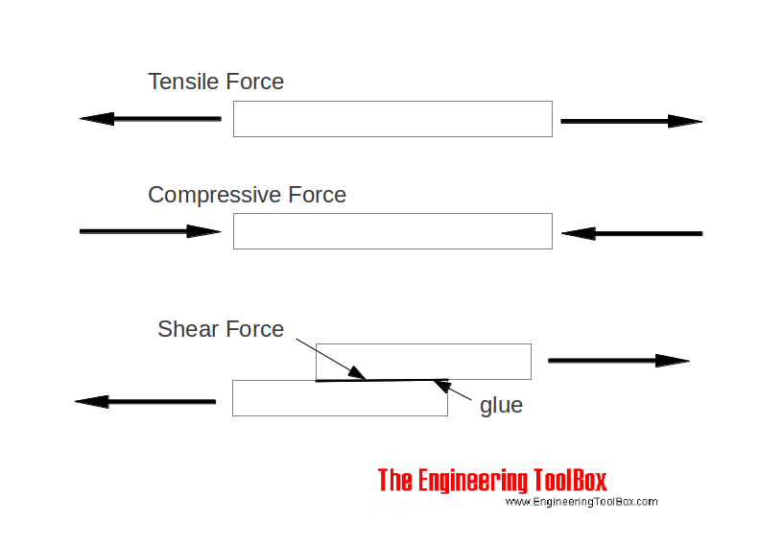
STRESS & STRAIN
Stress- internal distribution of load
F/A
Tensile force- elongation in direction of force application
Compressive force- contraction in direction of force application.
Strain-change in dimension of material specimen
-internal distortion produced by load
deflection/unit length

Slide 9
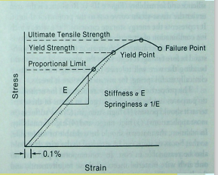
ELASTIC PROPERTIES OF ORTHODONTIC ARCH WIRE
defined in terms of stress strain response to an external load
PROPORTIONAL LIMIT
YIELD STRENGTH
ULTIMATE TENSILE STRENGTH
FAILURE POINT
YOUNG'S MODULUS (E) Hooke’s Law
MODULUS OF ELASTICITY

Slide 10
SPRINGBACK & STIFFNESS
proportional to E
Spring back is extent to which range recovers upon deactivation of an activated arch wire
stiffness = 1 . springiness

Slide 11
RESILIENCY & FORMABILITY
Resiliency- represents energy stored capacity of wire area under stress strain curve out to the proportional limit
Formability-ease with which the material can be deformed.
area under curve from yeild point to
failure point

Slide 12
FLEXIBILITY : flexible material can undergo large deformation with minimal force.
TOUGHNESS : force required to fracture material, measured as total area under stress strain graph
BRITTLENESS: opposite of toughness brittle material cannot undergo elastic deformation
FATIGUE : repeated cyclic stress of magnitude below fracture point can result in fracture

Slide 13
IDEAL ORTHODONTIC WIRE MATERIAL
OTHER PROPERTIES
weldable,
solderable
reasonable cost
DEFLECTION PROPERTIES
high strength
low stiffness
high range
high formability

Slide 14
STAINLESS STEEL
developed by Harry Brearley, F .M. Becket, Benno Strauss and Edward Maurer
Stainless steel’s rust resistance results from a relatively high chromium content. A typical formulation for orthodontic use has 18% chromium and 8% nickel (18-8 stainless steel)
Steel is softened by annealing and hardened by cold working.
Fully annealed stainless steel wires are soft and highly formable.
The steel ligatures used to tie orthodontic archwires into brackets on the teeth are made from such “dead soft” wire.

Slide 15
The steel wires with the most impressive yield strength (“super” grades) are almost brittle and will break if bent sharply.
The “regular” grade of orthodontic steel wire can be bent to almost any desired shape without breaking.
SS consists of mainly three types:
Ferritic SS
Austenitic SS
Martensitic SS

Slide 16
Austenitic stainless steels
Austenitic steels are used for the purpose of orthodontic wires and bands.
It was named after the British metallurgist Robert Austen.
These alloys are the most corrosion resistant of all the SS due to the presence of significant amount of nickel and chromium.
AISI 302 is the primary type of steel containing 18% chromium, 8% nickel and 0.15% carbon.
AISI 304 has similar composition, but carbon content is 0.08%.
Both 302 and 304 may be designated as 18–8 SS

Slide 17
SS VARIANTS
HIGH TENSILE WIRES
A.J. Wilcock, in collaboration with P.R. Begg developed pre-heat treated cold drawn steel wires that had the advantage of being more resilient and having higher tensile strength.
These wires were designed exclusively for use with Begg’s light wire technique.
They are graded according to the increasing order of resiliency and yield strength.
The resilient wires are highly brittle and break easily and are relatively more expensive than SS wires.
As these wires developed in Australia & were to be used with Begg’s technique, they are popularly called Australian wires.

Slide 18
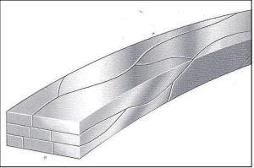
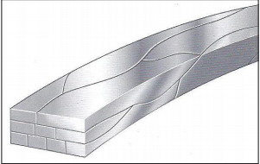
D- Rect (braided preformed and straight)
8 stranded, interwoven rectangular wire
high flexibility, greater control, good initial torque control
finishing archwire
Force 9 Braided Preformed
9 stranded interwoven rectangular wire
high flexibility and slot filling capacity
50% more force than 8 stranded.

Slide 19
Gold heat Treated SS
high temper ss wire with higher force levels and
Greater spring back.
High force levels & rigid nature: transverse arch form control
Menzanium (non nickel containing wires)
manganese and nitrogen replace allergic components of Ni.

Slide 20
COBALT CHROMIUM ALLOY
Developed by Elgin National Watch Company
Commercially: Elgiloy, Azura, and multiphase
COMPOSITION
Cobalt-40 to 45%
Chromium- 15- 22%
Nickel- 15% (strength and ductility)
Iron- 15%
Molybdenum- 7%
Manganese- 2%

Slide 21
color coding:
soft Blue - softest, and bent and soldered easily.
ductile Yellow - relatively ductile, and more resilient
semiresilient Green - more resilient than yellow
resilient Red - most resilient with highest spring properties

Slide 22
Elgiloy, the cobalt–chromium alloy, has the advantage that it can be supplied in a softer and therefore more formable state, and the wires can be hardened by heat treatment after being shaped.
It has almost disappeared because of its additional cost relative to stainless steel and the extra step of heat treatment to obtain optimal properties.
Chrome cobalt wires have a high modulus of elasticity suggesting that they deliver twice the force of beta-titanium and four times the force of nickel–titanium archwires.

Slide 23
NICKEL TITANIUM ALLOYS
Nitinol was developed for space programme by William F. Buehler
Ni—nickel, Ti—titanium, Nol—Naval Ordinance Laboratory
NiTi wires were introduced in orthodontics in 1971 by George Andreasen
They have an exceptional ability to deliver light force over a large range of activation.

Slide 24
These alloys can exist in more than one crystal structure at intraoral temperature.
At higher temperatures and lower stress, the alloy exists in a simple cubic structure called Austenite.
At lower temperatures and higher stress, the alloy is more stable in a monoclinic phase called Martensite.
Buehler termed the temperature at which this change took place as the ‘temperature transition range’ or TTR
Notes:
Nitinol wires were supposed to have characteristics of low stiffness, high reversibility and excellent spring back property. However, as it was manufactured by a work hardening process, this initial wire did not show any phase transition effects of shape memory or superelasticity. This family is now referred to as martensitic NiTi (M- NiTi)

Slide 25
The uniqueness of NiTi is that the transition between the two structures is fully reversible and may occur at an intraoral temperature.
This phase transition allows certain NiTi alloys to exhibit two remarkable properties found in no other arch wire materials— heat-activation and super elasticity.
Heat-activation refers to the ability of the material to go from a martensitic state to an austenitic state when its temperature is increased.
During heat activated phase transformation they show unique property of Shape memory.

Slide 26
Shape memory refers to the ability of the material to “remember” its original shape after being plastically deformed while in the martensitic form.
Super elasticity refers to the very large reversible strains that certain NiTi wires can withstand due to the martensite-austenite phase transition.
Austenite displays super elasticity, it undergo a transition to martensite in response to stress.
Shape memory is a thermal reaction and super elasticity is a mechanical.

Slide 27
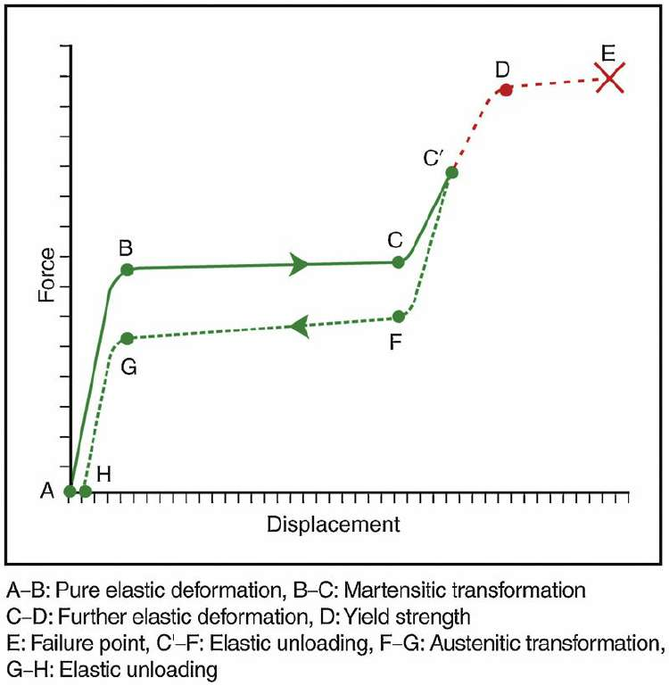
Point A stress–strain curve is illustrating superelasticity due to the transformation from the austenitic to the martensitic phase. Points A–B shows a purely elastic deformation of austenitic phase. The stress at point B is the minimum stress required for martensitic transformation to start. At point C, the transformation is completed. In the region C–D, wire undergoes elastic deformation on continued stressing. At point D, the yield strength of the material is reached. At E, it undergoes plastic deformation/failure. If the stress is released before reaching point D say at C, elastic unloading occurs of the martensitic structure along the line C’–F. Point F indicates the point at which reverse transformation to austenite begins. This continues to point G, where austenite is completely restored. Points G–H represents the elastic unloading of the austenite.

Slide 28
NiTi LIMITATION
NiTi wires have very low formability in the clinical setting.
These wires cannot be welded or soldered due to the passivating nature of titanium dioxide which is strongly adhered to the metal surface.
The frictional forces in the nitinol wire are very high due to high Ti content, and therefore these wires are unsuitable for sliding tooth movements such as retraction on the wire.
High nickel content could be disadvantageous by causing hypersensitive reactions. (Ti or epoxy-coated wires are recommended)

Slide 29
COPPER NiTi
Introduced by Rohit Sachdeva and Suchio Miuasaki in 1994.
This alloy contains 5%–6% of copper and 0.2%–0.5% chromium in addition to nickel–titanium added to bring down the TTR to oral temperature.
Copper is added to enhance the thermal properties of a nickel–titanium alloy.

Slide 30
Advantages of Cu-NiTi over other NiTi alloys are as follows.
Relatively, loading force is 20% less for the same degree of deformation of wire which makes it possible to engage severely malposed teeth with less patient discomfort.
Decreased hysteresis and flattening of unloading curve result in a more consistent force.
More resistance to permanent deformation, therefore, exhibits better spring back than others.
The patient can control the deactivation of the engaged wire by cold application, thereby reducing discomfort.

Slide 31
Four types of Cu-NiTi wires and clinical applications thereof
Type 1 (Austenitic final temperature-15°C): It generates very high forces, hence has limited clinical indications.
Type 2 (AF-27°C): This is most popular and generates moderate-to-high forces. Indicated in patients who have an average or higher pain threshold and in patients where rapid tooth movement is required.

Slide 32
Type 3 (AF-35°C): These generate forces in the mid-range and are indicated in patients who have a low to normal pain threshold, in patients whose periodontium is slightly compromised, and when lower forces are desired.
Type 4 (AF-40°C): These wires generate very low forces and are indicated in patients who are sensitive to pain, patient’s compromised periodontal condition and when the patient is irregular, noncompliant and the orthodontist does not want things to get out of hands.

Slide 33
β TITANIUM ALLOY
Titanium molybdenum alloy’ or TMA by Burstone and Goldberg in 1980s
COMPOSITION
Alloying titanium with molybdenum, niobium, vanadium, iron, chromium and manganese stabilises Ti in β-phase at room temperature.
Minimum additions of 6.5% Mn, 4% Fe, 8% Cr, 7% Co and 13% Cu are added for complete retention of beta-phase after quenching process

Slide 34
PROPERTIES
High flexibility and recover their shape fully from the initial deformation.
Spring back properties are not lost during the bending operation
Low modulus of elasticity
High tensile strength and is readily formable
Biocompatible and corrosion resistant
These wires show passivating effect due to the presence of TiO2.

Slide 35
LIMITATIONS OF TMA WIRE
The main disadvantage of TMA is their high coefficient of friction due to very high titanium content (85%)
The cost factor is unfavorable because these are expensive wires
Notes:
Nitrogen ion implantation on the wire surface has reported to cause surface hardening and decrease frictional force

Slide 36
NICKEL-FREE STAINLESS STEEL AND TMA WIRES
The steel is alloyed with 15%–18% chromium, 3%–4% molybdenum, 10%–14% manganese and about 0.9% nitrogen to compensate for the nickel.
for example Noninium® or Rematitan wires by Dentauram.

Slide 37
CONNECTICUT NEW ARCH WIRE
CNA wires are an improved version of beta-titanium archwires.
CNA is a nickel-free alloy that takes intricate bends and is half as stiff as stainless steel.
Does not break as easily as TMA wire.
Has a smooth, high polish finish which provides much less friction than TMA.
Maintains the shape of the loops much better than TMA.

Slide 38
TITANIUM-NOBIUM-ALUMINIUM SHAPE MEMORY ALLOY WIRES
This alloy contains a high proportion of nickel and therefore may induce hypersensitivity.
Hence are not recommended for nickel- sensitive patients
Titanium–niobium–aluminium (Ti–Nb–Al) alloy, which has the best mechanical performance among these nickel-free shape memory and superelastic alloys
The tooth movement pattern was smooth because of the mechanical properties of Ti–Nb–Al alloy

Slide 39
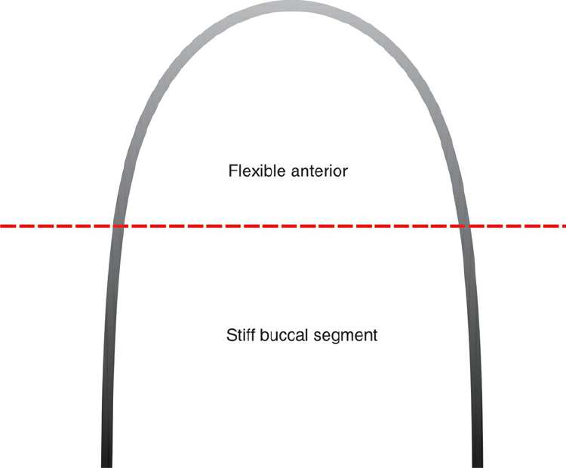
DUAL FLEX ARCHWIRES
These are special NiTi archwires that have two types of wire materials and cross-sections in the anterior or posterior sections of the same archwire.
This type of wire affords multiple functions in the same wire, thereby improving control and reducing treatment time
The anterior portion of combined wire is made of a Titanal alloy and posterior part is of SS separated by cast ball hooks mesial to canine bracket
It is manufactured by Lancer Pacific.
These wires have a flexible anterior portion and stiffer buccal segments
which facilitate alignment of anterior teeth without losing anchorage
control.

Slide 40
It consists of three types:
Dual Flex-l : - anterior section made of 0.016-in. round titanal and a posterior section made of 0.016-in. round steel. - The flexible front part quickly aligns the anterior teeth, and the rigid posterior portion maintains the anchorage and molar control. - It is during the initial stages of treatment for leveling and alignment. T
Dual Flex-2 : - flexible front segment composed of a 0.016 × 0.022-in. rectangular titanal and a rigid posterior segment of round 0.018-in. steel.

Slide 41
Dual Flex-3 : - It consists of a flexible anterior part of a 0.017 × 0.025-in. titanal rectangular wire and a posterior part of 0.018 square steel wire.
The Dual Flex-2 and 3 wires provide anterior anchorage and control molar rotation during the closure of posterior spaces and initiate considerable torque in the anterior segment

Slide 42
SUPERCABLE WIRE
In 1993, Hanson introduced super elastic NiTi coaxial wire which he called ‘Super Cable’.
It comprises seven individual NiTi strands woven together in a long, gentle spiral to maximize flexibility and minimize force delivery.
Supercable demonstrates very low and physiologically optimum orthodontic forces.
It exerts much less force compared with a solid nickel–titanium wire.
Full slot engagement by 0.018-in. super cable can be achieved even in severe crowding and rotation cases because of its low force delivery.
This wire was specially developed to be used with SPEED self-ligating bracket system.

Slide 43
TURBO WIRE OR BRAIDED NICKEL TITANIUM RECTANGULAR WIRE

Slide 44
HEAT TREATMENT
STAINLESS STEEL
STRESS RELIEF HEAT TREATMENT
The purpose is to remove any residual stresses induced when the wire was formed.
Recommended temp is 750ºF for 11 min.
This causes rearrangement of grains without loss of hardening and as internal stresses are relieved, some changes in the shape of the wire occur. this is called elastic memory .

Slide 45
This process increases the modulus of elasticity, resistance to fatigue, springback of wire and resisitance to plastic deformation
However during heat treatment 0.2% plastic recoil of wire occurs. thus needs further adjustment in the appliance.
SENSITIZATION
At temp b/w 400-900ºC carbon reacts with chromium and forms chromium carbide.
this precipitates at the grain boundaries and makes the wire susceptible to corrosion.

Slide 46
SOFTENING HEAT TREATMENT (ANNEALING)
Carried out at temp 950-1200oC and the wire looks red hot.
wires loses all its properties except ductility, malleability and formability.
HARDENING HEAT TREATMENT
not recommended for SSas at 400-900ºC sensitization can occur.

Slide 47
2. COBALT CHROMIUM WIRES
HARDENING HEAT TREATMENT
Upto 900ºC for each temperature of heat there is progressively increased in resistance to deformation.
At temp above 900ºC there is rapid declince in resistance to plastic deformation
Maximum resistance to permanent deformation occurs in the range of 800-900ºC
The heat treatment of the alloy to increase the ultimate strength and resilience without changing the stiffness is called precipitation hardening heat treatment.

Slide 48
A typical cycle of heat treatment is 482ºC for 7-12 min.
SOFTENING HEAT TREATMENT
Heating at 1100-1200ºF followed by rapid quenching may soften a Co-Cr wire.
Typical cycle is 370ºC for 11 min.
This not only improves the working elastic properties but also reduces failure caused by localized stress corrosion.

Slide 49
β TITANIUM ALLOY
Titanium molybdenum alloy’ or TMA by Burstone and Goldberg in 1980s
excellent resilience as well as reasonably good formability.
TMA wire is the choice for auxillary springs, closed loop, and for intermediate and finishing wire
COMPOSITION
Titanium - 80%
Molybdenum - 11.5%
Zirconium - 6%
Tin- 4.5%

Slide 50
ADVATAGES
Over SS
more range of action
high springback
low stiffness
Over NiTi
good formability
weldable

Slide 51
PROPERTIES
High flexibility and recover their shape fully from the initial deformation.
Spring back properties are not lost during the bending operation
Low modulus of elasticity
High tensile strength and is readily formable
Biocompatible and corrosion resistant
These wires show passivating effect due to the presence of TiO2.

Slide 52
LIMITATIONS OF TMA WIRE
The main disadvantage of TMA is their high coefficient of friction among all orthodontic wires due to very high titanium content (85%)
The cost factor is unfavorable because these are expensive wires
Notes:
Nitrogen ion implantation on the wire surface has reported to cause surface hardening and decrease frictional force

Slide 53
NICKEL-FREE STAINLESS STEEL AND TMA WIRES
The steel is alloyed with 15%–18% chromium, 3%–4% molybdenum, 10%–14% manganese and about 0.9% nitrogen to compensate for the nickel.
for example Noninium® or Rematitan wires by Dentauram.

Slide 54
CONNECTICUT NEW ARCH WIRE
CNA wires are an improved version of beta-titanium archwires.
CNA is a nickel-free alloy that takes intricate bends and is half as stiff as stainless steel.
Does not break as easily as TMA wire.
Has a smooth, high polish finish which provides much less friction than TMA.
Maintains the shape of the loops much better than TMA.

Slide 55
TITANIUM-NOBIUM-ALUMINIUM SHAPE MEMORY ALLOY WIRES
Titanium–niobium–aluminium (Ti–Nb–Al) alloy, are nickel-free shape memory and superelastic alloys
The Ti–Nb–Al expansion spring exerted lighter and continuous force and facilitated safe and efficient tooth movement.
The tooth movement pattern was smooth because of the mechanical properties of Ti–Nb–Al alloy

Slide 56
Used as finishing wires
these are soft and pliable
weldability is good
stiffness in bending is half of that of SS
springback in bending is 14% lower than that of SS

Slide 57
TIMOLIUM WIRES
Advanced technology Ti wires
Ti based alloy, an alpha beta alloy with Ti, Al and V as its components
It has smooth surface texture, less friction and better strength.
High yield strength that can withstand bending without breaking
poor weld characteristics

Slide 58
Excellent in all phases of treatment.
During initial treatment it is excellent for space closure, tooth alignment and bite opening.
It is nickel free thus eliminating the risk of allergies with sensitive patients.

Slide 59
DUAL FLEX ARCHWIRES
These are special NiTi archwires that have two types of wire materials and cross-sections in the anterior or posterior sections of the same archwire.
This type of wire affords multiple functions in the same wire, thereby improving control and reducing treatment time
These wires have a flexible anterior portion and stiffer buccal segments
which facilitate alignment of anterior teeth without losing anchorage
control.

Slide 60
The anterior portion of combined wire is made of a Titanal alloy and posterior part is of SS separated by cast ball hooks mesial to canine bracket
It is manufactured by Lancer Pacific.

Slide 61
It consists of three types:
Dual Flex-l : - anterior section made of 0.016-in. round titanal and a posterior section made of 0.016-in. round steel. - The flexible front part quickly aligns the anterior teeth, and the rigid posterior portion maintains the anchorage and molar control. - It is during the initial stages of treatment for leveling and alignment.

Slide 62
Dual Flex-2 : - flexible front segment composed of a 0.016 × 0.022-in. rectangular titanal and a rigid posterior segment of round 0.018-in. steel.

Slide 63
Dual Flex-3 : - It consists of a flexible anterior part of a 0.017 × 0.025-in. titanal rectangular wire and a posterior part of 0.018 square steel wire.
The Dual Flex-2 and 3 wires provide anterior anchorage and control molar rotation during the closure of posterior spaces and initiate considerable torque in the anterior segment

Slide 64
SUPERCABLE WIRE
In 1993, Hanson introduced super elastic NiTi coaxial wire which he called ‘Super Cable’.
It comprises seven individual NiTi strands woven together in a long, gentle spiral to maximize flexibility and minimize force delivery.
Supercable demonstrates very low and physiologically optimum orthodontic forces.
It exerts much less force compared with a solid nickel–titanium wire.

Slide 65
Full slot engagement by 0.018-in. super cable can be achieved even in severe crowding and rotation cases because of its low force delivery.
This wire was specially developed to be used with SPEED self-ligating bracket system.

Slide 66
TURBO WIRE OR BRAIDED NICKEL TITANIUM RECTANGULAR WIRE
These preformed braided NiTi wires combine the advantages of highly resilient NiTi with rectangular braided wire.
The braiding process increases the superelastic properties of NiTi.
This wire provides early torque control due to its rectangular cross-section.
Its indications for use are early torque control and mid-treatment engagement of second molars

Slide 67
OPTIFLEX
Talass introduced the first optiflex wire (Ormco, USA) to combine optimum mechanical properties with a highly aesthetic appearance.
It is highly resilient arch wire and is effective in alignment of crowded teeth
Sharp bends must be avoided as it could fracture the core
The wire is made of clear optical fibre and it comprises three layers

Slide 68
A silicon dioxide core provides the force for moving teeth.
A silicon resin middle layer that protects the core from moisture and adds strength.
A stain-resistant nylon outer layer that prevents damage to the wire and further increases its strength

Slide 69
PLASTIC/TEFLON COATED Ni-Ti
Plastic covered, tooth coloured superelastic nickel–titanium archwires are available as Nitanium (Tooth Tone).
It is claimed to have lower friction and blends with natural dentition as well as ceramic, plastic and composite brackets.
It is stain and cracks resistant.
The coated wires begin to lose their plastic coating in the mouth and take up the food stains making them unacceptable.

Slide 70
WIRE COMPOSITION | STIFFNESS | SPRINGBACK | LOAD DEFLECTION RATE | BIOCOMPATIBILITY | RESILIENCY | JOINABILTYY | FRICTION | FORMABILTIY | COST
SS | HIGH | LOW | HIGHEST | GOOD | LOW | GOOD BUT NEED TO BE SOLDERED | VERY GOOD | LOW | LOWEST
ELGILOY | HIGH | LOW | COMPARABLE TO SS | GOOD | LOW | GOOD BUT NEED TO BE SOLDERED | LOW TO MODERATE | VERY GOOD | LOW
M NiTi | LOW | HIGH | 1/4 OF SS | SOME CORROSION NOTED | HIGH | NO | HIGHER THAN SS | POOR | MODERATE

Slide 71
WIRE COMPOSITION | STIFFNESS | SPRINGBACK | LOAD DEFLECTION RATE | BIOCOMPATIBILITY | RESILIENCY | JOINABILTYY | FRICTION | FORMABILTIY | COST
A-NiTi | LOW | FOUR TIMES SS | LOWER THAN M-NiTi | BETTER THAN M-NiTi | BETTER THAN M-NiTi | NO | HIGHER THAN SS | POOR | VERY LOW
ß NiTi | AVG | AVG | 1/2 OF SS | VERY GOOD | GOOD BUT LOW THAN NiTi | TRULY WELDABLE AND SOLDERABLE | VERY HIGH | GOOD | HIGH
Cu NiTi | LOWEST | HIGHER THAN ALL | LOWEST | BETTER THAN M-NiTi | BETTER THAN M-NiTi | NO | HIGHER THAN SS | POOR | VERY HIGH

Slide 72
THANK YOU

