Slide 1
Basic concepts of Growth & Development

Slide 2
Contents:
Growth: Pattern, Variability, and Timing
Methods for Studying Physical Growth
Measurement Approaches
Experimental Approaches
Genetic Influences on Growth
The Nature of Skeletal Growth

Slide 3
Growth & Development
The term “Growth” usually refers to an increase in size or number.
Acc. to JS Huxley: “Growth is the self multiplication of living substance.”
Acc. to Krogman: “Growth is increase in size, change in proportion and progressive complexity.”
Acc. to Todd: “Growth is an increase in size.”
Acc. to Meridith: “Growth is the entire series of sequential anatomic and physiologic changes taking place from the beginning of prenatal life to senility.”
Acc. to Moyers: “Growth is quantitative aspect of biological development per unit time.”
Acc. to Moss: “Growth is change in any morphological parameter, which is measurable.”

Slide 4
The term “Development” refers to an increase in degree of organization along with an increase in complexity.
Acc. to Todd: “Development is progress towards maturity.”
Acc. to Moyers: “Development refers to all the naturally occurring unidirectional changes in the life of an individual from its existence as a single cell to its elaboration as a multifunctional unit terminating in death.”
Growth is largely an anatomic phenomenon, whereas development is physiologic and behavioral.

Slide 5
Growth: Pattern, Variability & Timing
Pattern in growth represents proportionality, not just a set of proportional relationships at a point in time, but to the change in these proportional relationships over time.

Slide 6
Fig. 1.

Slide 7
Another aspect of the normal growth pattern is that not all the tissue systems of the body grow at the same rate
Fig. 2

Slide 8
Interesting aspect of patterns is that they are predictable.
This means that the proportional relationship within a pattern can be specified mathematically, and the only difference between a growth pattern and a geometric one is the addition of time dimension.
A change in growth pattern would indicate some alteration in the expected changes in body proportions.
Fig.3

Slide 9
Variability
Fig. 4.
Fig. 4.

Slide 10
Final major concept of growth is Timing.
Variation in timing arises because the same event happens for different individuals at different times, or, the biological clocks of different individuals are set differently.
All children undergo a growth spurt at adolescence, but growth spurt occurs at different times in different subjects.
Fig. 5.

Slide 11
Fig. 6.
Fig. 7.

Slide 12
Methods for studying Physical Growth
Measurement Approaches
Experimental Approaches

Slide 13
Measurement Approach
Craniometry
This involves measurement of skulls found among human skeletal remains.
It has the advantage that precise measurements can be made on dry skulls.
The big disadvantage is such a growth study can only be cross-sectional, meaning it can be done at only one point of time in the test subject’s lifetime.

Slide 14
Anthropometry:
This involves measuring skeletal dimensions on living individuals.
Various soft tissue landmarks are established over the bony landmarks of craniometry, and measurement of the same is done.
Major advantage is this study can also be done longitudinally, meaning it can be done repeatedly and followed up during various intervals of time without damaging the test subject.

Slide 15
Cephalometric Radiography:
Cephalometric radiology is of considerable importance not only in the study of growth but also in clinical evaluation of orthodontic patients.
The technique depends on precisely orienting the head before making a radiograph, with equally precise control of magnification.
Growth studies are done by superimposing a tracing or digital model of a later cephalogram on an earlier one, so that the changes can be measured.
The disadvantage is that it produces 2-D representation of a 3-D structure making all of the measurements impossible.

Slide 17
3-Dimensional Imaging:
Computed Axial Tomography(CAT) or Computed Tomography(CT) allows 3-D reconstruction of the cranium and face.
Recently, Cone Beam Computed Tomography(CBCT) rather than Axial CT has been applied to the scans of the head and face.
CBCT significantly reduces both the radiation dose and the cost.
Superimposition of these 3-D images helps to judge the growth of different regions of the area of interest from any perspective.

Slide 18
Fig. 10.

Slide 19
Fig. 11.
3-D Photography now makes much more accurate measurements of facial soft tissue dimensions and changes possible.

Slide 20
Analysis of Measurement Data:
Measurement of data can be presented graphically in a variety of different ways.
Growth data can be shown by plotting the size/stature in relation to age, known as the “Distance curve”.
If the growth data is plotted in terms of increment added within a specified time interval, it is known as the “Velocity curve”.

Slide 21
This is a graph of growth velocity data of different individuals with different timings of their adolescent growth spurts.
Evidently, the Mean curve is not an accurate representation of the growth pattern for many individuals.
This “smoothening” of individual variation is a major limitation of cross-sectional method for study of growth.
Therefore, longitudinal studies are preferred over cross-sectional ones to appropriately judge the details of the growth patterns.

Slide 22
In order to study exponential growth like during embryonic development, the growth data can be presented logarithmically.
This gives us a straight line, in contrast to the actual growth data, where the curve rises steeply.
This also shows that even though the overall size of the embryo is increasing exponentially, the rate of cellular multiplication remains constant.

Slide 23
Experimental Approach
Vital staining:
Alizarin dye, which reacts strongly to calcium where bone calcification occurs, was injected into the test subject at specific time intervals.
Later, the subject was slaughtered and bones were found to have incremental lines of the dye, indicating the timing of the injections.
The bones displayed patterns of bone deposition and resorption which were helpful in the study of bone growth & development.

Slide 24
The effect of the dye is not just superficially anatomic, but histological sections of bones also reveal similar pattern of bone deposition and resorption.

Slide 25
Vital staining was inadvertently discovered in humans, when tetracycline was used to treat recurrent infections in young children.
It was later discovered that tetracycline binds to calcium at growth sites the same way as Alizarin.
The resultant intrinsic staining, though doesn’t have much ill-effect, can be an aesthetic disaster.

Slide 26
With advances in radioactive tracers, different metabolites and structures can be marked with radioactive isotopes, the weak radioactivity of which can be detected.
In fetal rat bones growing in organ culture, Tritium(H3)-thymidine is incorporated into DNA, so when the cells undergo mitosis, the new nuclei are tagged with the isotope.
Carbon(C14)-proline was also introduced, proline being a major constituent of collagen, was observed in extracellularly secreted collagen.

Slide 27
Implant Radiography:
Inert metal pins are placed anywhere in the skeleton, including face and jaws.
These pins are biocompatible and can easily be visualized by a cephalogram.
Superimposition of two cephalograms taken at different time periods can show the amount of growth occurring at different sites.

Slide 28
Genetic influences on Growth
Msx and Dix genes are expressed differentially not only in development of teeth but also in growth of the mandible.
Msx-1 predominates in tooth formation and is expressed in basal bone.
Msx-2 is strongly expressed in the alveolar process.
Dix-1 and Dix-2 are expressed in dental mesenchyme and in the epithelium of the maxillary and mandibular arch mesenchyme.
Other homeobox gene groups play a role in dental and facial development.

Slide 29
Nature of Skeletal Growth
At the cellular level, there are only 3 possibilities for growth:
Hypertrophy, which refers to an increase in the size of individual cells.
Hyperplasia, describing increase in the number of cells.
Secretion of extracellular material, which contributes to an increase in the size independent of the number or size of the cells themselves.
All of the 3 processes are involved in skeletal growth.

Slide 30
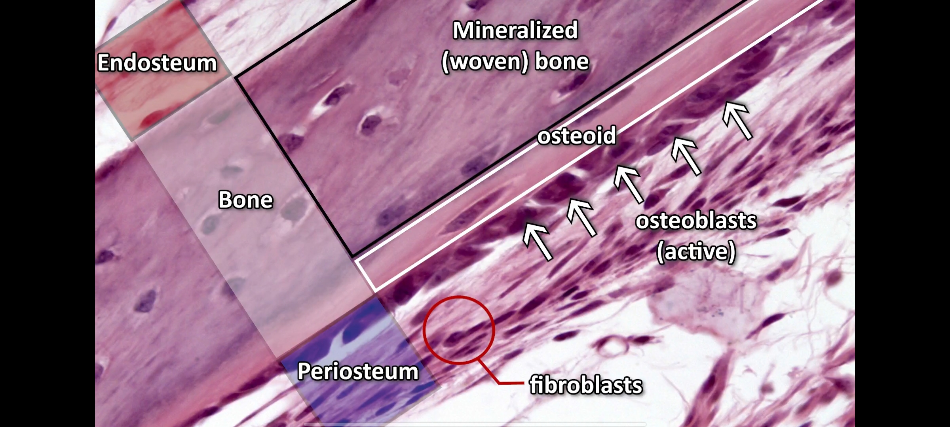
Direct apposition or Surface apposition is the term given to the process where direct addition of new bone to the surface of existing bone, occurring due to the activity of the cells in the periosteum.
Formation of new cells occurs in the periosteum and extracellular material secreted there is gets mineralized and forms new bone.

Slide 31
Endochondral ossification is the type of bone formation where cartilage is transformed into bone, with islands of bone appear in degenerating cartilage.
Bone replaces the cartilaginous skeleton or the primary cartilage formed during embryogenesis.

Slide 32
The embryonic chondroskeleton, which is the cartilaginous endoskeleton formed during embryogenesis, is termed as Primary cartilage.
This cartilage has some degree of intrinsic growth potential.
Primary cartilage react primarily to systemic growth stimuli, such as hormones.
Growth in the primary cartilage occurs by the interstitial proliferation of the chondrocytes. For example, the Meckel’s cartilage.
The Secondary cartilage is an accessory cartilage formed after the primary skeleton and is independent of the primary cartilaginous skeleton.
Growth in the secondary cartilage occurs by appositional proliferation.
Secondary cartilage follows the systemic stimuli after additional modulation by local growth factors. For example, the Mandibular condylar cartilage.

Slide 33
In long bones, area of ossification appear in the center of the bones and at the ends, producing a central shaft, known as the Diaphysis and a bony cap on each end called the Epiphysis.
Between epiphysis and diaphysis is a remaining area of uncalcified cartilage called the Epiphyseal plate.
The epiphyseal plate of cartilage is a major center for their growth as it is responsible for almost all growth in length of these bones.
Epiphysis
Epiphyseal plate
Diaphysis
Epiphyseal plate
Epiphysis

Slide 34
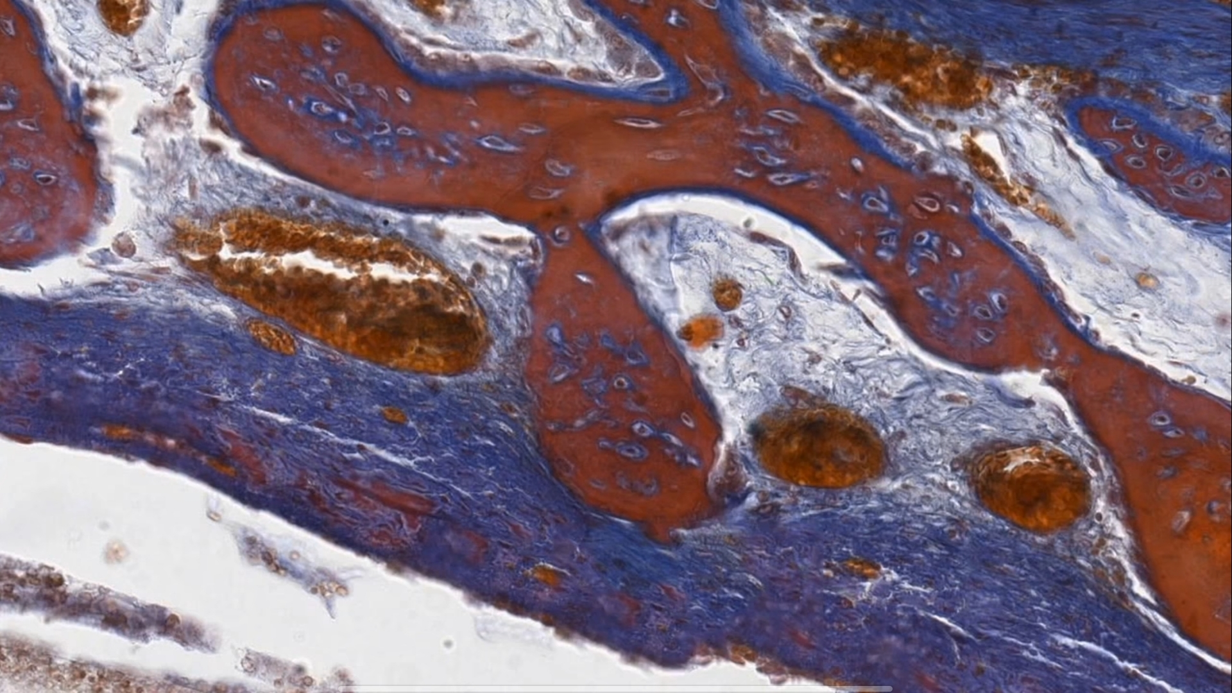
Intramembranous ossification is another type of bone formation where the bone matrix is directly secreted in highly vascular connective tissues without formation of cartilage.
This type of bone formation is seen in cranial vault and both the jaws.

Slide 35
After formation and maturation of a bone, its shape can be changed by resorption in one area and apposition in the other.
This process of balancing of apposition and resorption has two components- Modeling and Remodeling.
Modeling adapts structure to function by changing bone shape and size to maintain bone strength as loading of the bone changes. This also includes bone drift, such as the relocation of mandibular ramus during growth.
Remodeling occurs at the cellular level via osteocyte apposition and osteoclast resorption in opposite areas.

Slide 36
Growth Fields:
All bones have both resorptive and depository fields all over the inside and outside cortical surfaces.
The different activities and rates of growth of these fields are responsible for the differential growth processes that produce bones of irregular shapes.
Bone does not grow itself, it is grown by this environment of soft-tissue growth fields.
The genetic program for bone growth is not contained within the hard bone tissue; rather, the determinants of bone growth reside in the bone's investing soft tissues, muscles, mucosa, blood vessels, nerves, connective tissue, the brain, etc.

Slide 37
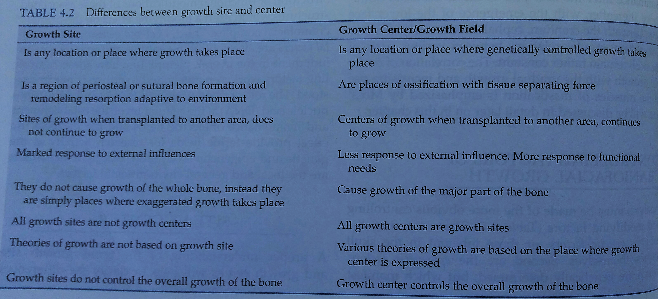

Slide 38
Example of Growth sites- the mandibular condyle, the maxillary tuberosity, the synchondroses of the basicranium, the sutures, and the alveolar processes.
Example of Growth centers- the epiphyseal plates of long bones.

Slide 39
Thank you

