Slide 1
SEMINAR ON
SHORT FACE SYNDROME

Slide 2
CONTENTS:
Introduction
Clinical Features
Etiology, prevalence.
Diagnosis
Cephalometric Features
Management-Orthopedic,Orthodontic and Surgical correction
Conclusion

Slide 3
Introduction:
When facial proportion was discovered ,there were standards set for balance & harmony
A well balanced face is important for ideal esthetics.
Achieving good esthetics includes careful evaluation of the dentofacial complex in the anteroposterior, transverse, and vertical dimensions.
According to Sassouni , the vertical facial forms are classified into long, average and short faces and reported a definitive correlation between facial patterns and anterior vertical facial proportions.
Vertical dimension includes anterior facial height (AFH) and posterior facial height (PFH).

Slide 4
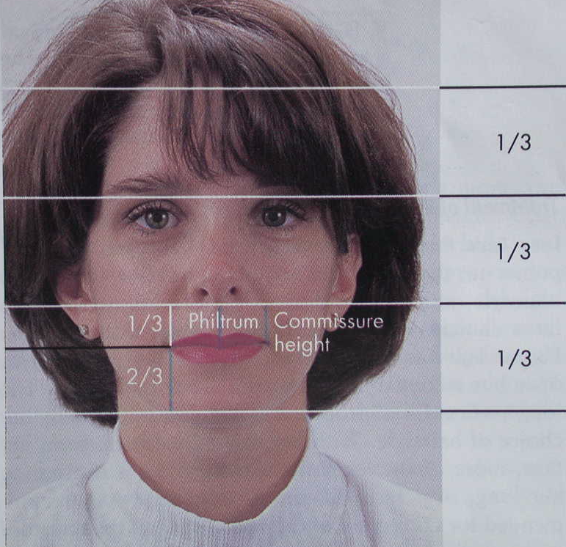
Ideal face is divided into equal thirds by horizontal lines.
Lower one third is again divided into upper 1/3rd and lower 2/3rd.
In case of short face – reduce/ relationship closed to 1:1.
Schudy introduced the terms “hyperdivergent” and “hypodivergent” as classifications of extremes along the vertical spectrum.

Slide 5
Vertical dysplasia +AP dysplasia so new term, according to what is considered to be the most important clinical manifestation or possible etiologic factor.
Synonyms :
Low angle type
Skeletal deep bite type
Vertical maxillary deficiency
Idiopathic short face
Extreme counter clockwise rotation type
In a given facial type similar esthetic, cephalometric, and occlusal features are grouped together, the term “syndrome” has been introduced to describe the face in vertical dimensions, as it allows a more complete description of the facial, dental, and skeletal characteristics of a given facial type and its variants. SHORT FACE SYNDROME

Slide 6
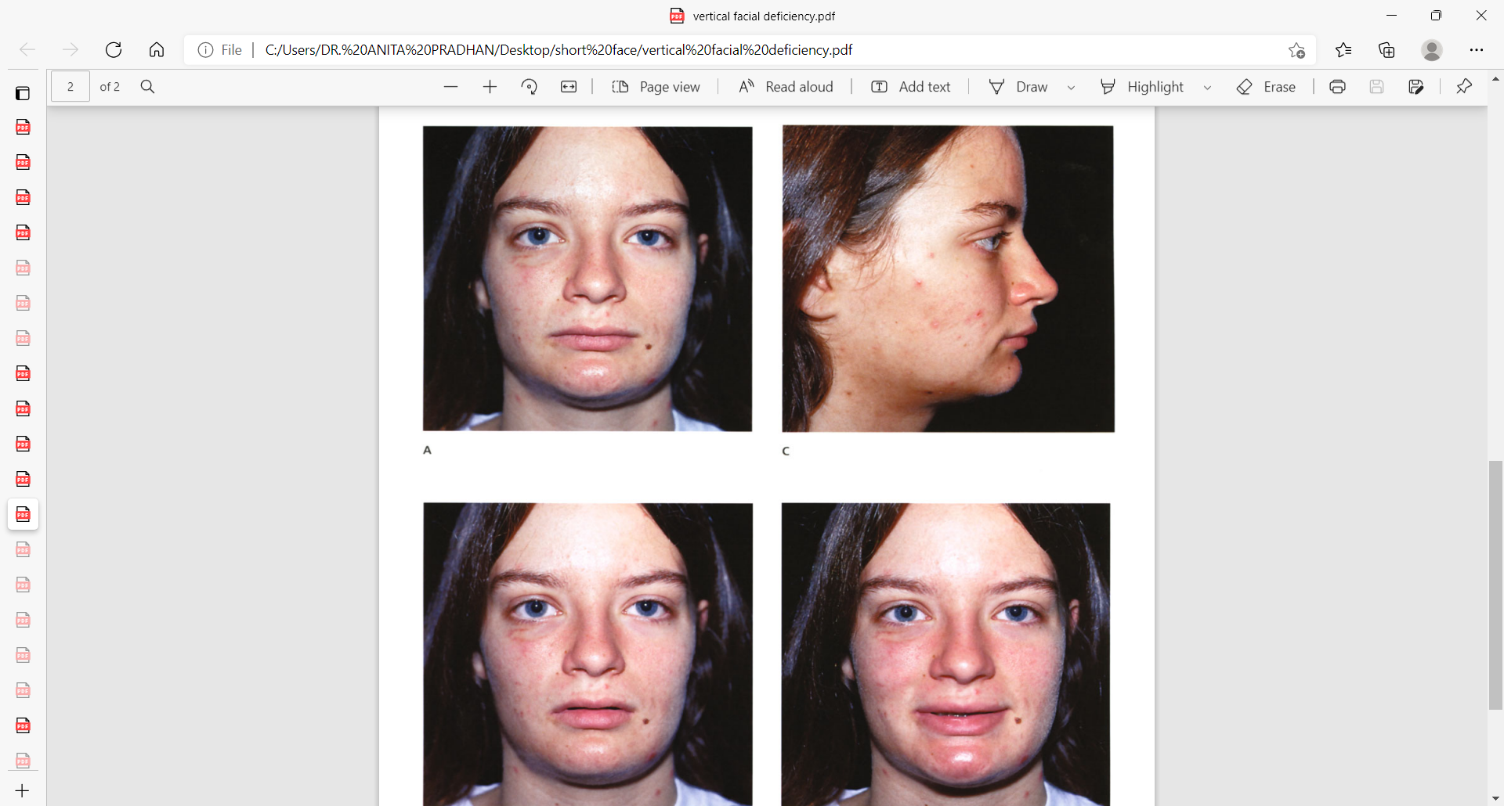
Short Face
A frequently seen pattern of facial disharmony has the common denominator of a significant degree of vertical and horizontal (sagittal) deficiency in the maxilla and mandible.
Measuring the ratio LFH:UFH - diminished.
The height of the alveolar process in both jaws - reduced.
The visual presentation of the face includes an apparent redundancy of the soft-tissue envelope of the lower face, thereby creating “chubby cheeks” in the adolescent and a prematurely aged look by early adulthood.

Slide 7
There may be a Class II malocclusion with greater than average overjet. If so, the mandible has greater deficiency than the maxilla, and the pogonion will lack prominence.
Individuals with Class I deep bite without excess overjet are more likely to have a retropositioned A-point as compared with the B-point (i.e., a counterclockwise rotated maxillomandibular complex) and a prominent pogonion.
The maxillary and mandibular planes are often nearly horizontal, which results in a “square jaw” brachyfacial appearance.

Slide 8
Short lower facial height can result from vertical maxillary deficiency, mandibular deficiency with diminished mandibular body or ramus height, or a short chin height.
Characteristics of vertical maxillary deficiency include
insufficient incisor display at rest,
inadequate upper incisor display on smile, and
short lower facial height
deep vertical overbite
Everted lower lip, deep mentolabial sulcus and
A strong overclosed appearance.
The maxillary incisors are often completely covered by the upper lip, which creates an edentulous appearance in repose and an unfavorable “no gingiva” smile.

Slide 9
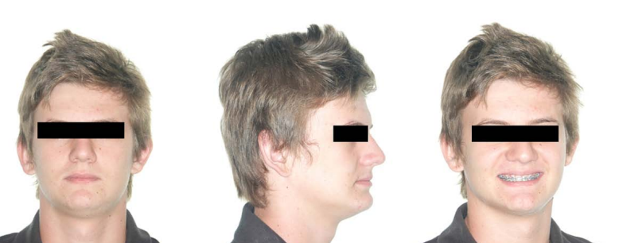
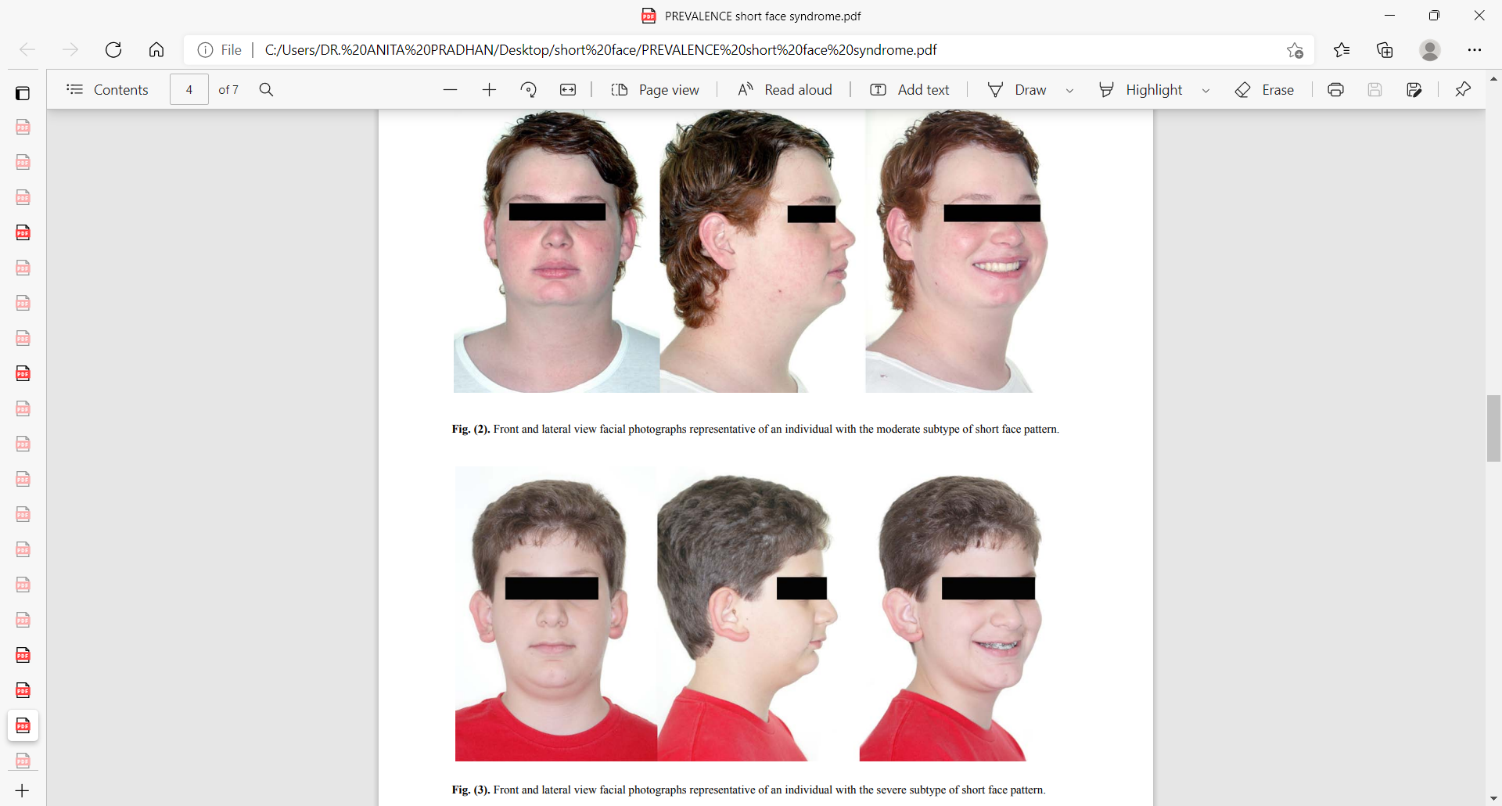
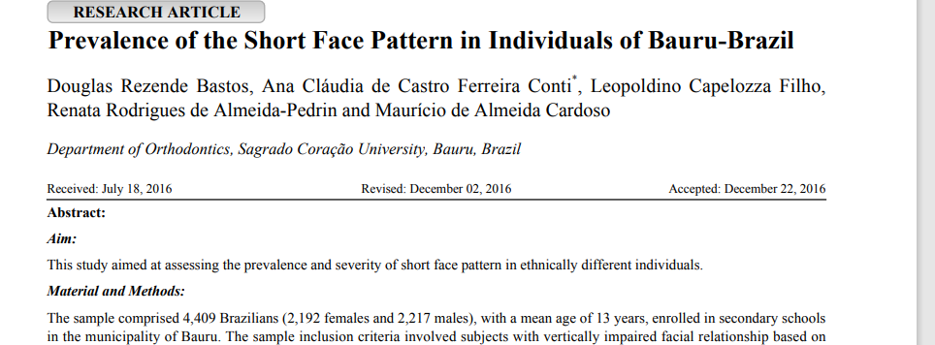
Prevalence of the Short Face Pattern
The prevalence of short face pattern was 3.15%, as 1.11%, 1.99%, and 0.02% considered mild, moderate and severe subtypes, respectively.
The prevalence of short face pattern was 3.15%, and White individuals had the highest prevalence

Slide 10
Etiological Factors
Genetic factors :
Heritability estimates have been reported in the literature for various vertical dimensions of the face.
For instance, the heritability of total face height is reported to range from 0.8 to 1.3, while that of the lower anterior face is between 0.9 and 1.6.
In contrast, the heritability of the posterior and upper anterior face height ranges from 0.2 to 0.9 and 0.2 to 0.7, respectively.

Slide 11
Jaw Growth
Isaacson et al(1977) and Schudy(1965) studied jaw rotation caused by vertical condylar growth.
when vertical condylar growth exceeds the combined sutural and alveolar growth of the maxilla and mandible a forward mandibular rotation.

Slide 12
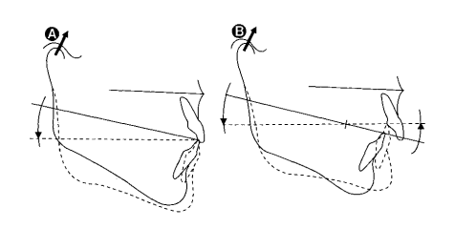
Upward and forward growth of the mandibular condyle with decreased eruption of posterior teeth and decreased vertical maxillary growth.

Slide 13
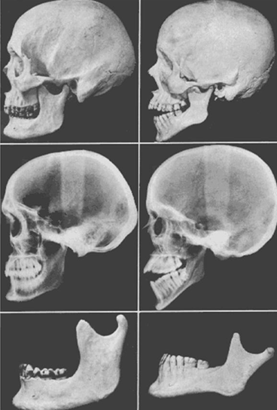
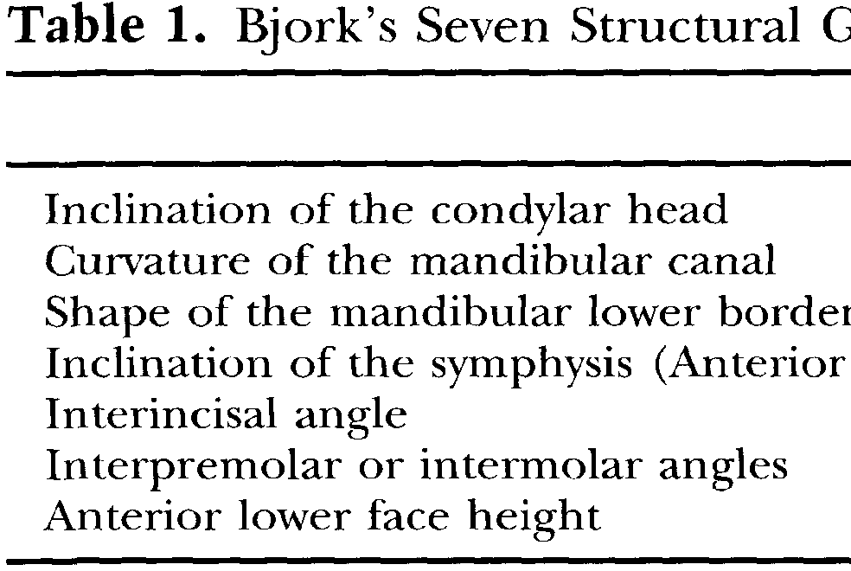
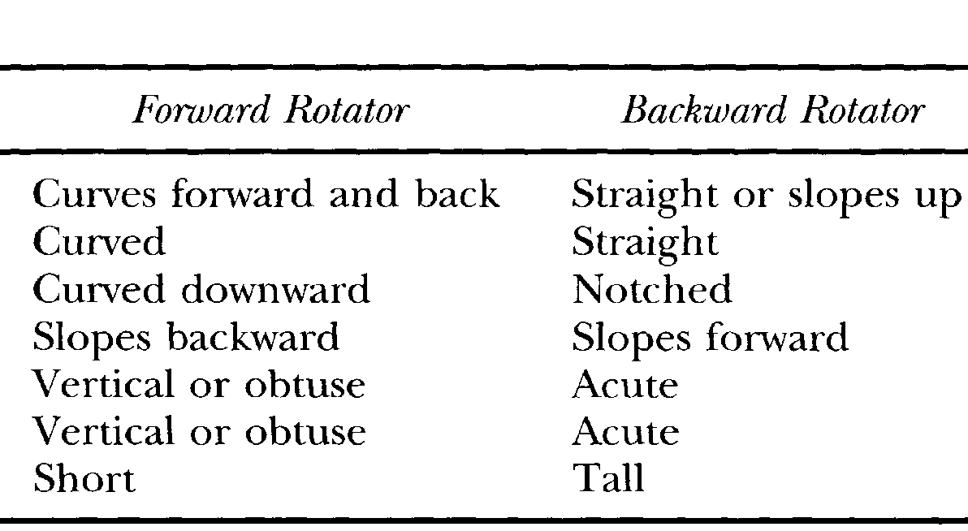
Bjork’s (AJO 1969) seven specific structural features as a result of remodeling during a particular type of growth rotation.

Slide 14
According to the type of rotation and the centre of rotation, the growth of the mandible can be divided into
  Forward rotation
    Type I
    Type II
    Type III
  Backward rotation
    Type I
    Type II

Slide 15
Forward rotation type I
Centre of rotation is in the joint.
Deep bite is seen.
Decreased lower anterior facial height.
Powerful musculature is usually seen
May lead to occlusal imbalance and loss of teeth.

Slide 17
Forward rotation type II
Centre of rotation is at the incisal edges of the lower incisors.
Increased posterior facial height normal lower anterior facial height.
Posterior facial height can increase due to
  Caudally placed glenoid fossa.
  Increased ramal height.
Anterior facial height does not change as
  The eruption of molars occurs in the pace with increased ramal height.
  Lower border of the mandible undergoes remodeling.
Mandibular symphysis swings forward.

Slide 19
Forward rotation type III
In cases of increased overjet the centre of rotation is displaced to the premolars.
There is decreased lower facial height.
Increased posterior facial height.
Skeletal deep bite is seen.
Mandibular symphysis swings forward.

Slide 20
Rotation of the mandible effects the inclination of the teeth. The interincisal angle is almost constant (showing the lower incisors are functionally related to upper incisors). Hence their eruption is guided forward and there is increase in alveolar prognathisim.
Rotation also influences the posterior teeth = more upright, increasing the intermolar and interpremolar angles.

Slide 22
Dentoalveolar development
Issacson et al (AO 1971) studied dentoalveolar development in three groups of subjects—those with short anterior facial height, those with average anterior facial height, and those with excessive anterior facial height.
The amount of maxillary posterior alveolar development was found to decrease as the MP-SN angle decreased.

Slide 23
They found that mean distance from the occlusal plane to the inferior edge of the palate was
22.5 mm - long anterior facial height.
19.6 mm - average group.
17.1 mm - short anterior facial height.
This difference of 5.1 mm of dentoalveolar development between the high angle and low angle groups - significance.

Slide 24
Mandibular posterior alveolar development similar decreased with decreases in the MP-SN.
Mandibular height showed a mean of
31.2 mm for the long anterior face height group,
28.2 mm for the average group, and
28.3 mm for the short anterior face height group.

Slide 25
Differences in AFH and PFH =>rotational growth or to changes in mandibular position that greatly influence the position of the chin.
Strong Muscles : Vertically oriented jaw muscles in brachyfacial subject expected to retrain the vertical component of growth and it contribute to the forward rotation of mandible (Moller (1966) , Ingervall and Thilander (1974) ).
Occlusal Biting Forces : Molar biting force generated in short faced individuals is 150 - 200 pounds compared to 50-80 pounds in long-faced individuals. The difference is due to the muscle strength.

Slide 26
Diagnosis :
Clinical and cephalometric features.
Facial posture, disproportion between the upper and lower facial heights,

Slide 27
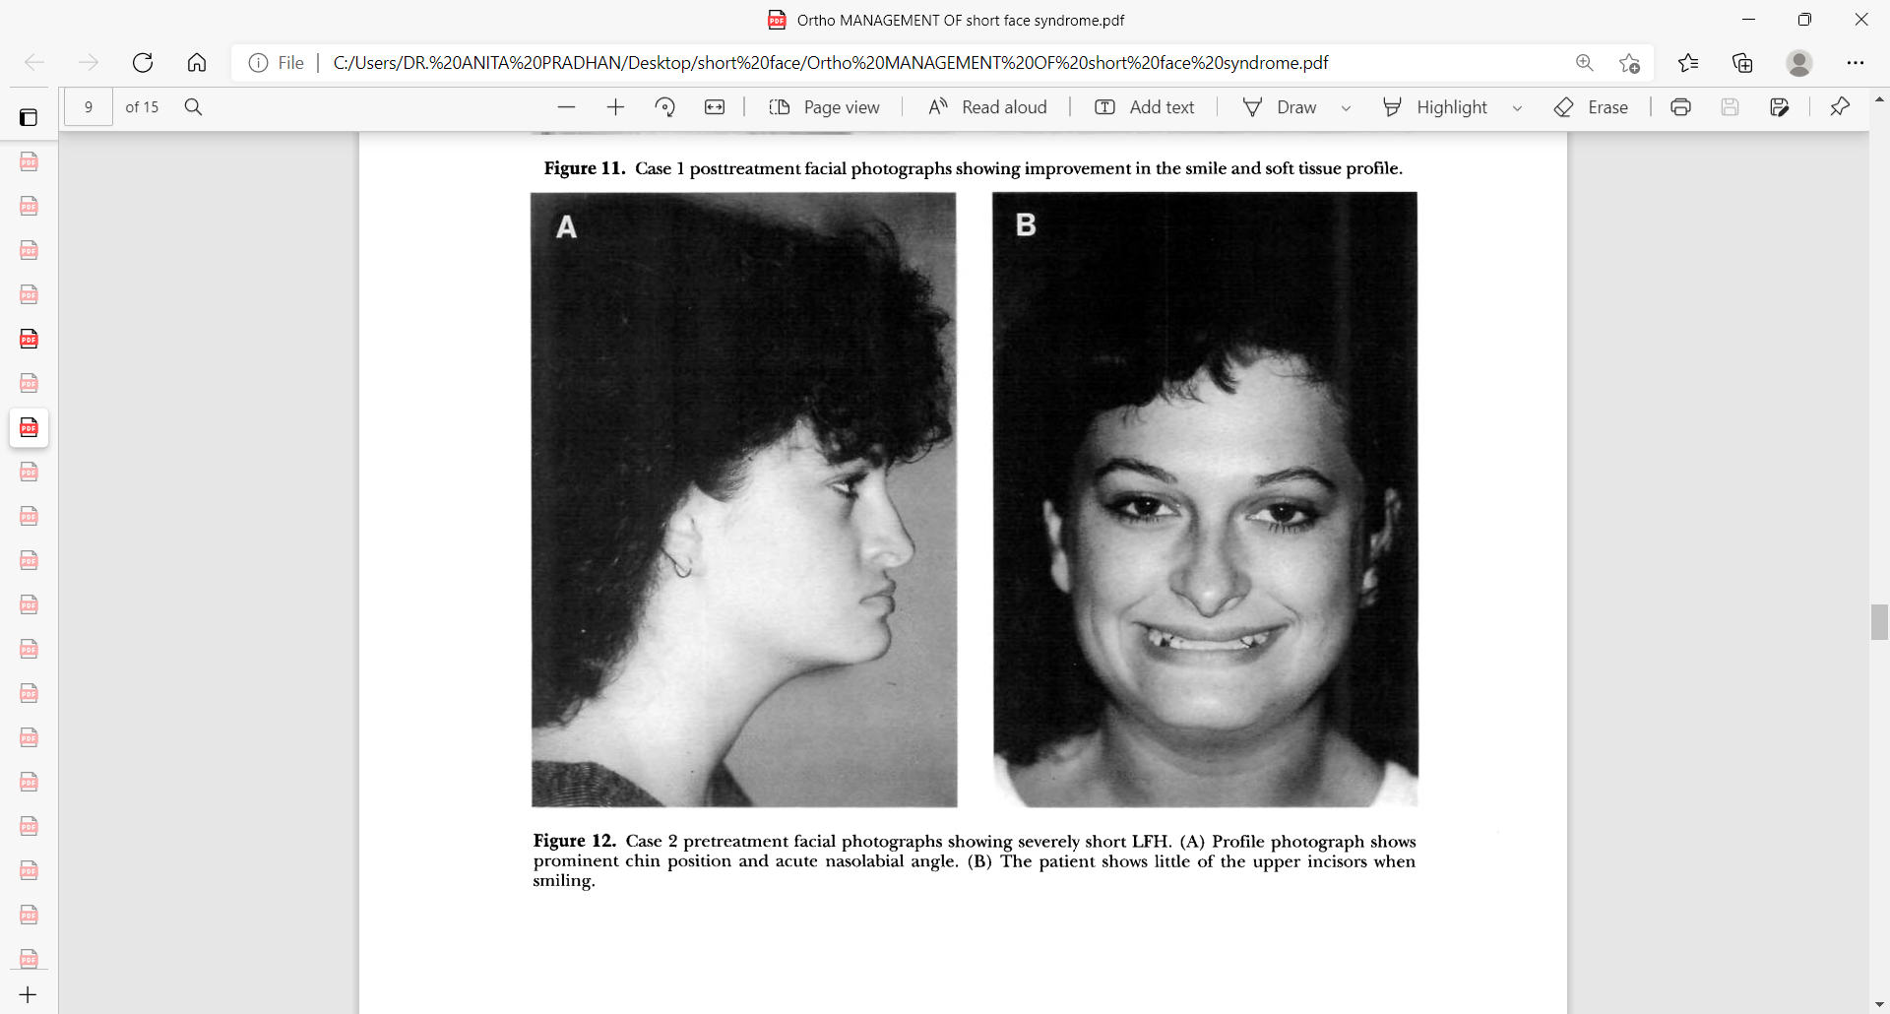
Clinical Characteristics
Profile view
The nasolabial angle, which was most frequently increased, added to the impression of a “jutted-out” nose.
A projected nose, an increased nasolabial angle, and
a well-developed pogonion resulted in a “concave” lower profile, with the upper and lower lips far posterior to the Ricketts esthetic plane.
Appearance of an excessive chin because of overclosure
Improvement in the profile when the mandible is in the rest position
Deep labiomental fold.

Slide 28
Frontal view
Normal height of the middle and upper thirds of the face.
Nose - broad with enlarged nasal apertures.
Thin, curled lips, decreased ht of lip curvation.
Maxillary incisors that often are not visible with the mouth open, creating an edentulous look, and incisors that are only partially exposed when the patient smiles.
Deep bite- frequent.
Increased intercommissure distance.
Appearance of a short and square face, with strong, exaggerated masseter muscles

Slide 29
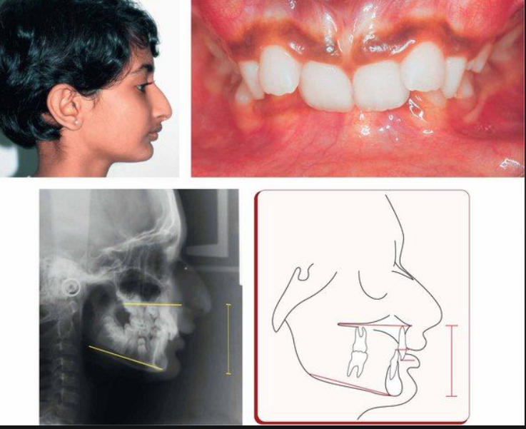
Dental characteristics
Heavy musculature and overclosed occlusion that frequently predispose the patient to bruxism and resulting attrition
Often, increased interocclusal freeway space
A deep impinging bite with palatal irritation.
Dental crowding with flaring of the incisors in each arch.
various types of malocclusion, such as Class II, Div 2, Div 1: Class I occlusion with symptoms of Class II, Div 2; and even Class III

Slide 30
Functional Aspects
Articulation errors in speech and altered swallowing mechanisms that result from the small jaws, the Class II deep-bite malocclusion.
Difficulties with chewing and with lateral and protrusive mandibular movements as a result of the Class II deep-bite malocclusion.
Detrimental long-term effects on the dentition and the periodontium as a result of traumatic malocclusion, the crowding of the teeth in the limited alveolar area.
A higher incidence of temporomandibular disorders in the form of masticatory muscle discomfort as a result of the short facial height and the deep-bite malocclusion.

Slide 31
Cephalometric Analysis
Opdebeeck and Bell studied the Class II SF syndrome, Various linear and angular measurements were taken and compared to the Bolton standards.
On the basis of the FPI (facial proportion index), the RH (ramus height), the OP-PP distance (or posterior maxillary height), and the SN: MP angle, two subgroups were distinguished in the SFS group.

Slide 32
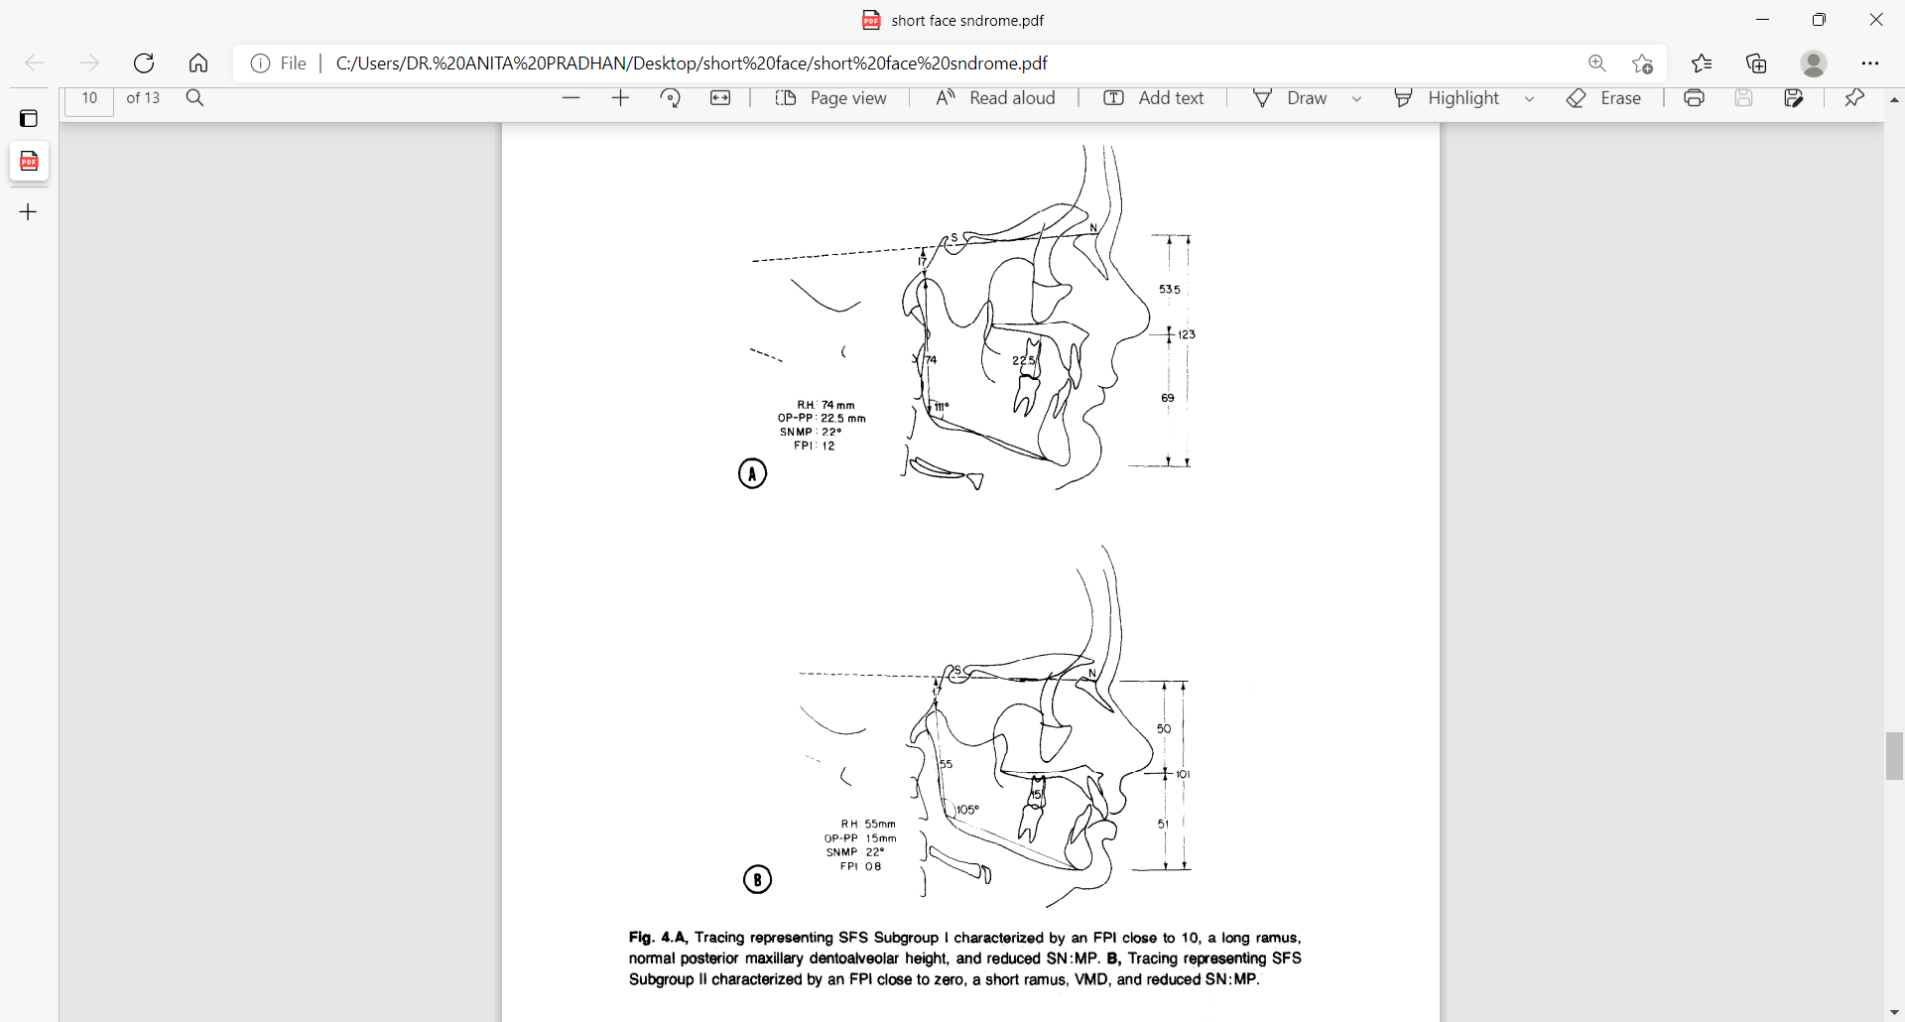
SFS1, was characterized by a long ramus, sharply reduced SN : MP angle, an FPI close to 10, and a slightly reduced posterior maxillary height.
SFS2 was characterized by a short ramus, a slightly reduced SN: MP angle, an FPI with values around or below zero, and a sharply reduced posterior maxillary height (vertical maxillary deficiency).

Slide 33
Cephalometric measures such as SNB, facial depth, and pogonion to nasion perpendicular, may also suggest mandibular prognathism as the structural etiology because the chin is forward of its normal position.
Mandibular size may be normal, however, leaving the practitioner unsure of the definitive diagnosis.
Such cases are difficult to diagnose because most cephalometric analyses are deficient when examining a patient with a significant vertical discrepancy.
Because of these shortcomings, Patrik K. develop a vertical analysis from measurements found to be significant with vertical malocclusions.
The analysis examines not only the vertical proportions of the face, but the anatomical features that contribute to that face.

Slide 34
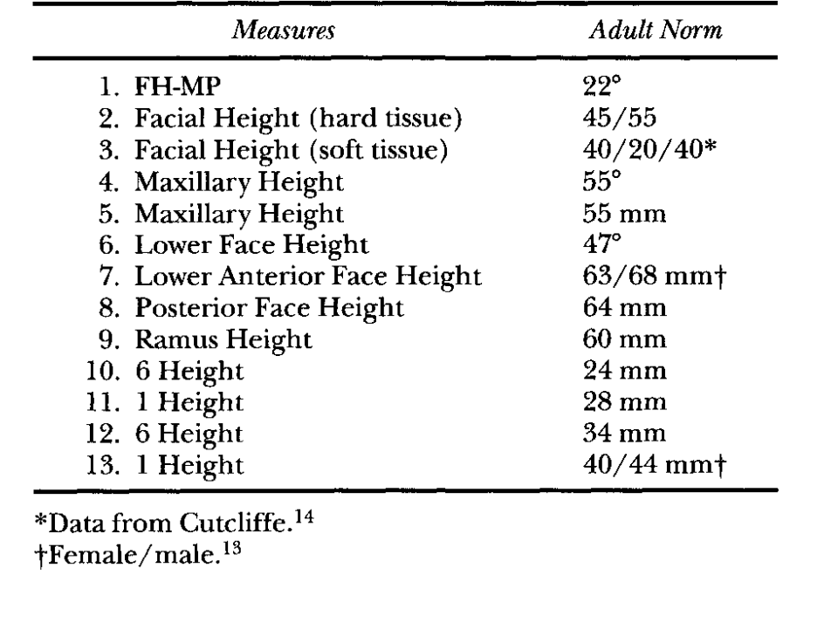
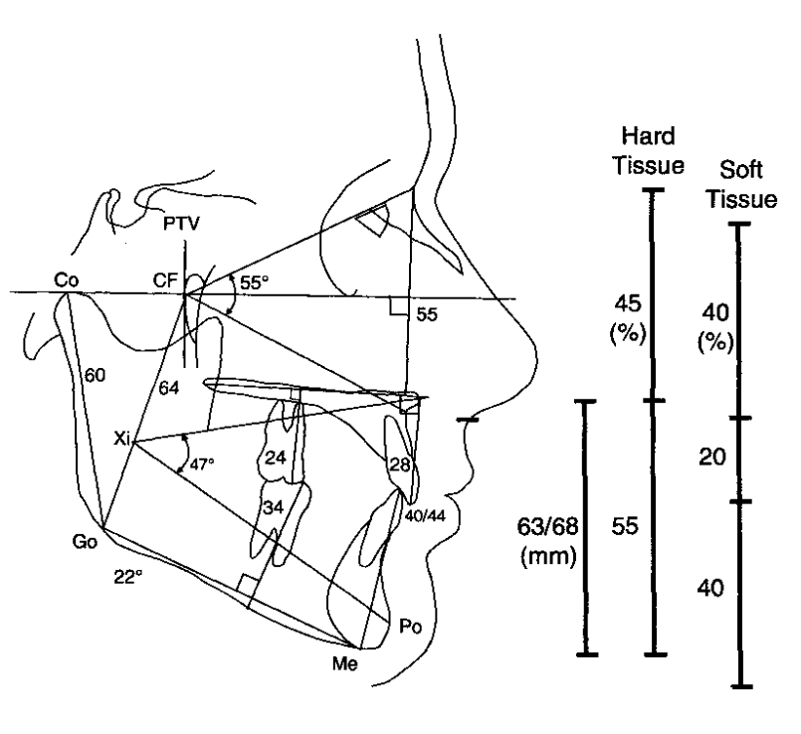
Vertical cephalometric analysis- Patrik K
…

Slide 35
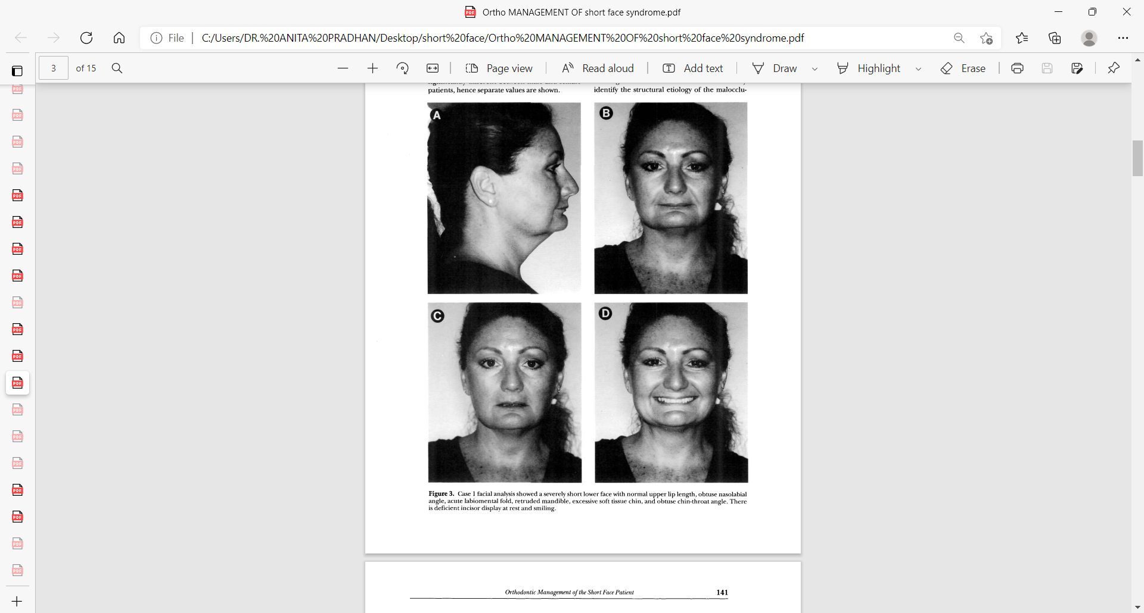
Facial Analysis
The SF patient can be found within each of Angle's anteroposterior classifications.
Features common to these patients include excessive overbite, deep curve of Spee, and thin and competent lips.
The most common malocclusion is the Class II with excessive overbite. commonly display normal upper lip length, an obtuse nasolabial angle, acute labiomental fold, a retruded mandible, but often an adequate or excessive soft tissue chin.
The chin-throat angle is usually obtuse.

Slide 36
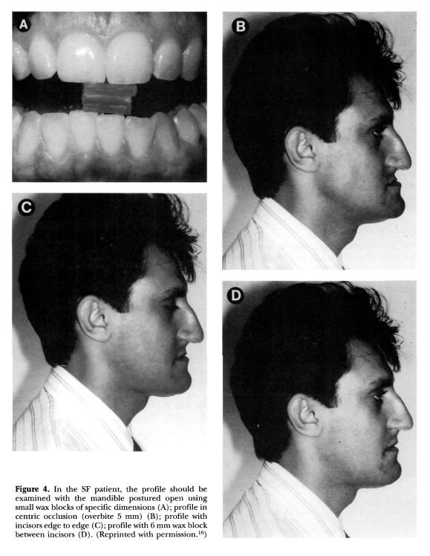
The Class III patient presents many opposite facial characteristics with a short upper lip, an acute nasolabial angle, obtuse labiomental fold, and prognathic appearing mandible.
The Class I patient will display a prominent chin with thin and competent lips. The vertical height of both anterior and posterior teeth is decreased. The maxillary and mandibular incisors are often upright exhibiting a bidentoalveolar retrusion.

Slide 37
Treatment
Orthodontic Therapy
Orthopaedic Therapy
Orthognathic Surgery

Slide 38
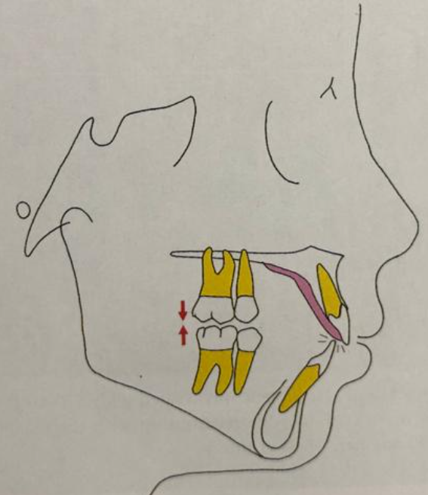
Orthodontic Therapy
Biteplates :
most popular appliances, it load the incisors for an intrusive effect but leave the posterior teeth free to erupt, thereby levelling COS.
Sleichter studied the vertical change in molar and incisors and found that the alveolar height in molar region increased while there was minimal change in incisal area.
Two types- removable and fixed.
The bite plate must be worn continually and also should be worn even after bite opening to maintain the increase in facial height and bite opening.

Slide 39
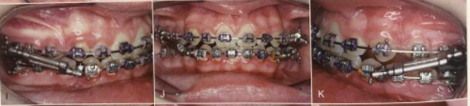
Functional Appliances:
For growing Class II patients, a functional appliance may be the most effective way to correct the sagittal relationships, as well as to allow for vertical development of the lower face.
Maxillary expansion may also be used to encourage vertical maxillary movement.
Class I SF patient often displays bimaxillary retrusion with vertically inclined incisors, protraction forces from a facemask can be directed at both arches to encourage anterior and vertical movement of the teeth, as well as downward movement of the maxilla.

Slide 40
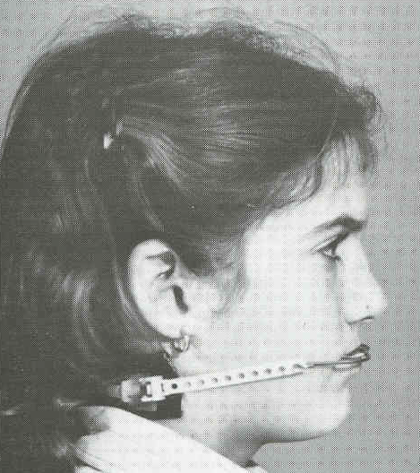
Cervical Headgear :
Cervical headgear to encourage maxillary posterior eruption during growth modification.
Cervical headgear produces an extraoral force in a posterior and inferior direction below the center of resistance of the teeth and the maxilla, resulting in dentoskeletal extrusion and an increase in lower facial height.

Slide 41
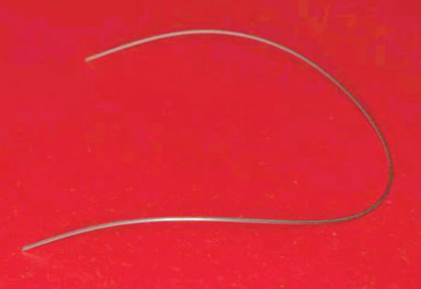
Eruptive wire mechanics designed to extrude the mandibular posterior segments. A reverse curve of Spee commonly is placed in the lower archwire to open the bite .
Intermaxillary Class II or Class III elastics can be use to correct short facial height.

Slide 42
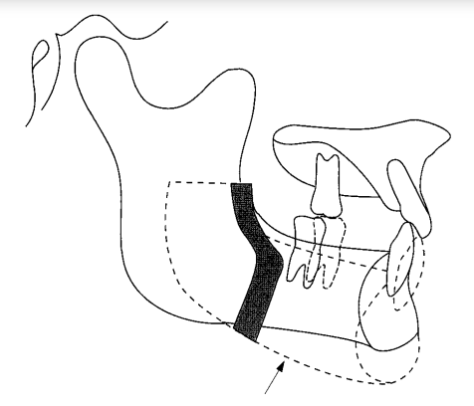
Surgical-Orthodontic Therapy
Most Class II SF patients can be treated adequately with a sagittal split osteotomy of the mandible with clockwise rotation of the distal segment.
A maximum increase in LFH is obtained by leaving the curve of Spee until after surgery when it is leveled by extruding the posterior teeth.
Any intrusion of the lower incisors before surgery, will therefore result in a shorter face height postsurgically.
The presurgical eruption of posterior teeth can be encouraged with the use of a bite plate, however, patients with bruxing or clenching habits may intrude or procline the lower incisors by functioning against the bite plate.
Although in one study a 44% relapse in facial height was observed, Witt in another study found a significant increase in lower facial height (mean value, 5.5 mm) with negligible (2%) relapse tendency.

Slide 43
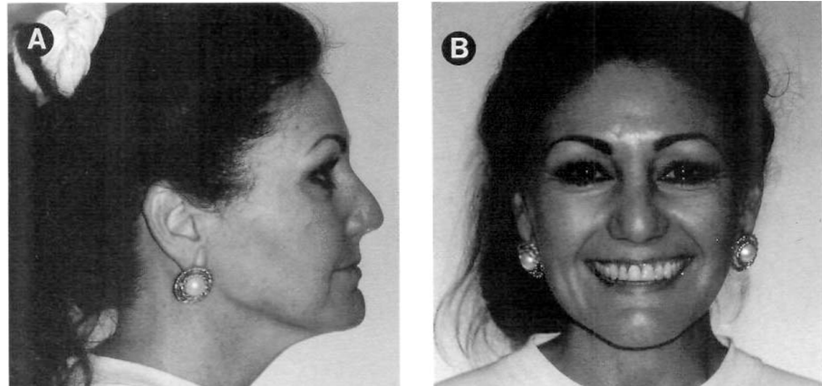
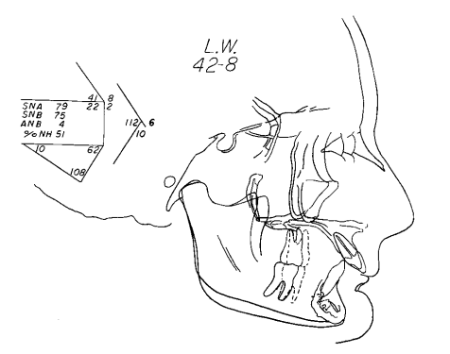
The Class II malocclusion with a severely short lower face may require surgery in both the mandible and maxilla; a mandibular osteotomy with clockwise advancement, and a LeFort I osteotomy to move the maxilla inferiorly. If chin height is shorter than normal (<40 mm) an interpositional genioplasty also can be performed to increase LFH.

Slide 44
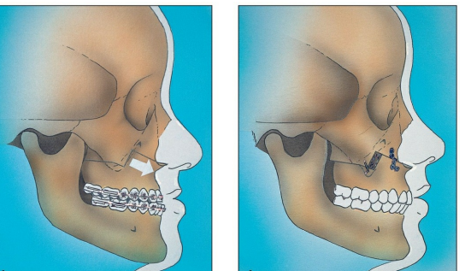
Patients with vertical maxillary deficiency as the structural etiology for the reduced facial height require downward repositioning of the maxilla.
Increasing facial height with the LeFort I osteotomy and the use of interpositional grafts, have resulted in more stable and predictable results.

Slide 45
Many Class III patients can be treated with a LeFort I osteotomy alone to move the maxilla down and forward.
Inferior repositioning of the maxilla rotates the mandible down and back into a more normal position often eliminating the need for mandibular surgery.
If the malocclusion is caused by both maxillary deficiency and mandibular excess, a mandibular osteotomy may also be required.
The Class I SF patient is treated similar to the Class III patient, with a LeFort I osteotomy to move the maxilla downward.

Slide 46
Conclusion
The short face syndrome SFS is a clinically recognizable facial type with reduced lower facial height as the common denominator.
Although correction of the malocclusion can often be accomplished with routine orthodontics, resolution of the short facial height is often inadequate.
With a more thorough facial and cephalometric examination in the vertical dimension, proper diagnosis and treatment planning of the SF patient is possible.
For adults seeking treatment, orthodontic/orthognathic surgical techniques enable the practitioner to adequately treat these difficult anomalies.

Slide 47
THANK YOU

