Slide 1
SKELETAL MATURITY INDICATOR

Slide 2
CONTENT
Introduction
Importance of pubertal/adolescent growth
Methods to assess skeletal maturity –
Radiological
Biochemical
conclusion

Slide 3
Introduction
Maturational status can have considerable influence on diagnosis, treatment goals, treatment planning, and the eventual outcome of orthodontic treatment.
Clinical decisions regarding the use of extra oral traction forces, functional appliances, extraction versus non-extraction treatment, or orthognathic surgeries are, at least partially, based on growth considerations.

Slide 4
Skeletal maturity assessment involves visual inspection of the developing bone and their initial appearance, sequential ossification, and related changes in shape and size.

Slide 5
Importance of Pubertal/Adolescent Growth Spurt
Every growth spurt has definite onset, accelerating phase, peak of the growth spurt, decelerating phase, end of the growth spurt.
The duration of this growth spurt is short in females around 3-4 years compared to males in which it extends 4-5 years.
The accelerating phase may last for 2 years on average.
After 3-4 years of the end of this growth spurt, the active growth ceases.

Slide 6
Methods to assess skeletal maturity
Radiological –
1. Special radiographs
2. Lateral cephalograms
3. Orthopantomogram (OPG)/intraoral periapical

Slide 7
Hand wrist radiographs
The most standardized method of skeletal assessment.
Assessment of skeletal maturation using hand wrist radiograph as an index based upon time and sequence of appearance of carpal bones and certain ossification events.
INDICATIONS –
Major discrepancy between dental and chronological age.
Determination of skeletal maturity status
To assess skeletal age in pt. whose growth is affected by infection, neoplastic condition.

Slide 8
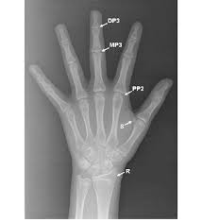
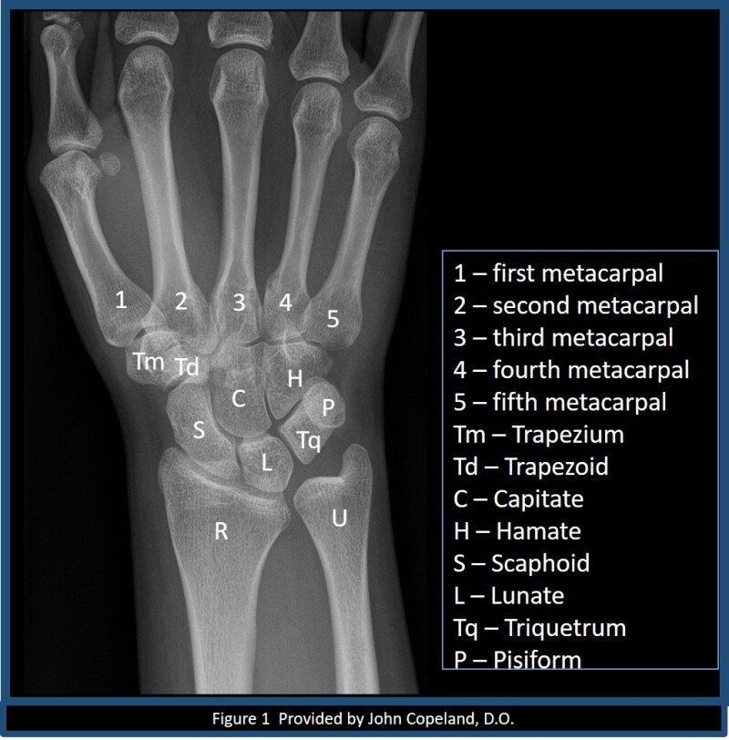
ANATOMY OF HAND WRIST RADIOGRAPH

Slide 9
Methods to assess skeletal maturity using hand wrist radiographs
Method by Greulich and Pyle.
Bjork, Grave and Brown Method modified by Schopf in 1978.
Fishman's skeletal maturity indicators.
Hδgg and Taranger Method.

Slide 10
Atlas Method by Greulich and Pyle
Stage 1: The epiphysis and diaphysis are equal (Sign convention '=').
Stage 2: The epiphysis caps the diaphysis by surrounding it like a cap (cap).
Stage 3: Fusion occurs between the epiphysis and diaphysis (U-Union).

Slide 11
Bjork Grave and Brown [1976]
They divide maturation process of bone of hand between ages 9 to 17 years into 9 stages.
Each stage represent level of skeletal maturity.
Total 14 ossification points were used
Stages-
Stage -1 (male 10.6y, female 8.1y) – epiphysis width = diaphysis width of proximal phalanx of index finger. Occurs 3yr before peak of pubertal growth spurt.

Slide 12
stage-2(male 12y, female 8.1y) – epiphysis = diaphysis, occurs prior to the beginning of the pubertal growth spurt.
Stage -3(male 12.6y, female 9.6y) – characterized by three areas of ossification:
ossification of hamate, pisiform and epiphysis and diaphysis of radius are equal.

Slide 13
Stage – 4(male 13y, female 10.6y) – marks the beginning of pubertal growth spurt.
Initial mineralization of ulnar sesamoid
Increased ossification of hamular process.
Stage -5(male 14y, female 11y)
Occurs at the peak of pubertal growth spurt
Capping of diaphysis by the epiphysis seen in; MP3, PP of thumb and radius.

Slide 14
Stage-6 (male 15y, female 13y) –
Union of epiphysis and diaphysis of DP of middle finger.
Signifies the end of pubertal growth spurt.
Stage –7 (male 15.9y, female 13.3y) –
Union of epiphysis and diaphysis of PP of the little finger.
Seen after a year of growth spurt.

Slide 15
Stage – 8(male15.9y, female 13.9y)
Fusion between epiphysis and diaphysis of MP3.
Stage – 9(male 18.5y, female 16y)
Fusion of diaphysis and epiphysis at radius.
Signifies the end of skeletal growth.

Slide 16
FISHMAN’S SKELETAL MATURITY INDICATORS
Leonard S. Fishman in 1982 proposed a system for evaluation of skeletal maturation.
It uses anatomical sites located on thumb, third finger, fifth finger, and radius.
Uses four stages of bone maturation –
epiphysis equal in width to diaphysis
Appearance of adductor sesamoid of thumb
Capping of epiphysis
Fusion of epiphysis

Slide 17
S.M.I.1 – PP3
Third finger shows equal width of epiphysis with diaphysis.
S.M.I.2- MP3
Epiphysis width = diaphysis in middle phalanx of third finger.
Appears during onset of pubertal growth spurt.

Slide 18
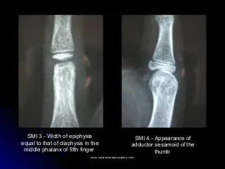
S.M.I.3 – MP5
Epiphysis width = diaphysis in middle phalanx of fifth finger.

Slide 19
S.M.I.4 –
Appearance of adductor sesamoid of thumb.
Become visible during rapid growth growth period.
S.M.I.5 –DP3cap
Capping of epiphysis over diaphysis in distal phalanx of third finger.
Peak height velocity.

Slide 20


S.M.I.6 – MP3cap
Capping of epiphysis over diaphysis in middle phalanx of third finger.
Become visible during very rapid growth period.
S.M.I.7- MP5cap
Capping of epiphysis over diaphysis in middle phalanx of fifth finger.
Peak of growth

Slide 21

S.M.I.8 – DP3U
Fusion of epiphysis over diaphysis in distal phalanx of third finger.
Time interval of decelerating growth rate.
S.M.I.9 -PP3
Fusion of epiphysis over diaphysis in proximal phalanx of third finger.

Slide 22
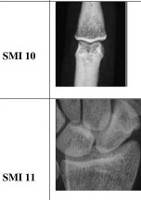
S.M.I.10 – MP3u
Fusion of epiphysis and diaphysis in middle phalanx of third finger
Time of decelerating growth rate.
S.M.I.11 – RU
Fusion of epiphysis and diaphysis in radius.
Growth completed.

Slide 23
SKELATAL MATURATION EVALUATION USING CERVICAL VERTEBRAE
Developed by Hassel and Farman.
The shape of cervical vertebrae were seen to differ at each level of skeletal development.
The following six stages were put forward in vertebral development;

Slide 24
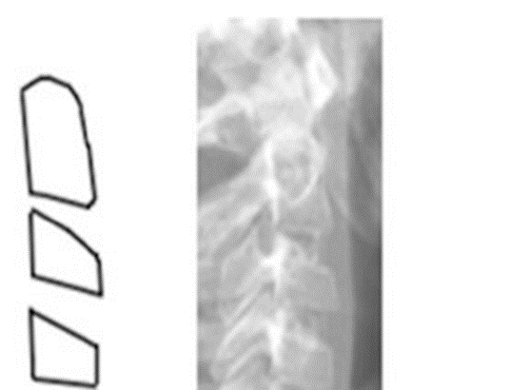
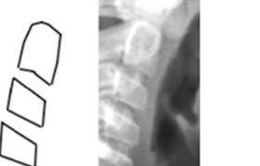
STAGE 1 OR INITIATION STAGE –
Flat inferior border of C2, C3 and C4.
Wedge shaped vertebrae, tapered superior border from posterior to anterior.
STAGE 2 OR ACCELERATION STAGE –
Concavities developing in the inferior border of C2 and C3.
Flat inferior border of C4.
Bodies of C3 and C4 were nearly rectangular.

Slide 25
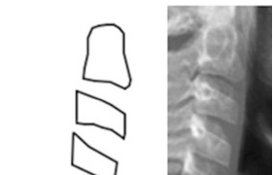
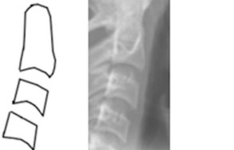
STAGE 3 OR TRANSITION STAGE –
distinct concavities seen in inferior border of C2 and C3.
Concavity begin to develop in the inferior border of C4.
The bodies of C3 and C4 were rectangular in shape.
STAGE 4 OR DECELERATION STAGE –
Distinct concavities seen in the inferior borders of C2, C3 and C4.
C3 and C4 bodies become more square in shape.

Slide 26
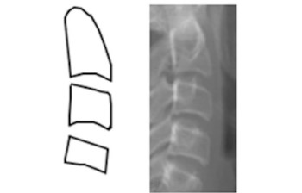
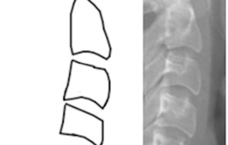
STAGE 5 OR MATURATION STAGE –
More accentuated concavities seen in the inferior border of C2, C3 and C4.
Bodies of C3 and C4 were nearly square in shape.
STAGE 6 OR COMPLETION –
deep concavities in the inferior borders of C2,C3 and C4.
The bodies of C3 and C4 become square in shape

Slide 27
INTRAORAL RADIOGRAPHS AND OPG
Dental maturity can be determined by stages of tooth eruption .
Tooth formation is proposed as more reliable criteria for determining dental maturation.
Demerjian developed a method for estimating dental maturity or dental age using panoramic radiographs.

Slide 28
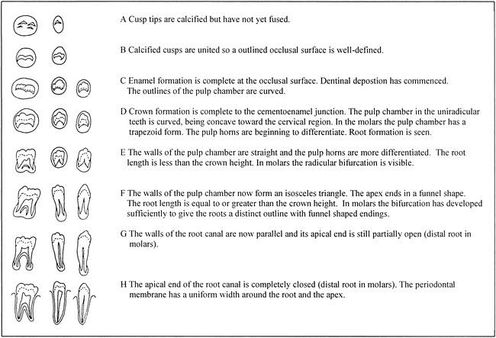
DEMERJIAN’S STAGES OF DENTAL CALCIFICATION (1973)

Slide 29
Biochemical
Recent biochemical method in saliva and serum are the –
A. Insulin-like growth factor (IGF) growth hormone (GH),
B. Osteocalcin
C. Alkaline phosphatase (ALP).

Slide 30
GH AND IGF-1
GH receptors in the mandibular condyle have both direct and indirect effects on tissues with indirect effects mediated by insulin-like growth factor-I (IGF-1), generated in the liver in response to GH.
At puberty, amplitude of GH release (pulsatile pattern) increases, After puberty, GH secretion decreases with age.
Maximum GH concentrations are reached in early puberty in girls and late puberty in boys.
Serum IGF-1 levels tend to peak whenever there is accelerated growth in the body whether during pubertal growth spurt, adrenarche, residual mandibular growth, condylar hyperplasia, or tumorous growth occurring in the body.
Rise in IGF-I causes longitudinal bone growth in the condyle with no effect on their histologic pattern.

Slide 31
Alkaline Phosphatase
As ALP is a marker for osteoblastic activity, its levels are higher at the time of growth as compared to the levels after the growth cessation.
Increases up to age of 14 years in boys and 11 years in girls and rapid falls after that in both sexes to reach adult levels by 20 years in boys and 18 years in girls.

Slide 32
Osteocalcin
Also known as bone γ-carboxyglutamic acid (Gla) protein, is Vitamin K-dependent protein of the bone.
It is produced by osteoblasts, odontoblasts, and hypertrophic chondrocytes and binds to hydroxyapatite.
According to Kirmani et al., serum osteocalcin increased early in puberty and peaked at 14 years of age but declined after the age of 14 years.
Osteocalcin is a potential biomarker, which can predict growth status.

Slide 33
APPLICATION TO DENTOFACIAL ORTHOPAEDICS
Class II treatment is most affective when it includes in the peak in mandibular growth. (stage 3)
Class III treatment with maxillary expansion and protraction is effective when performed before the peak( stage1 and 2).
Skeletal effect of rapid maxillary expansion for the correction of transverse maxillary deficiencies are greater at pubertal stages. (stage 1- 3).

Slide 34
CONCLUSION
Skeletal maturity indictaors can be used as an secondary diagnostic tool for orthodontic treatment.

