Slide 1
CLASS III MALOCCLUSION

Slide 2
CONTENTS
INTRODUCTION
DEFINITION
PREVALENCE
CLASSIFICATION
ETIOLOGY
FEATURES
DIFEERENTIAL DIAGNOSIS
GROWTH TREND AND ASSESSMENT
GTRV

Slide 3
INTRODUCTION
The father of modern orthodontics, Edward Hartley Angle, in 1899 classified malocclusions in Class I, Class II, and Class III based on permanent first maxillary and mandibular molars relationship and alignment (or lack of it) of teeth with reference to the line of occlusion.
Class III malocclusion can be defined as skeletofacial deformity characterized by a forward mandibular position with respect to the cranial base and for maxilla.
The facial dysplasia can be classified into mandibular prognathism, maxillary retrognathism or combination of both depending variation of the anteroposterior jaw relation.

Slide 4
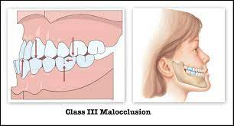
DEFINITION
In terms of angle classification, a class III malocclusion is one in which mesiobuccal cusp of maxillary 1st permanent molar occlude the interdental space between mandibular 1st and 2nd molar .
According to the British Standard Institute (BSI), the class III incisor relationship is defined as one in which the lower incisor edge lies anterior to the cingulum plateau of the upper incisors, with reduced or reversed overjet.

Slide 5
Angle’ s Classification
1.True or skeletal class III
mandibular hypertrophy
Marked shortening of midface
Combination
2. Pseudo or functional or postural class III
▪ Occlusal prematurities
▪ Premature loss of deciduous posteriors
▪ Enlarged adenoids
3. Class III , Subdivision
▪ Class III on one side and class I on other a

Slide 6
Dewey’s modification of Class III

Slide 7
Tweed’s Classification
Skeletal Class III
Large mandible
Normal maxilla
Pseudo Class III
Normal mandible
Underdeveloped maxilla

Slide 8
PREVALENCE
Notes:
The prevalence of angle class III malocclusion varies greatly among and within populations (from 1% to more than 10%).
The incidence of Caucasians ranges between 1% and 4%. In Swedish children about 4.2%.
In African American the frequency of Class III between 5 - 8%.
In Asian society the frequency of Class III malocclusion is higher because of a large percentage of patients with maxillary deficiency The incidence is 4-13% among Japanese and4-13% among Japanese and 4-14% of Chinese.

Slide 9
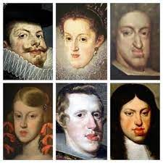
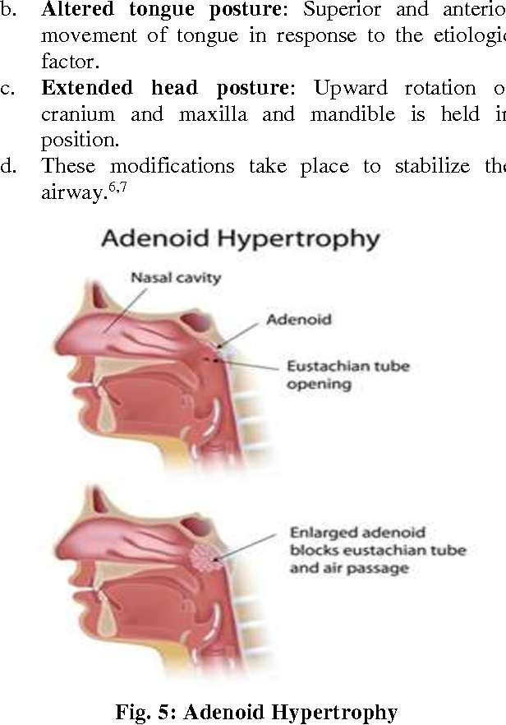
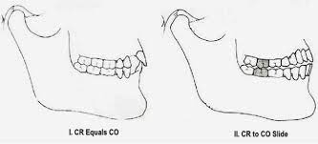
ETIOLOGY OF CLASS III MALOCCLUSION
Genetic factors
Ethnicity
Environ-mental factor
Habitual posture
ETIOLOGY OF CLASS III MALOCCLUSION
Notes:
The most well-known example of inheritance is that of the Hapsburg royal family. The distinctive characteristics of this family included a prognathic lower jaw and hence a class III malocclusion. Out of the forty members of the family for whom records were available, thirtythree showed prognathic mandible and consequently a class III malocclusion
These include the ectopic eruption of the maxillary central incisor, enlarged tonsils, difficulty with nasal breathing, congenital anatomic defects, diseases of the pituitary gland

Slide 10
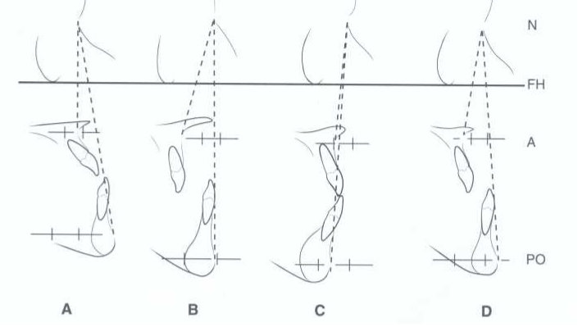
4. combination of retrognathic and/or micrognathic maxilla with prognathic and/or macrognathic mandible
1. prognathic and/or macrognathic mandible with a normal maxilla both in position and in size
2. retrognathic and/or micrognathic maxilla with a normal mandible both in position and in size
3. normal skeletal jaw relationship with reverse overjet in the presence of centric relation (CR)–centric occlusion (CO) discrepancy(“pseudo” Class III relationship.)
Skeletal Class III malocclusions can be a result of various factors:

Slide 11
FEATURES OF CLASS III MALOCCLUSION

Slide 12
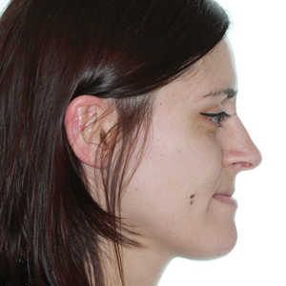
A- Sagittal dimension
Mandibular vs maxillary contribution
concave facial profile
maxillary retrusion
mandibular protrusion
combination of both problems
Notes:
Class III patients usually have a

Slide 13
McNamara ----
Staudt & Killaridis (2009) ---
Notes:
(either in position or size)

Slide 14
Baccetti, Reyes and McNamara studied gender differences among class III patients
Proff et al. found that mandibular length relative to anterior cranial base is increased in patients with class III skeletal growth patterns, while maxillary length is not consistently affected in those patients
Males subjects with class III malocclusion
significantly smaller linear dimensions in terms of the maxilla, mandible, and anterior facial heights
Comparitively larger linear dimensions in terms of the maxilla, mandible, and anterior facial heights
Female subjects with class III malocclusion

Slide 15
B-Transverse dimension
• Author : Chen et al.
Study : development of the dental arches and the skeletal mandibular- maxillary bases in untreated subjects with class III malocclusions as compared with a class I control group.
Parameters : maxillary skeletal base width,
biantegonial widths, and
maxillary and mandibular inter-molar widths from cephalometric radiographs at annual intervals
AGE Group : between the ages of 10 and 14 years.

Slide 16
Inference:
the maxillary skeletal base widths were statistically significantly smaller in the class III than in the class I group, while there were no statistically significant differences in biantegonial widths.
However, the maxillary inter-molar widths were smaller in the class III group as compared with the class I group (statistically significant at all ages).
The mandibular inter-molar widths showed no significant differences between the examined groups

Slide 17
C- Vertical dimension
Staudt and Kiliaridis---
class III patients have more hyperdivergent vertical dimensions, with increased lower anterior facial heights
Baccetti et al. ---
increases in the vertical facial dimensions in class III subjects occurred not only at the pubertal growth spurt but also at late developmental stages
Notes:
pubertal growth spurt (corresponding with the eruption of the canines and premolars)
at late developmental stages (corresponding with the complete eruption of the second and third molars)

Slide 18
D- Dental features
In skeletal class III patients, the teeth tend to compensate for the sagittal skeletal discrepancy between both arches

Slide 19
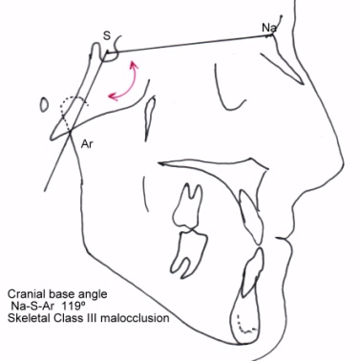
Other common features
Common skeletal features such as
shortened anterior (N-S) and posterior cranial base (S-Ar/Ba),
reduced saddle angle (N-S-Ar), and
an increased gonial angle (Ar-Go-Gn) were identified to lead to a more forward positioning of the glenoid fossa resulting in Class III malocclusion.
Dental features of Class III individuals include
Class III molar and canine relationship,
maxillary incisors protrusion and
mandibular incisors retrusion with edge-to-edge bite or anterior crossbite.

Slide 20
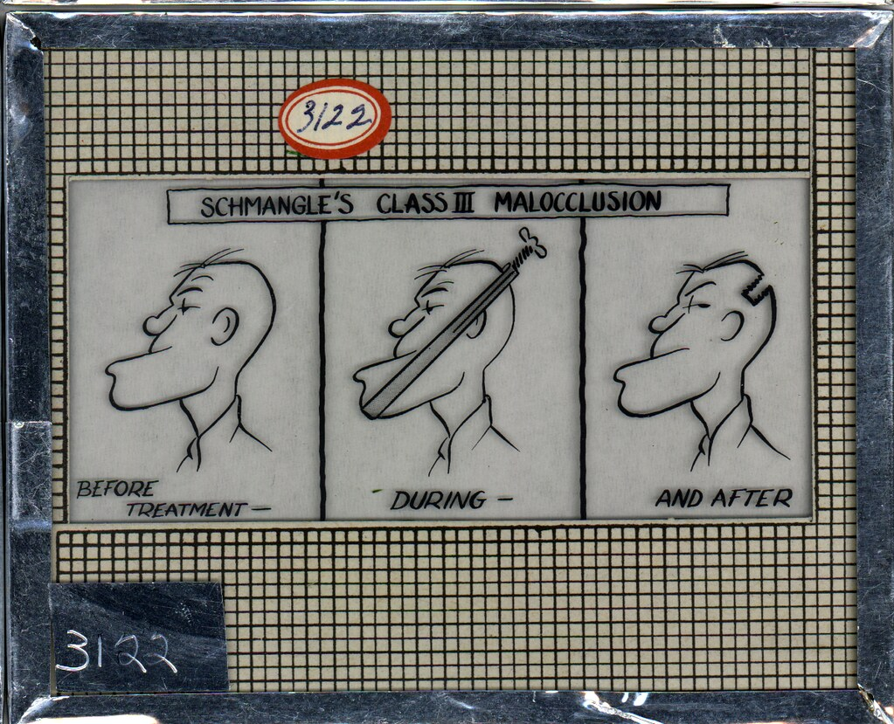
Differential diagnosis of Class III malocclusion

Slide 21
--Differential diagnosis of Class III malocclusions and anterior crossbite in a step by step approach has been presented here based on the work of authors Ngan et al, Battagel, and Turley.
--These include:
A. History of the mandibular prognathism or anterior crossbite
B. Dental And Functional Assessment
C. Profile Assessment
D. Cephalometric Assessment
Notes:
The specter of problems of Class III malocclusion ranges in gravity from dentoalveolar problems with functional anterior shift of the mandible to true skeletal problems with serious maxillomandibular discrepancies, which leads to its highly challenging diagnosis.

Slide 22
A. History of the mandibular prognathism (or anterior crossbite)
The first question that should be asked to the patient or par- ents (caregiver) should concern mandibular prognathism or anterior crossbite in the family and close relatives.
A history of it indicates a genetic cause of Class III malocclusion.

Slide 23
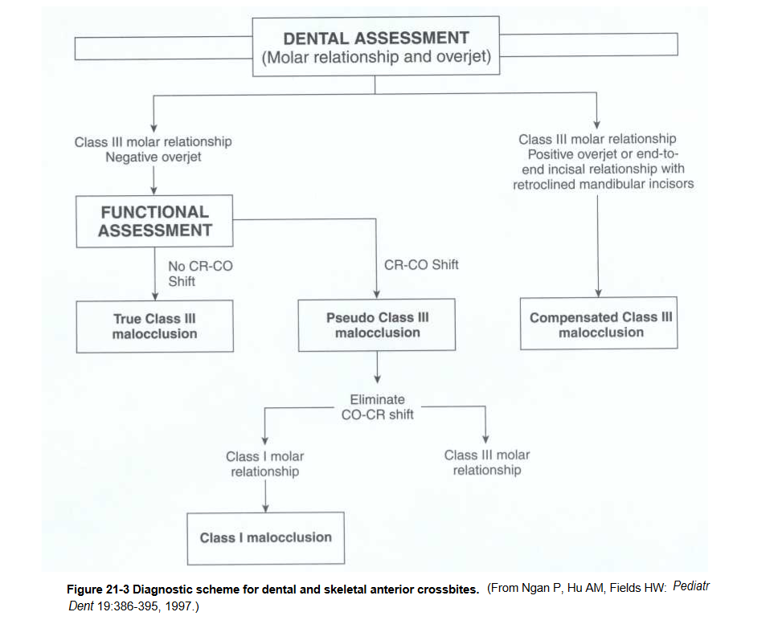
B. Dental And Functional Assessment

Slide 24
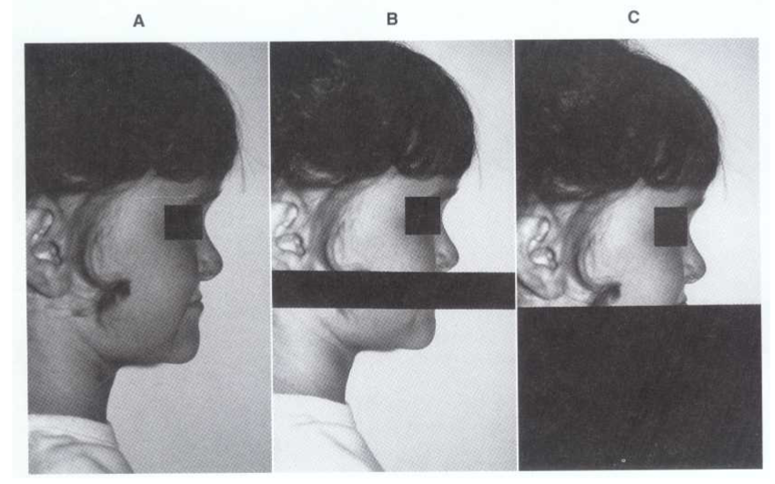
C. Profile Assessment
Notes:
A profile evaluation involves an analysis of the facial proportions , chin position, Mid facial position, and vertical proportion.
A– is overall profile convex , concave or straight. Pt with max def usually have concave profile, flattening of infraorbital rims and areas adjacent to nose
B—block upper and lower lip, evaluate chin position in reference to nose , upper face and forehead. Chin shou

Slide 25
Best analyses for cephalometric assessment of Class III malocclusion are those that correlate the maxilla to the mandible and each of them to the anterior cranial base.
These are
ANB (2°),
Wits (0 mm),
maxillomandibular differential (23 mm for 12 years old),
nasion perpendicular to point A (+2.3 mm),
nasion perpendicular pogonion (0 mm).
D. Cephalometric Assessment

Slide 26
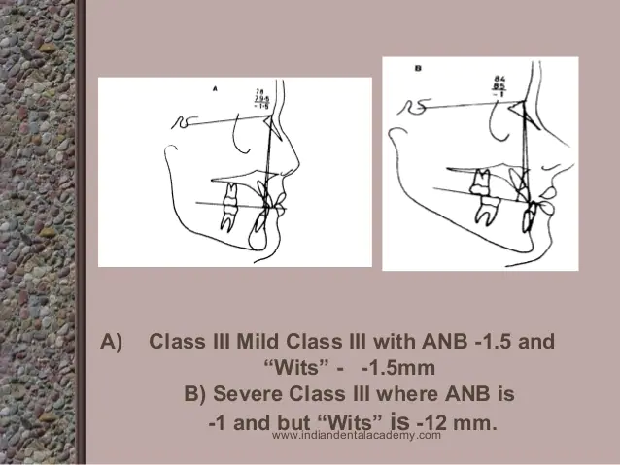
-It has been found in discriminant analysis that “Wits” appraisal is the most important factor in the decision making from orthodontic camouflage treatment to surgical options.
-A “Wits” appraisal from 0 to −5 mm ---- Class III problem
being resolved by means of orthodontic camouflage treatment
with facemask or chin cup therapy.
-A “Wits” appraisal between −4 and −12 mm requires
further growth treatment response vector (GTRV) analysis
using serial cephalometric radiographs before a decision
can be made of whether to camouflage or wait for
comprehensive growth before surgical treatment.

Slide 27
Growth trends of Class III malocclusion

Slide 28
For effective treatment planning and realistic prediction of stability of treatment outcomes in Class III growing patients, knowledge of growth trends is of paramount importance.
The prognosis of orthopedic treatment for skeletal Class III malocclusion is favorable when treatment is administered before the pubertal growth peak.

Slide 29
However, a Class III malocclusion may worsen due to growth if a patient is left untreated.
Therefore, early treatment is recommended for skeletal Class III malocclusion to obtain a balanced skeletal relationship and, by doing this, there is a possibility to minimize the need of further future complicated treatment such as orthognathic surgery.
Studies have suggested that the posttreatment outcome of orthopedic treatment may not be stable depending on the residual growth.

Slide 30
When unfavorable growth is expected, treatment would not be initiated in the early phase or would be delayed until completion of growth, because a discrepancy between maxillary, mandibular, and skeletal base growth during the pubertal phase can result in relapse of the corrections and patients ultimately may require orthognathic surgery at a later stage.
This may be prevented if accurate prediction of the eventual prognosis of early orthopedic treatment for skeletal Class III malocclusion would have been possible before commencing and executing treatment.

Slide 31
Turpin in his editorial published in the American Journal of Orthodontics and Dentofacial Orthopaedics has emphasized that a deep understanding of the individual patient’s growth weighs much more than the treatment timing and treatment mechanics used on a specific Class III malocclusion growing patient whose timing of treatment is considered to be controversial.

Slide 32
In essence, he summarized the studies of Mitani et al on Class III growth assessment over the years, as “the basic pattern of mandibular prognathism is established before puberty and does not change fundamentally.
However, their total growth increments were about the same as those with a normal mandible after the pubertal growth peak.”

Slide 33
Turpin developed a list of positive and negative factors that helped decision making on developing Class III malocclusions and these guidelines were reviewed by Campbell for deciding when to intercept Class III malocclusion.
He suggested that :
early interceptive treatment of Class III malocclusion should be considered for patients who presented with positive characteristics.
individuals with negative characteristics should delay treatment until the completion of growth.
patients should be warned that surgery may be needed in future, even after an early successful interceptive treatment.

Slide 34
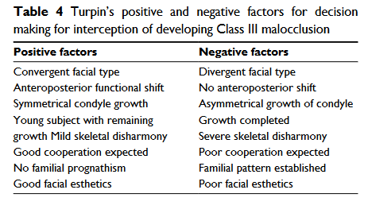

Slide 35
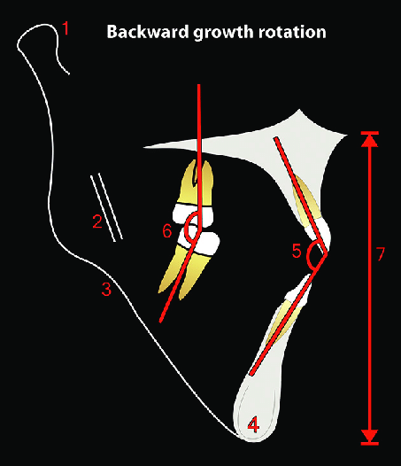
Björk, based on single cephalogram analysis, defined seven structural signs of extreme growth rotation of mandible in the early developmental stage.
These seven signs are
the inclination of the condylar head,
curvature of the mandibular canal,
shape of the lower border of the mandible,
width of the symphysis,
interincisal angle,
intermolar angle, and
anterior lower face height.

Slide 36
Even though seven structural signs of growth rotation have been reported, growth prediction of the mandible still remains a challenge, probably because mandibular growth shows wide variations in terms of amount, direction, and time or because the prediction procedure is based on individual reasoning.
The GTRV analysis as suggested by Ngan is helpful to the clinicians to assess the growth of the mandible to predict the prognosis after early interceptive orthopedic treatment of Class III malocclusion.

Slide 37
GTRV
(Growth Treatment Response Vector)

Slide 38
According to Ngan,
“the horizontal growth changes of the maxilla and mandible are determined by locating the A and B points on the posttreatment lateral cephalometric radiograph.
Another cephalogram was taken during 2–4 years of follow-up visits after the treatment of Class III malocclusion with facemask therapy.”
The incisal tip of maxillary incisor and mesiobuccal cusp tip of maxillary molar are used as a landmark to construct the occlusal plane (O).
Point A and point B should be marked on the lateral cephalogram and connecting points A and B perpendicular to the occlusal plane would construct the lines AO and BO.

Slide 39
Using stable landmarks on the midsagittal cranial structure, the nasion (N), and sella turcica (S), post-facemask treatment tracing (first tracing) is superimposed on the follow-up radiograph and the lines AO and BO are again constructed on the follow-up radiograph on the occlusal plane of the first tracing.
The distance between the A points and point B of the two tracings along the occlusal plane represents the growth changes of the maxilla and mandible, respectively
After the measurements are completed, the GTRV ratio for each is determined.

Slide 40
GTRV = horizontal growth changes of the maxilla
horizontal growth changes of the mandible
GTRV is defined as “the horizontal growth changes at A point divided by the horizontal growth changes at B point on the post-facemask and follow-up lateral cephalogram.”
---For an individual with the age range of 6–16 and with normal growth pattern, the GTRV ratio is 0.77.
---In studies by Ngan and Youssef et al, in patients treated with early interceptive orthopedic treatment, the GTRV ratios were significantly different for successful cases and unsuccessful cases.
Notes:
This suggests that the horizontal growth of mandible exceeds 23% as compared to the maxilla to maintain a normal skeletal relationship.

Slide 41
For successful cases, GTRV was in the range of 0.33–0.88 (mean 0.45) and for unsuccessful cases it was in the range of 0.06–0.38 (mean 0.22).
Notes:
This suggests that subjects with mild to moderate Class III malocclusion can be camouflaged orthodontically after successful early interceptive treatment, if the GTRV ratio ranges between 0.33 and 0.88.
Class III patients with a GTRV ratio between 0.33 and 0.38 can be considered as borderline cases which can either be treated successfully with facemask or turn out to be surgical cases at the end and would better be warned of future need for surgical intervention, if the GTRV ratio is <0.38.
Hence

Slide 42
Thank you

Slide 43
MANAGEMENT OF CLASS III MALOCCLUSION
Presented by
DR. SWATIKA SANKRIT PG II YEAR

Slide 44
CONTENTS
-Class III treatment modalities
-Dentoalveolar corrections
.Removable appliance
.Fixed appliance
-Skeletal corrections with orthopedic appliances
.orthopedic face mask
.protraction with skeletal anchorage
.class III elastics to maxillary and mandibular miniplates
.chin cup
-Skeletal corrections with functional appliances
.frankel III
.reverse twin block
.bionator
-Camouflage treatment
-Orthognathic surgery

Slide 45
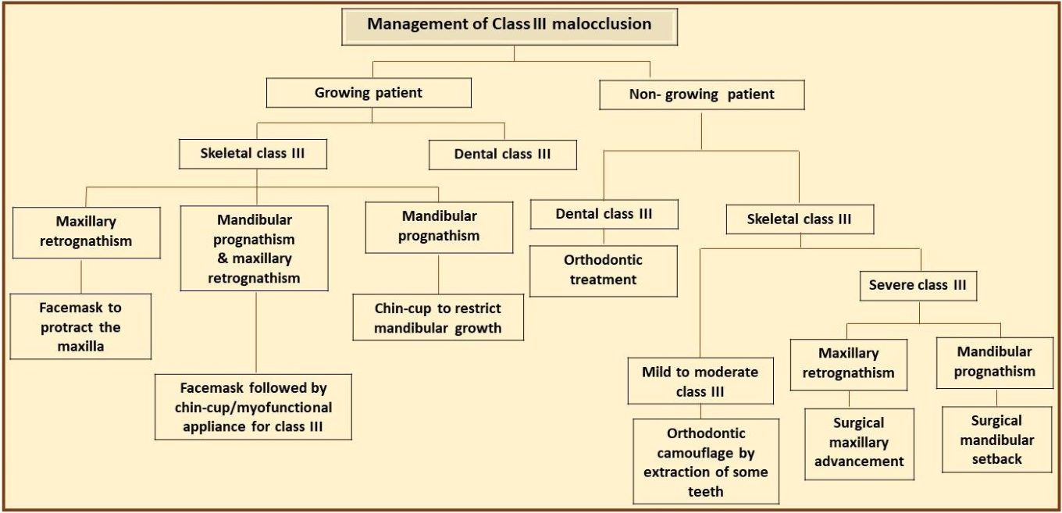

Slide 46
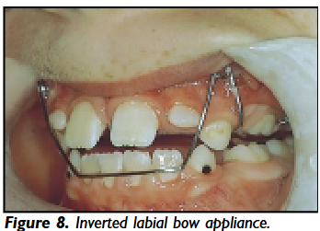
Grant McIntyre(2004) – Dental update
Notes:
Deciduous Dentition- no intervention
Early mixd-pmc – incisors-wear facets in long term- procline incisor using Ura(z spring or ant bite plane)

Slide 47
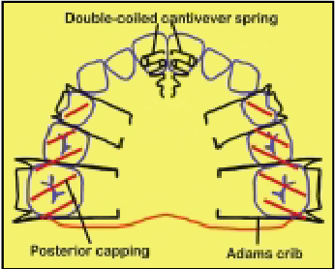
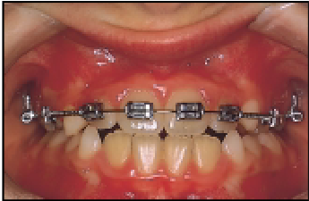

Slide 48
Edlira Zereet al (2018)
Clinical, Cosmetic and Investigational Dentistry
Notes:
The proper timing of interventions may therefore rely on chronological age and phases of dentition for very young patients, and on other radiological indicators, such as cervical vertebral maturation and/or hand and wrist maturation methods for older children.

Slide 49
In mixed dentition from the treatment point of view, there are effectively three types of Class III malocclusions:
dental
incorrect inclination or position of maxillary or mandibular incisors
dental
anterior positioning of the mandible as a result of premature dental contacts
skeletal
true skeletal discrepancies in the maxilla and/or mandible

Slide 50
Treatment of simple dentoalveolar anterior crossbites
Types and indications of both types of appliances are provided below
1. Removable appliances: there are three types of removable appliances used to intercept the developing crossbite:
• inclined plane; • modified inclined plane; • active Hawley appliance.
2. Fixed appliance: • 2 by 4 appliance
Notes:
The percentage of success is increased if there is a minimal existing proclination of the upper incisors and adequate overbite to maintain correction at the end of treatment.

Slide 51
Inclined plane
Notes:
It is indicated in patients with:
1.retroclined maxillary anterior teeth with an anterior crossbite with or without functional shift; 2. well-aligned mandibular anterior teeth without proclination; 3. normal to deep overbite; 4. average to horizontal growth pattern patients.
Angulation : 45degree
corrected within 3–4 weeks

Slide 52
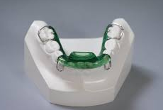
Modified Inclined Plane
Notes:
; indicated in patients with an anterior dental crossbite with lingually inclined maxillary incisors and labially inclined mandibular incisors.
for this reason, an inclined plane is contraindicated because it may cause mandibular incisors proclination
.

Slide 53
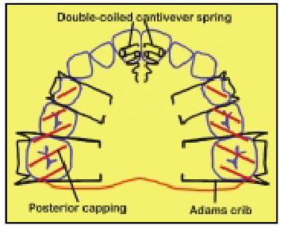
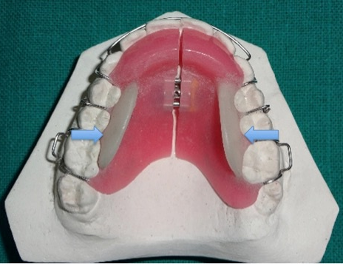
Active Hawley appliance
Notes:
indicated in patients with anterior crossbite in mixed dentition stage.
This appliance has an active component anteriorly to procline the upper anterior tooth or teeth to correct the anterior crossbite.
This active component can either be a palatal “Z” spring, or a screw, The turning of the screw by a quarter turn (90°) brings about 0.18 mm of linear movement depending upon the pitch of the screw. Correction of 2 mm of overjet with this appliance can be achieved in 5–6 weeks.

Slide 54
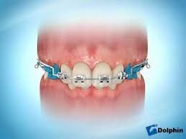
Fixed appliance
Notes:
as it is only bonded on the two upper first permanent molars and the four upper incisors or six anterior teeth.
This appliance is often referred to as a “2 by 4” or “2 by 6” appliance Fixed appliances Mostly use late mixed dentition or early permanent dentition.
An open coil NiTi spring often compressed between the molars and the incisors to procline the incisors or a 0.016-inch stainless steel stoppered arch wire may be used to increase the arch length.
Fixed appliances allow tipping, bodily movement, and correction of rotations as and when required

Slide 55
The Orthopedic Facial Mask

Slide 56
Of the three mixed dentition treatment strategies discussed earlier, the orthopedic Face mask has the widest application and produces the most dramatic results in the shortest period of time.
given in the early mixed dentition or late deciduous dentition (eruption of the permanent maxillary central incisors).
the appliance system affects virtually all areas contributing to a Class III malocclusion (e.g., maxillary skeletal retrusion, maxillary dentoalveolar retrusion, mandibular prognathism, decreased lower anterior facial height) by manipulating force vectors

Slide 57
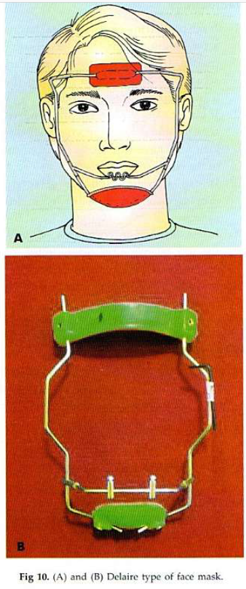
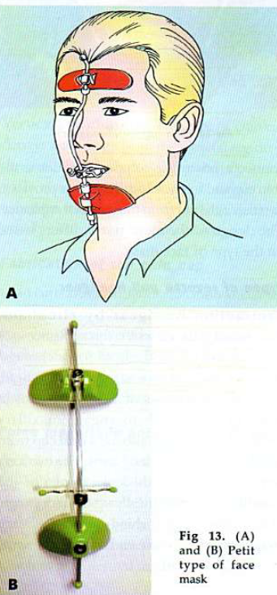
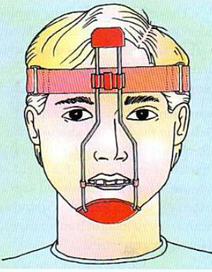
Notes:
Hickman type

Slide 58
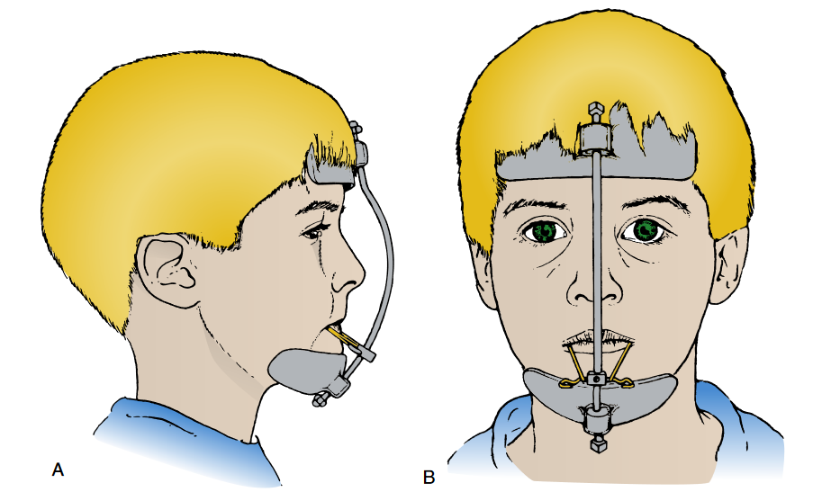
Notes:
The orthopedic FM system has three basic components: the FM, a bonded maxillary splint, and elastics. The FM (see Fig.16-47) is an extraoral device that has been modified by Petit 106and now is available in various forms commercially. It can also be custom designed as discussed in Chapter 15. In essence,the FM is composed of a forehead pad and a chin pad that areconnected by a heavy steel support rod. To this support rod is connected a crossbow to which are attached rubber bands to produce a forward and downward elastic traction on the max - illa. The position of the pads and crossbow can be adjusted sim- ply by loosening and tightening set screws within each part of the appliance.

Slide 59
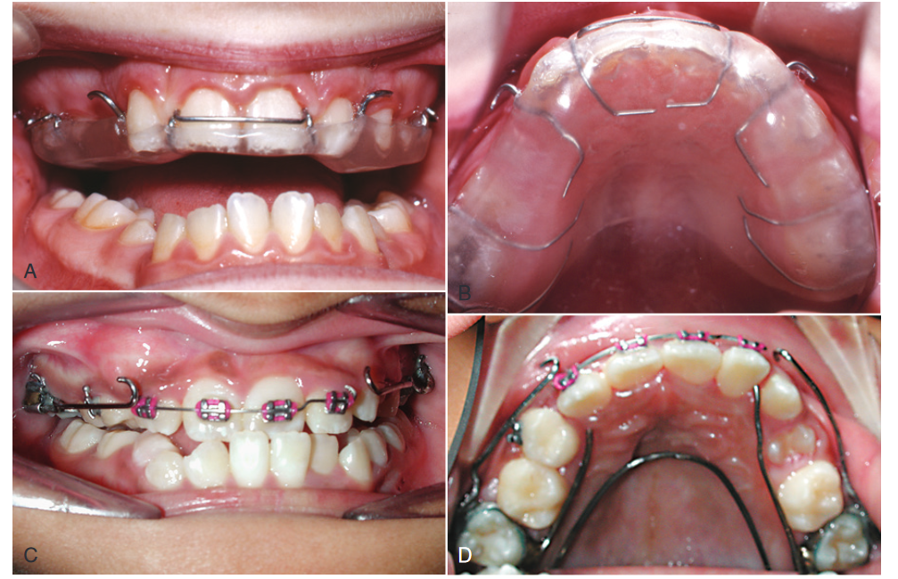
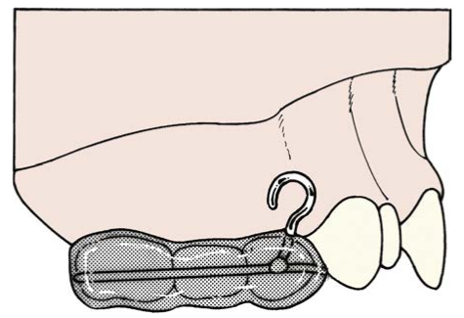
Notes:
intraoral devices both fixed and removable,
preference to use a bonded maxillary expansion appliance
The major modification in the splint design is the addition of FM hooks in the region of the maxillary deciduous first molar

Slide 60
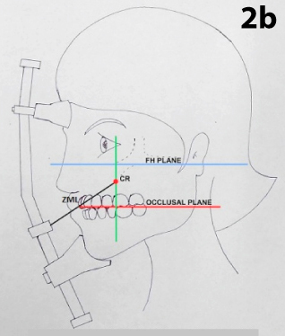

Slide 61
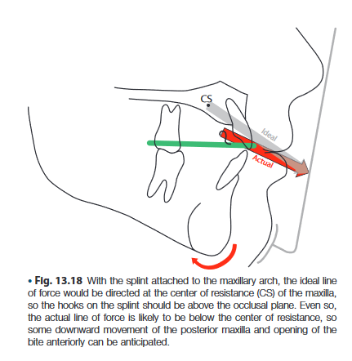
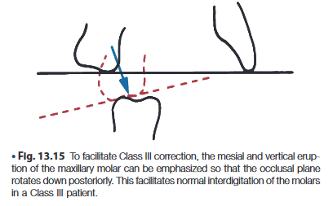
It appears that the FM can produce one or more of the following treatment effects:
1. Correction of CO-CR shift (pseudo–Class III patients) 2. Maxillary skeletal protraction, (1 to 2 mm) 3. Forward movement of the maxillary dentition
4. Lingual tipping of the lower incisors
5. Redirection of mandibular growth
Notes:
Correction of a discrepancy between centric occlusion and centric relation, a shift in occlusal relationship that is immediate and is associated with pseudo–Class III patients, especiallywhen combined with a rigid maxillary anchorage unit (e.g., a bonded acrylic splint expander) that unlocks the occlusion,
Redirection of mandibular growth in a downward and backward direction, resulting in an increase in lower anterior facial height

Slide 62
ACTIVATION
The expander/splint is activated 0.25 mm once per day at bedtime until the desired increase in maxillary width has been achieved.
In patients in whom no increase in transverse dimension is desired, the appliance still is activated for 8 to 10 days to disrupt the maxillary sutural system and to promote maxillary protraction.

Slide 63
A sequence of elastics of increasing force (200, 350, 600 g per side) is used during the break-in period until a heavy orthopedic force is delivered to the maxillary complex.
Ideally, the FM is worn on a full-time basis ( ≈20 hours per day) for 4 to 6 months, and then it can be worn on a nighttime basis only for an additional period of time.
Notes:
It usually is unwise to have the splint remain bonded in place for longer than 9 to 12 months because of the potential risk of leakage and subsequent decalcification of the underlying dentition.

Slide 64
Alt-RAMEC protocol
--the maxilla is expanded by 7 mm on week 1 through an expansion device that expands 1 mm/day, and then the screw is closed at a rate of 1 mm/s on week 2.
--In the remaining weeks, the screw of the expansion device is turned on for 1 week and closed for 1 week, and the Alt-RAMEC protocol is completed at the end of the 9-week cycle.
--Following completion of this protocol, protraction force is applied to move the maxillae forward

Slide 65
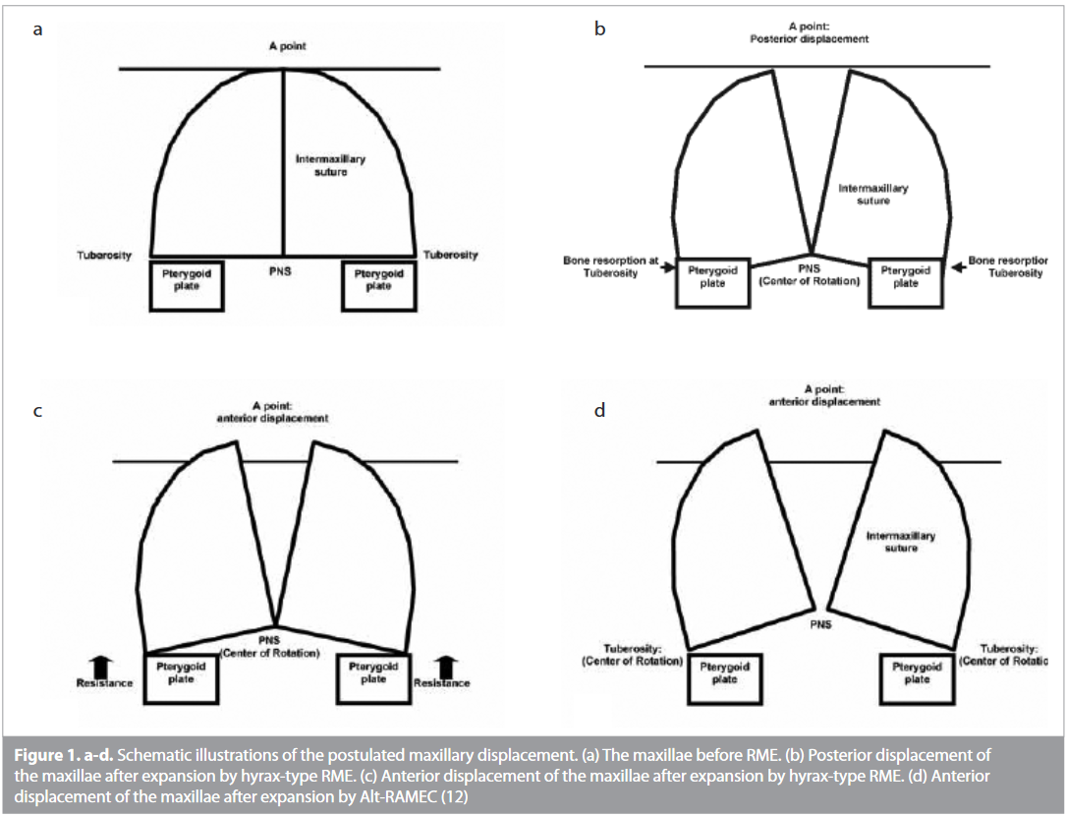
Notes:
In his article introducing the Liou Alt-RAMEC protocol, Liou sche -matized the changes that occur in the maxillae with RME and Alt-RAMEC (Figure 1). With the hyrax-type RME, the center of rotation of the maxillae is opened at the point of the PNS, and the tu - ber maxillae move forward and backward as the A point is located at the same position according to the amount of resorption in the maxilla. With the Alt-RAMEC, the center of rotation of the maxillae is opened at the point of the PNS, and the tuber maxillae move forward more without any resorption in the maxilla. Owing to this protocol, there is much more mobilization in the sutures, and re - sistance structures (e.g., sphenoid) are weakened

Slide 66
Retainer
After the FM and the RME appliance have been removed, the patient can be retained using a number of appliances, including a simple maintenance plate ,an FR-3 appliance of Fränkel, or a chin cup (or a combination of these

Slide 67
Facemask Traction to Skeletal Anchorage.

Slide 68
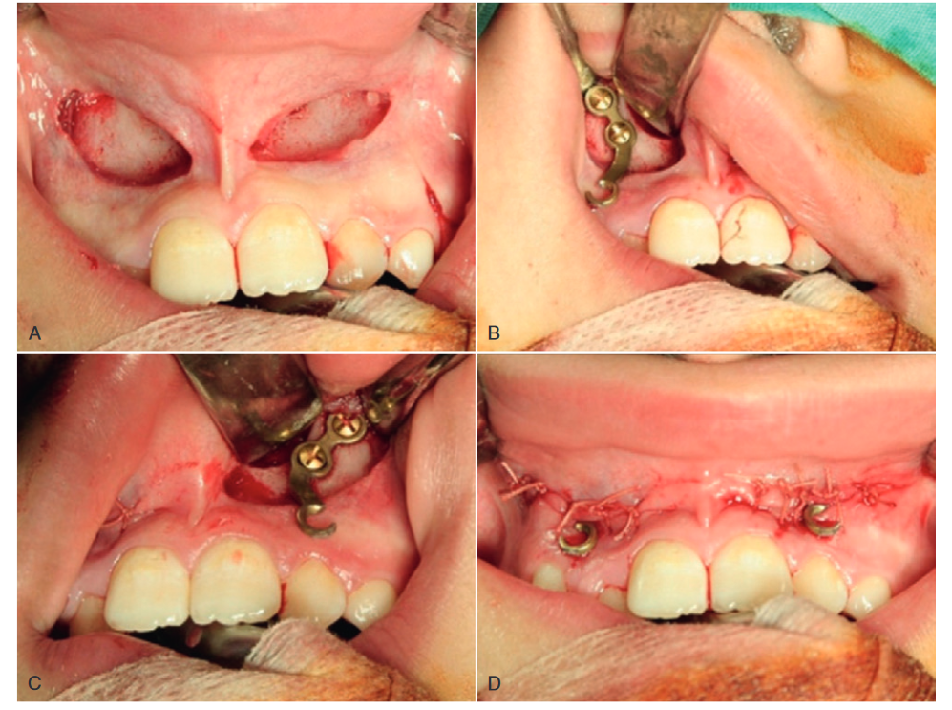
Notes:
Clearly, a major negative side effect of conventional maxillary protraction is tooth movement that detracts from the skeletal change. With bone screws and miniplates now readily available as temporary implants, skeletal anchorage for maxillary protraction is straightforward. Single alveolar bone screws are not adequate, but a facemask can be attached to miniplates on the anterior maxilla
The greatest difficulty with this approach is that miniplate placement on the anterior surface of the maxilla is invasive and bone maturity is not adequate until around age 11, well after the preferred time window for facemasktherapy (age 8 to 10).
4-5mm advacement

Slide 69
Class III Elastics to Maxillary and Mandibular Miniplates

Slide 70
The most effective approach to protraction of the maxilla is Class III elastics between bone-supported miniplates at the base of the zygoma above the maxillary molars and the anterolateral surface of the mandible, so that light force is delivered to the jaws rather than the teeth.
This method was introduced by De Clerck and coworkers in 2010

Slide 71
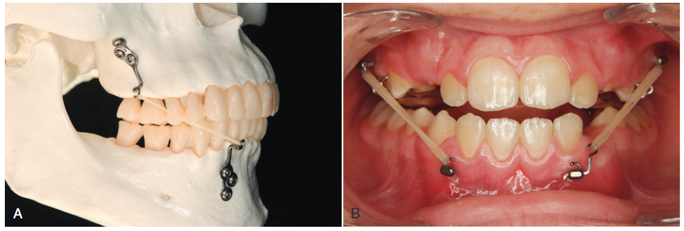
Notes:
The first step is placement of the bone anchors, with a three-screw plate at the base of the zygomatic arch and a two-screw plate on the anterolateral surface of the mandible (Fig. 13.21). This requires reflection of a flap and, especially in the maxilla, careful contouring of the surface of the miniplate to follow the curving surface of the bone. It

Slide 72
In the timing of treatment, two related factors are important. 1. adequate bone density to retain the screws does not develop until approximately age 11
2. the mandibular bone plates should not be inserted until the permanent mandibular canineshave erupted, (9 years of age).
With the skeletally anchored Class III elastics, a favorable growth response can be obtained throughout the adolescent growth spurt, so treatment for about 1 year between the ages 12 and 14 is the best plan
Only light force is needed to obtain the desired growth modification (not more than 250 gm per side; often 150 gm is adequate).
Notes:
This means treatment with this method cannot begin until the patient is already too old for a good response to facemask therapy—but it also means that now there is a way to obtain excellent maxillary protraction for patients who are too old to hope for a good response to facemask therapy.

Slide 73
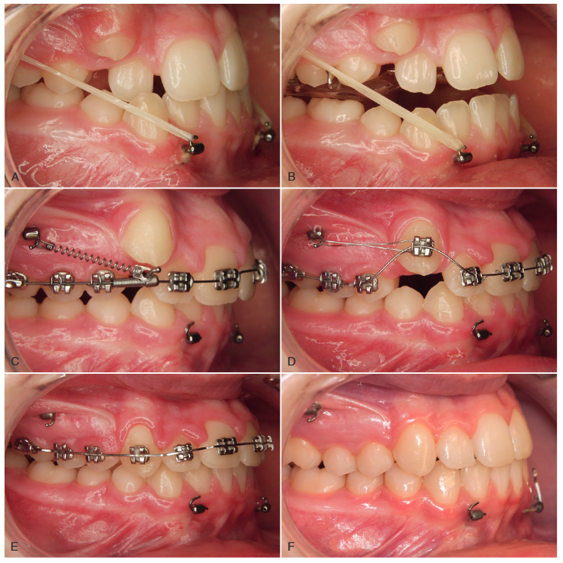
Notes:
. The same zygomatic anchors used for growth modification can be used to distalize the maxillary posterior teeth, opening space for the canines and completing nonextraction treatment (Fig. 13.22).40 It is possible that after debonding, even if this is toward the end of adolescence, some additional growth in the Class III pattern can occur. For that reason, it is wise not to remove the miniplates for another 6 to 12 months (or longer if mandibular growth continues) so that additional elastic wear can be used if needed.

Slide 74
Comparison With Facemask.
--Facemask patients were younger; mean age at start of treatment was 8 years 3 months versus 11 years 10 months for Class III elastics and miniplates.
-- Force with facemask was twice as large: 300 to 500 gm versus 150 to 200 gm.
--on average there was about twice as much change with the elastics, and about the same amount of change with the skeletally anchored facemask as with the dentallyanchored Michigan group.
Notes:
In a comparison of facemask patients treated at the University of Michigan using dental anchorage with a group treated with Class III elastics and miniplates in Brussels and at the University of North Carolina,41 the data were as follows:

Slide 75
The Orthopedic Chin Cup

Slide 76
The oldest of the orthopedic approaches to the treatment of Class III malocclusion is the chin cup.
These appliances can be divided into two types.
The occipital-pull chin cup
The vertical-pull chin cup (VPCC)
Notes:
The occipital-pull chin cup is used in instances of mandibular prognathism, and thevertical-pull chin cup (VPCC) is used in patients with steep mandibular plane angles and excessive lower anterior facial height.

Slide 77
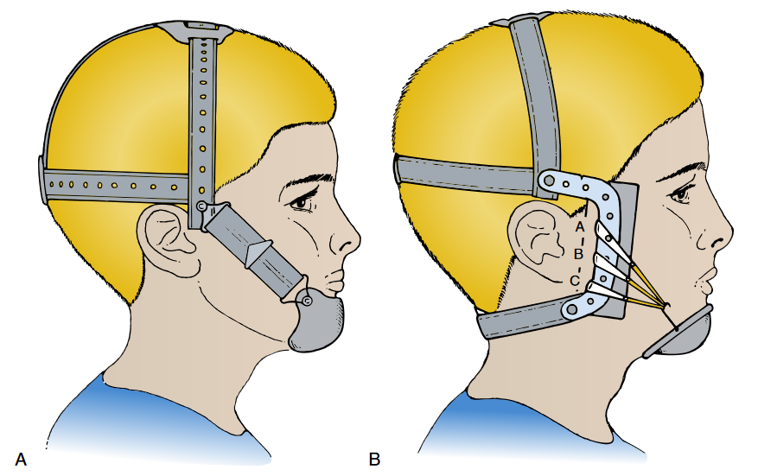
occipital-pull chin cup
Notes:
This type of chin cup is indicated for use in patients with mild to moderate mandibular prognathism.
This treatment is useful particularly in patients who begin treatment with a short lower anterior facial height because this type of treatment can lead to an increase vertical facial height.
If the pull of the chin cup is directed below the condyle, the force of the appliance may lead to a downward and backward rotation of the mandible. If no opening of the mandibular plane angle is desired, the force should be directed through the condyle to help restrict and redirect mandibular growth.
The use of a Hickham-type headcap combined with a hard chin cup ( Fig.16-50, B) allows for variable vectors of force to be produced on the lower jaw.

Slide 78
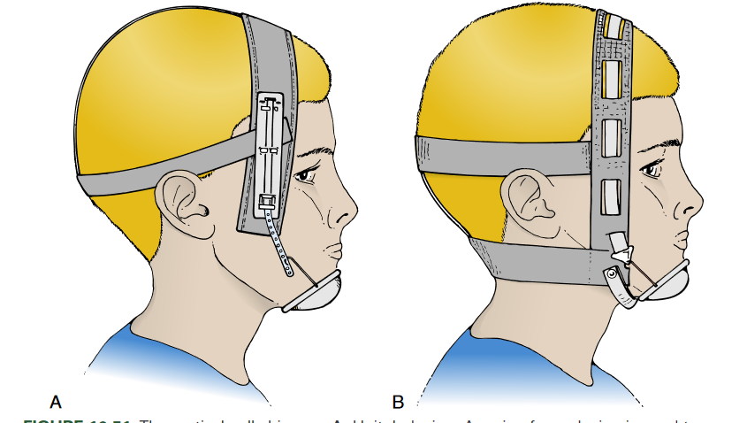
Vertical Pull Chin Cup
Notes:
If no increase in lower anterior facial height is desired, the VPCC can be used
VPCC can result in a decrease in the mandib ular plane angle and the gonial angle and an increase in poste rior facial height in comparison with the growth of untreated individuals. This type of extraoral traction can be used not only in individuals who have a Class III malocclusion but also for patients in whom an increase in the anterior vertical dimensionis not desired.

Slide 79
Line of force of applied force for chin cup therapy should be directed along the lines from the chin point to the condyle heads, bilaterally
Range of force : 400–500 g
Duration of wear: 10–14 hours per day.
While trying the chin cup appliance on patients, care should be taken to ensure that the chin cup does not impinge on the lower lips as it may cause retroclination of the lower incisors and recession of labial gingiva

Slide 80
CONTENTS
-Skeletal corrections with functional appliances
.Frankel III
.Class III Activator
.Reverse twin block
.Bionator
-Camouflage treatment
-Orthognathic surgery for class III

Slide 81
The FR-3 Appliance of Fränkel

Slide 82
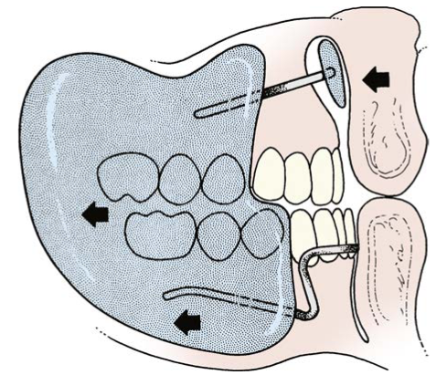
It is a soft tissue–borne appliance
Developed by frankel
Indication:
-Early mixed dentition or late deciduous dentition
-Deficiency of maxillary arch

Slide 83
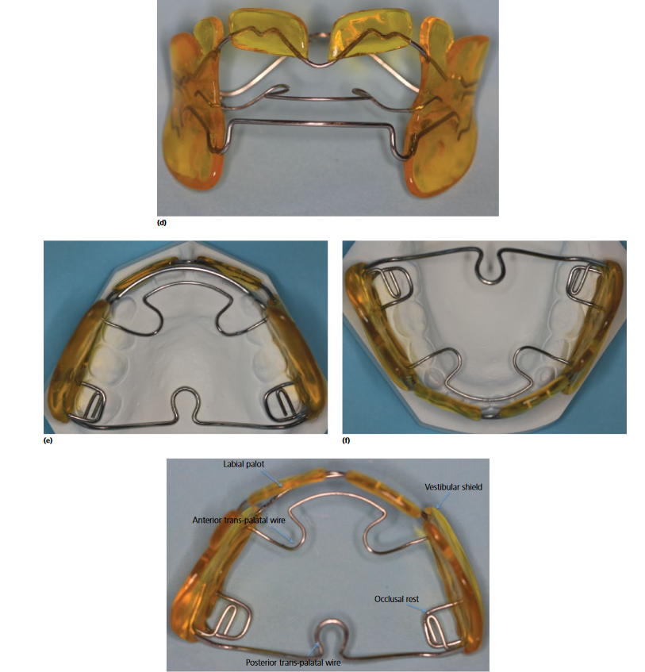
Components:
1. Lip pads
2. Labial bow
3. Protrusion bow
4. Palatal bow
5. Occlusal rests
6. Buccal shields
Notes:
Lip pads: labial vestibular sulcus of upper incisor segment , has supportive metal framework , stands away from mucosa and alveolar bone
purpose : 1. eliminates the restrictive pressure of the upper lip on underdeveloped maxilla
2. exert tension on the tissues and periosteal attachments in the depth of the maxillary sulcus for stimulation of bone growth
3. transmit upper lip force to the mand via the lower labial arch for a retrusive stimuli
Gives negative feedback signal to false anterior positioning
Labial bow : against mand teeth and makes contact with the teeth at the lowest possible level to avoid further lingual tipping
Protrusion bow : passes behind the upper incisors above cingulum and exerts some protrusive force if slight forward movement is desired
Palatal bow : posteriorly directed loop approximates mucosa, end of bow passes distal to max molars delivering a slight anterior stimulus to max dentition, lateral extensions passes in buccal shields, not primary a tooth moving wire but a stabilizing wire
Occlusal rests : on mand first molars ,prevents upward and forward movement of mand molars and max buccal segment is free to erupt down and forward reducing class III relation
Buccal shields : stands away from max by 3mm and approximates mand base , restrict forces from buccinator and orbicularis oris , constricts mand

Slide 84
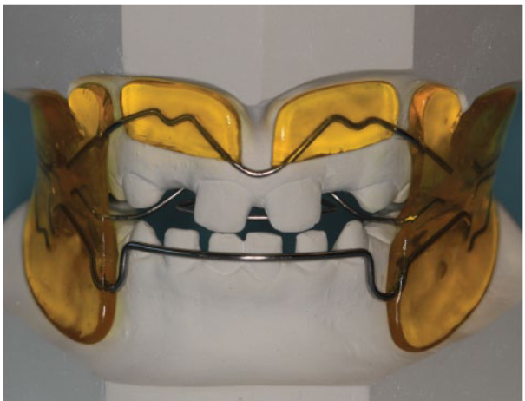
base of operation of the FR-3 appliance
--It stretches the soft tissue at the base of the upper lip, attempting to stimulate forward growth of the maxilla by stretching the maxillary periosteum while maintaining the mandible in its most retruded position.
Notes:
The FR-III appliance stretches the soft tissue at the base of the upper lip, attempting to stimulate forward growth of the maxilla by stretching the maxillary periosteum while maintaining the mandible in its most retruded position. The vertical opening is used to enhance down - ward and forward eruption of maxillary posterior teeth.

Slide 85
Effects
-Little true forward movement of the upper jaw, most of the improvement is from dental changes.
-Allows the maxillary molars to erupt and move mesially while holding the lower molars in place vertically and anteroposteriorly.
-The appliance tips the maxillary anterior teeth facially and retracts the mandibular anterior teeth
-Rotation of the occlusal plane as the upper molars erupt more than the lowers also contributes to a change from a Class III to a Class I molar relationship

Slide 86
Advantage:
Relatively inconspicuous, especially compared with the orthopedic FM or chin cup.
improves the appearance of the patient by filling out the upper lip region in individuals with substantial maxillary skeletal retrusion.
It also helps to reduce forward mandibular posture and overclosure.

Slide 87
CLASS III ACTIVATOR

Slide 88
--The activator was introduced by andresen and has been long served for correction of skeletal class II malocclusions.
--Rakosi suggested modification of the activator for use in class III treatment.
--The goal of using a class III activator was to achieve posterior positioning of the mandible or maxillary protraction.
And used during preadolescent and adolescent growth periods

Slide 89
The wire components are
• 4 stop-loops located mesial to all first molars to prevent mesial tipping of the molars and to stabilize the appliance,
• Lower labial bow to stabilize the appliance,
• Upper labial pads to remove the force of the upper lip and create periosteal pull to induce bone formation, and
• Tongue crib to correct anterior tongue thrusting habit.
• The construction bite is taken by retruding the lower jaw. The upper labial pad of the activator is intended to protract the maxilla
Notes:
4 stop-loops located mesial to all first molars to prevent mesial tipping of the molars and to stabilize the appliance,
• Lower labial bow to stabilize the appliance,
• Upper labial pads to remove the force of the upper lip and create periosteal pull to induce bone formation, and
• Tongue crib to correct anterior tongue thrusting habit.

Slide 90
Treatment changes
• backward positioning of the mandible.
• significant increases of the anb angle and the wits values.
• The SNB and SN Pog get smaller resulting in increasing facial convexity
• Dentoalveolar adaptations included labial tipping of the upper incisors as well as lingual tipping of lower incisors .
Notes:
• The articular angle enlarges, thus augmenting the sum of the saddle, articular, and gonial angles. • The facial axis opens

Slide 91
Duration:
12 hours a day in conjugation with face mask.
11 months of treatment time and 18 -24 months of retention

Slide 92
Bionator

Slide 93
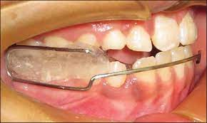
The Bionator, developed by Balters is a derivative of the Activator. The reverse Bionator or Bionator III is a modified version of the traditional bionator and can be used in the treatment of Class III malocclusion.
PHILOSOPHY OF BIONATOR According to Balters, "the equilibrium between the tongue and the circumoral muscles is responsible for the shape of the dental arches and that the functional space for the tongue is essential for the normal development of the orofacial system".
Taking into consideration the dominant role of
the tongue, Balters designed an appliance, which
could take advantage of tongue posture.
Notes:
His design has a palatal wire and also a wire with ‘buccinator wings’ to reduce cheek pressure, while the amount of acrylic is reduced. The Bionator can be worn both day and night.5

Slide 94
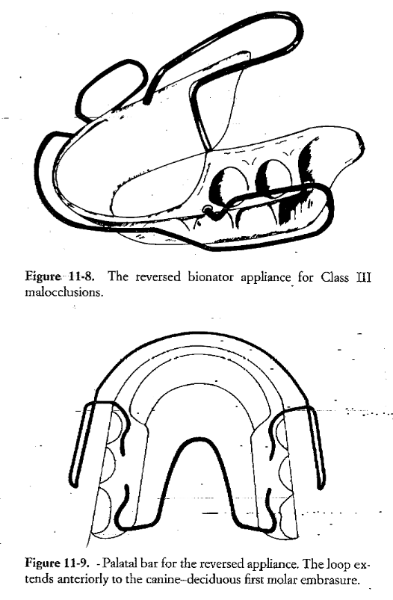
Components:
The construction bite is recorded in most retruded position
The bite is slightly opened , creating about a 2 mm of interincisal space.
The lower acrylic portion is extended incisally from canine to canine
The extension is positioned behind the upper incisors , which are stimulated to glide anteriorly along the resultant inclined plane.
The acrylic is trimmed away behind the lower incisors about 1mm to prevent labial tipping of lower incisors
Notes:
The labial arch is placed in the middle of the lower teeth .

Slide 95
The palatal bar runs forward instead of posteriorly , extending to deciduoud molars or premolar
The tongue is supposedly stimulated to remain in retracted position in its proper functional space. It should contact the anterior portion of the palate , encouraging the forward growth of this area.
Labial bow runs infront of the lower incisors touching the labial surface slightly

Slide 96
Reverse twin block

Slide 97
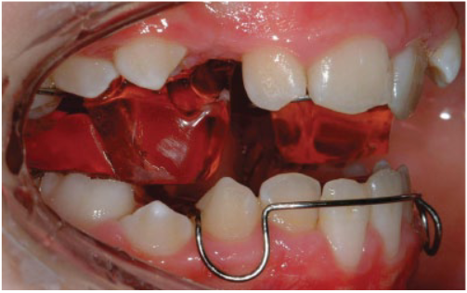
Functional correction of class III malocclusion is achieved in the twin block technique by reversing the angulation of the inclined planes and harnessing occlusal forces as the functional mechanism to correct arch relationships by maxillary advancement, while using the lower arch as the means of anchorage
The position of the bite blocks is reversed compared to
twin blocks for class II treatment.
The occlusal blocks are placed over the upper deciduous
molars and the lower first molars.
Notes:
dams clasps are placed on the first molars and ball‐ended clasps between the primary first and second molars. The retention of the lower appliance can be reinforced by the use of an acrylated lower labial bow. If activated, this will also help to retrocline the lower incisors. Cantilever or recurved springs can be placed behind the upper incisors to procline them.

Slide 98
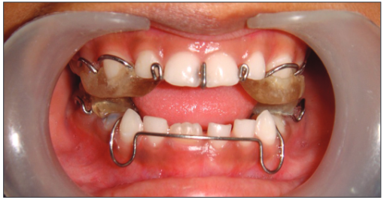
Construction and management
A usual wax bite registration in a maximum retrusive position of the mandible is made, leaving sufficient clearance between the posterior teeth for occlusal bite blocks.
A lower outer passive labial bow and clasps and are incorporated for the purpose of retention in the acrylic plate
Following this, upper and lower bite blocks are fabricated using cold-cure acrylic resin, with clasps on the maxillary and mandibular molars.
Notes:
Adams clasps are placed on the first molars and ball‐ended clasps between the primary first and second molars.

Slide 99
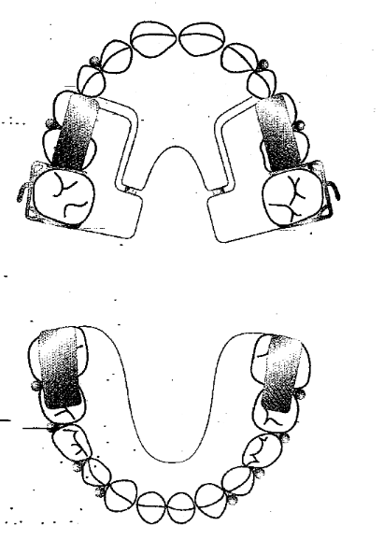
The bite blocks are made to cover the upper primary first molar and the lower second molar, with a reverse direction of the inclined planes at an angle of 70⁰.
Cantilever or recurved springs can be placed behind the upper incisors to procline them.
Expansion screw is inserted in maxillary appliance for both transverse and anteroposterior expansion
The appliance is activated every 2 weeks by addition of acrylic resin on the inclines of the bite blocks.
Notes:
However, care should be taken not to overactivate these, as this will tend to displace the upper appliance. Alternatively, a split plate can be used with a screw behind the upper incisors. The upper appliance can also incorporate a midline screw, which can be turned twice a week

Slide 100
Effects of reverse Twin Block
Kidner et al. showed that full‐time wear of the appliance resulted in proclination of the upper incisors and retroclination of the lower, as well as a down-ward and backward rotation of the mandible.
Both anteroposterior and transverse expansion as oftenly required in class III cases
Correction of the anterior crossbite
This resulted in an increase in lower anterior face height and a relative reduction in mandibular prognathism.
These changes were achieved in just over 6 months.

Slide 101
Camouflage treatment approach for class III malocclusion

Slide 102
--There are class III cases, where skeletal deformity is mild to moderate and orthodontic non surgical treatment can correct the dental malocclusion without having and adverse effects on the soft tissue of the face.
--Such treatment approach where the underlying skeletal deformity is left untreated but teeth are moved to such positions to create an acceptable occlusion without violating the norms of aesthetics and stability is categorized as camouflage treatment .

Slide 103
Indications
Class III with mild to moderate severity
Have passed the active growth phase for orthopaedic treatment
No skeletal facial asymmetry
Hypo divergent class III
Lack of posterior crossbite
Presence of good alveolar support
Good oral hygiene and periodontal health
Pt with limited expectation in the improvement of their profile

Slide 104
Contraindication
Acute nasolabial angle
Limited possibilities for further mandibular incisor retroclination
Large negative overjet
Large tongue
Familial or genetic etiology
Significant skeletal facial asymmetry and jaw deviation
Open gonial angle, open bite and vertical growers
High expectations of profile improvement

Slide 105
Camouflage
Non Extraction
MEAW Technique
Distalization of lower arch
Extraction
incisor
premolar
TREATMENT APPROACHES

Slide 106
Introduced by kims in 1987 Widely used in open bite cases
MEAW
Notes:
The MEAWs are constructed with 0.016 x 0.022stainless steel (bracket 0.018 inch slot) or 0.017x0.025 stainless steel (bracket 0.022– inch slot). The arches have ideal arch form with five loops on each side of the arch.

Slide 107
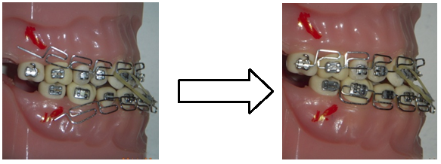
The treatment mechanics use tip back bend activations of the MEAW and vertical or short class III elastics

Slide 108
The objectives of the treatment are:
a) to eliminate posterior discrepancy,
b) to intrude the posterior teeth and to upright them,
c) reconstruction the occlusal plane (steepning the occlusal plane) which induces mandibular backward adaption.
The entire lower dentition is moved distally and uprighted using a MEAW with short class III elastics after extraction of the third molars.

Slide 109
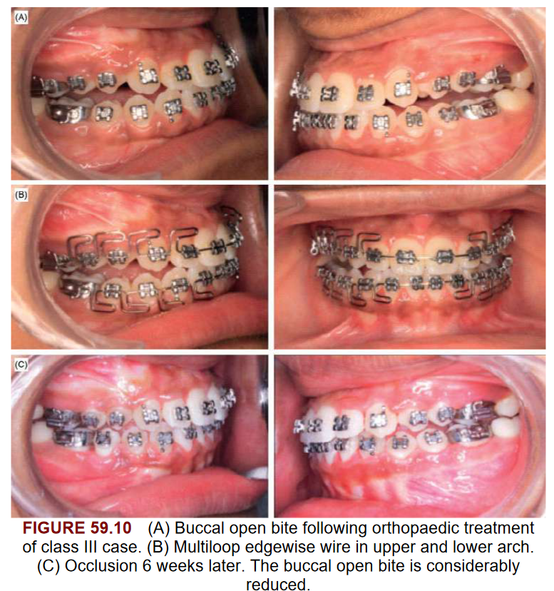

Slide 110
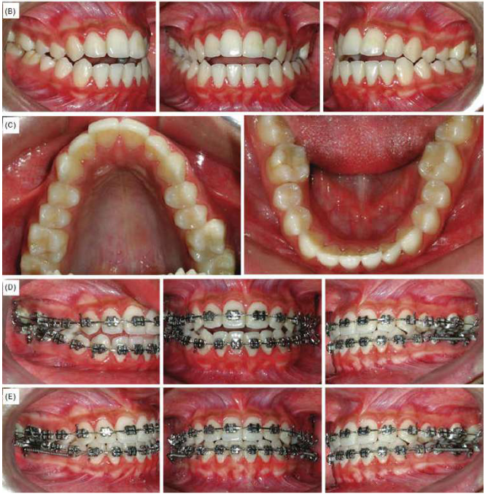
DISTALIZATION
Notes:
Using skeletal anchorage

Slide 111
Extraction approach

Slide 112
Mandibular incisor
Indications
Not enough crowding
Bolton’s discrepancy
Disadvantage
Long time retainer
Midline mismatch

Slide 113
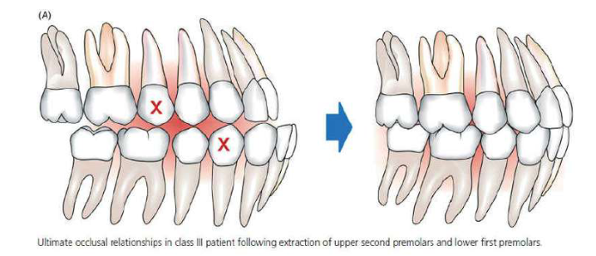
Upper 2nd lower 1st bicuspid
Indication
Large mandibular crowding
Significant tipping of the mandibular arch
Lesser crowding in upper arch

Slide 114
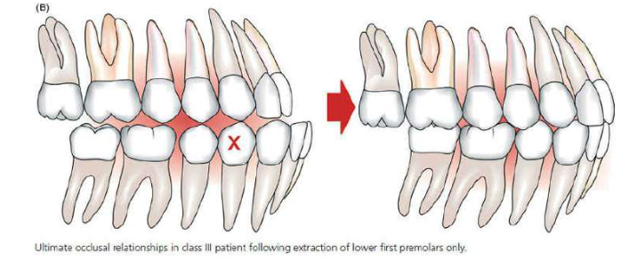
Only lower bicuspids
Well aligned maxillary arch
Significant crowding in lower arch

Slide 115
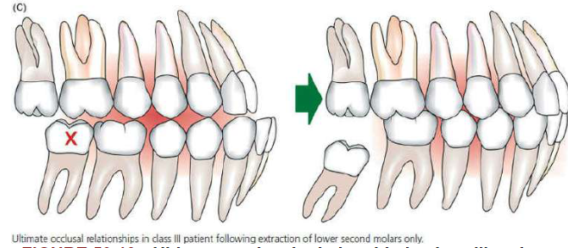
Mandibular second molars
Significant distalization of lower arch

Slide 116
Advantages(Mora et al)
Reduction in quantity and duration of the therapy with fixed appliances
Rapid eruption of the third molar
Aiding in prevention of late incisor crowding
Overjet correction by distal movement of first molar and anterior dentition
Avoiding complications of the surgical removal of impacted third molar

Slide 117
Orthognathic surgery

Slide 118
--Non-growing patients with severe skeletal class III malocclusion are best treated with a combined orthodontic and surgical approach.
--The strategies of Class III treatment in adolescence include ̄ Forward displacement of the midface ̄ Inhibition of mandibular growth ̄ Redirection of mandibular growth ̄ Dental and alveolar process repositioning.
--For patients with continued disproportional sagittal and vertical growth, or Class III patients with mandibular excess combined with a divergent facial pattern, there are no good nonsurgical treatment solutions.
-- Such patients are outside the "envelope of discrepancy“ proposed by Proffit and Ackerman.

Slide 119
Notes:
With the ideal position of the upper and lower incisors shown by the origin of the x- and y-axes, the envelope of discrepancy shows the amount of change that could be produced by orthodontic tooth movement alone (the inner envelope of each diagram); orthodontic tooth movement combined with growth modification (the middle envelope); and orthognathic surgery (the outer envelope). Note that the possibilities for each direction of movement are not symmetric. There is more potential to move teeth forward than back and more potential for extrusion than intrusion. Because growth of the maxilla cannot be modified independently of the mandible, the growth modification envelope for the two jaws is the same. Surgery to move the lower jaw back has more potential than surgery to advance it.

Slide 120
Kerr et al. suggested that surgery should be performed for patients with the following characteristics:
• An ANB angle of less than -4 degrees, • an inclination of the lower incisors to the mandibular plane of 83 degrees • and a Holdaway angle of 3.5 degrees
Notes:
a maxillary/mandibular (M/M) ratio of 84%,

Slide 121
Stellzig-Eisenhauer et al. (2002) found that the WIT’s appraisal was the most decisive factor in discriminating between the surgical and non- surgical class III groups, with the surgical group having a WIT appraisal value of (-12.2 ± 4.3 mm) and the non-surgical group having a WIT appraisal value of (-4.6 ± 1.7 mm)

Slide 122
Common surgical movements include maxillary advancement and mandibular setback or combination of both movements in cases of severe class III malocclusion with a huge negative overjet.
Kitagawa et al. suggested that patients in whom significant mandibular setback surgery was performed would have a higher risk of breathing problems while asleep.
Currently, the two-jaw-surgery approach is becoming more popular than the single-jaw-surgery approach because facial appearance is improved if concurrent maxillary advancement allows for smaller mandibular setback

Slide 123
Notes:
The hierarchy of stability during the first postsurgical year, based on data from the University of North Carolina (UNC) Dentofacial Clinic. In this context, “very stable” means a 90% chance of no significant postsurgical change; “stable” means a greater than 80% chance of no change and almost no chance of more than 2mm of relapse; “problematic” means some degree of relapse is likely and major relapse is possible
Class III treatment, maxillary advancement is the most stable procedure, whereas downward movement of the maxilla and mandibular setback remain problematic.

Slide 124
Notes:
Presurgical orthodontic treatment usually involves the provision of fixed appliances to align the maxillary and mandibular arches, in order that they will co-ordinate when their respective skeletal bases have been surgically repositioned. This necessitates both alignment and decompensation of the axial inclination of the incisors Thus the maxillary incisors are retroclined and the mandibular incisors are proclined to approximately 109o and 90o to the maxillary and mandibular planes, respectively.
A short period of orthodontic treatment (ideally
less than6 months) is often required after surgery to finish and detail the occlusion

Slide 125
The current surgical methods for correcting skeletal Class III problems are:
--Ramus osteotomy to set back a prognathic mandible
--Mandibular inferior border osteotomy to reduce chin height and/or prominence
--LeFort I osteotomy advance a deficient maxilla, often with segmentation to allow transverse expansion.

Slide 126
CONCLUSION
-- The thorough examination and diagnosis of class III malocclusion patients are mandatory for its management. Patient gender, age, complaints and malocclusion severity are key factors in determining the best treatment modality.
--Variations are present in the long-term stability of the various growth modification approaches to class III malocclusion.
-- The use of titanium miniplates permitted equivalent, favourable skeletal changes, without unwanted dento-alveolar effects.
--Non-growing patients with severe skeletal class III malocclusion are best treated with combined orthodontic and surgical intervention.

Slide 127
Thank you

Slide 128
Disadvantages:
Normally, 12 to 24 months is necessary to produce an appreciable response with the FR-3 appliance.
When used as the primary appliance, the FR-3 is worn for about 20 hours per day, with the patients removing the appliance only during such activities as eating and playing contact sports.
Notes:
It is obvious, however, that the FR-3 appliance has much more of an effect on theassociated soft tissue, particularly on any existing hyperactivity in the muscles associated with the maxilla, than does the FM.

