Slide 1
FUNDAMENTAL CONCEPTS OF ENAMEL AND DENTIN ADHESION

Slide 2
ADHESION
Definition-
The American Society for Testing and Materials (ASTM; specification D 907) defines adhesion as "the state in which two surfaces are held together by interfacial forces which may consist of valence forces or interlocking forces or both.

Slide 3
Mechanisms of dental adhesion-
Bonding of resins to tooth structure is a result of four possible mechanisms:
1. Mechanical-penetration of resin and formation of resin tags within the tooth surface.
2. Diffusion-precipitation of substances on the tooth surfaces to which resin monomers can bond mechanically or chemically.
3. Adsorption-chemical bonding to the inorganic component (hydroxyapatite) or organic omponents (mainly Type I collagen) of tooth structure.
4. A combination of the previous three mechanisms

Slide 4
Indications for adhesive dentistry-
Adhesive restorative techniques are currently used to:
1. Change the shape and the color of anterior teeth.
2. Restore Classes I, II, III, IV, V, and VI carious or traumatic defects.
3. Restore teeth with amalgam using an adhesive technique.
4. Bond all ceramic restorations.

Slide 5
5. Seal pits and fissures.
6. Bond orthodontic brcakets.
7. Bond periodontal splints.
8. Densensitize exposed root surfeces.
9. Bond fractured segments of anterior teeth.
10. Bond prefabricated metal and fibre posts.
11. Seal root canals during endodontic therapy.

Slide 6
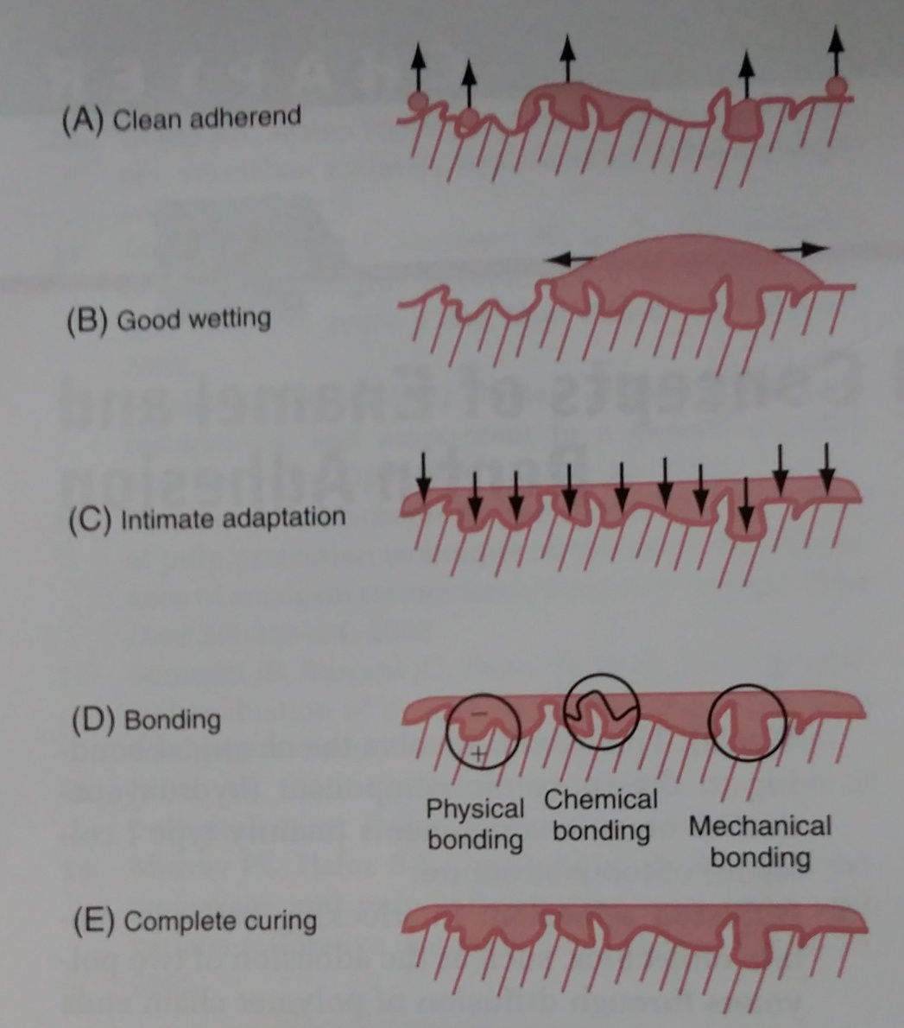
Key steps in development of good adhesion

Slide 7
ENAMEL ADHESION: (Buonocore’s Acid Etch Technique)
Buonocore in 1955 suggested the use of acids to etch enamel for sealing the pits and fissures. After being inspired by the use of 85% phosphoric acid to facilitate adhesion of paints to metallic surfaces.

Slide 8
Resin microtag mechanism of enamel adhesion
Acid etching transforms smooth enamel into an irregular surface. Also increases surface free energy.
Application of fluid resin – based material to this irregular etched surface facilitates its penetration by capillary action
Monomers in the material are then polymerized and the material becomes interlocked with the enamel surface

Slide 9
Etch Pattern
Namel etching results in 3 different etching patterns-
Type 1- dissolution of prism cores without dissolution of prism peripheries.
Type 2- Opposite of type 1.
Only peipheral enamel is involved.
Core is left intact
3. Type 3- less distinct than other two patterns. Includes areas not related to prism morphology.

Slide 10
Etchant concentration- 37% phosphoric acid.
Etch time- 15 seconds.
Bond strength- 20 MPa

Slide 11
DENTIN ADHESION-
Bonding to enamel is a relatively simple process, without major technical requirements or difficulties.
Bonding to dentin, on the other hand, presents a much greater challenge. This is because of:
Structure of dentin
Smear layer
Stresses at the resin- dentin interface

Slide 12
Structure Of Dentin
Whereas enamel is a highly mineralized tissue composed of more than 90% (by volume) hydroxyapatite, dentin contains a substantial proportion of water and organic material, primarily Type I collagen.
Dentin is an intrinsically hydrated tissue, penetrated fluid-filled dentinal tubules. There is movement of fluid from the pulp to the dentinenamel junction which makes bonding to dentin diificult as compared to enamel.

Slide 13
Smear layer
Whenever tooth structure is prepared with a bur or other instrument, residual organic and inorganic components form a "smear layer" of debris on the surface .
Other than debris and bacteria it contains hydroxyapatite and altered denatured collagen
The smear layer fills the orifices of dentin tubules forming smear plugs, decreases dentin permeability by up to 90% and thus interfere with bonding.

Slide 14
Thickness of smear layer- 0.5-2 µm.
Thickness of smear plug- 1-10 µm
Optimal bonding can take place by-
A. Complete removal of smear layer prior to the bonding procedure.
B. Incorporation of the smear layer into the bonding layer itself.

Slide 15
Stresses at The Resin Dentin Interface
Composites shrink as they polymerize, creating stresses within the composite mass depending on the configuration of the preparation.
The stresses at the resin dentin interface can be determined by the following factors-
Configuration factor-
It is the ration between bonded to unbonded surfaces of a restoration. It determines the stress relief within a 3- dimensional bonded restoration.

Slide 16
Eg- When the composite is bonded to one surface only (such as in the case of a direct facial veneer), stresses within the composite are relieved by flow from the unbonded surface.
But in an occlusal preparation, composite is bonded to five surfaces-mesial, distal, facial, lingual, and pulpal. The occlusal surface is the only "free" or unrestrained surface.
In such a clinical situation, the ratio between the number of bonded and unbonded surfaces is 5, giving the restoration a C-factor of 5.
Higher the value of c-factor limited will be the stress relief because stress flow can then occur only from lesser number of free surfaces.
These unrelieved stresses in the composite may cause internal bond disruption as well as marginal gaps around restorations that increase microleakage.

Slide 17
2. Coefficient of thermal expansion-
Each time a restoration is exposed to wide temperature variations in the oral environment (such as drinking coffee and eating ice cream), the restoration undergoes volumetric changes of different magnitude than those of the tooth structure.
This occurs because the linear coefficient of thermal expansion of the composite is about four times greater than that of the tooth structure.
Accordingly, microleakage around dentin margins is potentiated by this discrepancy in linear coefficient of thermal expansion between the restoration and the substrate.

Slide 18
3. Occlusal loading-
Repeated loading and unloading cycles of restored teeth can cause gaps at the resin dentin interface wich affects bonding adversely.

Slide 19
CLASSIFICATION OF DENTINAL ADHESIVES
Historical strategies-
First generation (1965)
Second generation (1978)
Third generation (1984)
Current Strategies-
1. Etch and rinse adhesives
Three step – etch and rinse adhesive (fourth generation)
Two step- etch and rinse adhesive (fifth generation)

Slide 20
2. Self-etch adhesives
Two component- self etch adhesive (sixth generation)
Two step- two component- self etch adhesive
One step- two component- self eth adhesive
b. Single component- one step – self-etch adhesive (seventh generation)

Slide 21
First generation (1965)-
Chemical- surface-active co- monomer NPG –GMA.
Mechanism of action- chelate with calcium on the tooth surface to generate water-resistant chemical bonds of resin to dentinal calcium.
Brand Name- Cervident
Bond strength- 2-3 MPA
Clinical results- Poor

Slide 22
Second Generation (1978)-
Chemical- phosphate-ester material (phenyl-P and HEMA in ethanol)
Mechanism of action- based on the polar interaction between negatively charged phosphate groups in the resin and the positively charged calcium in the smear layer.
Brand names- Clearfil Bond System F (Kuraray, Osaka, Japan), Scotchbond (3M ESPE, St. Paul, Minnesota)
Bond strength- 1-5 Mpa

Slide 23
Third generation (1984)-
Chemical- phosphate-based material contained HEMA and a ten-carbon molecule known as 10-MDP, which includes a long hydrophobic and a short hydrophilic component.
Mechanism of action- The concept of phosphoric acid-etching of dentin before application of a phosphate ester-type bonding agent was introduced by Fusayama and others in 1979.

Slide 24
But because of the hydrophobic nature of the bonding resin, acid-etching did not produce a significant improvement in dentin bond strengths, despite the flow of the resin into the open dentinal tubules .
Furthermore, pulpal inflammatory responses were thought to be triggered by the application of acid on dentin surfaces, providing another reason for not using acid.

Slide 25
Clearfil New Bond (Kuraray,japan) was the only 3rd generation bonding agent to follow the etched dentin philosophy.
Most other third-generation materials were designed not to remove the entire smear layer, bur rather to modify it and allow penetration of acidic monomers

Slide 26
CURRENT STRATEGIES FOR RESIN DENTIN BONDING

Slide 27
1. Etch And Rinse Adhesives
Although the smear layer acts as a “diffusion barrier” that reduces the permeability of dentin, it also can be considered an obstacle that must be removed to permit resin bonding to the underlying dentin substrate.
Removal of the smear layer via acid-etching led to significant improvements in the in vitro bond strengths of resins to dentin.
Because the clinical technique involves simultaneous application of an acid to enamel and dentin, this method was originally known as the “total-etch” technique, now commonly known as the etch-and-rinse technique.

Slide 28
Mechanism of action
Application of acid to dentin results in partial or total removal of the smear layer and demineralization of the underlying dentin
Besides demineralizing intertubular and peritubular dentin, acids open the dentin tubules and expose a dense filigree of collagen fibers (see thus increasing the microporosity of the intertubular dentin
Dentin is demineralized up to 7.5 um, depending on the type of
acid, application time, and concentration.

Slide 29
The primer increases the critical surface tension of dentin
Bonding occurs-
1. Primer and bonding agent penetrate the intertubular dentin forming a resin dentin interdiffusion zone- hybrid layer
2. They also penetrate and polymerize in the open dentinal tubules forming resin tags.

Slide 30
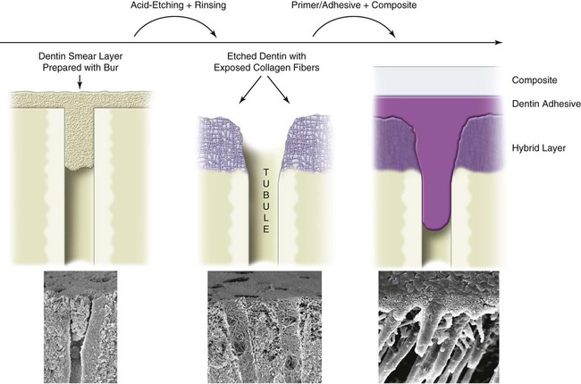
BONDING OF RESIN TO DENTIN USING AN ETCH AND RINSE TECHNIQUE

Slide 31
Moist bonding technique-
Complete drying of dentin after completion of acid etching is not recommended.
Drying the dentin with air will cause the dentin collagen to collapse.
The etch-and-rinse adhesive systems have organic solvents acetone or ethanol in the primers or adhesives that can displace water from the dentin surface and the moist collagen network, thus promoting the inﬁltration of resin monomers throughout the nanospaces of the dense collagen web.

Slide 32
Pooled moisture should not remain on the tooth because excess water can dilute the primer and render it less effective.
A glistening hydrated surface is preferred.
The moist bonding technique has been shown repeatedly to enhance bond strengths of etch-and-rinse adhesives because water preserves the porosity of collagen network available for monomer.

Slide 33
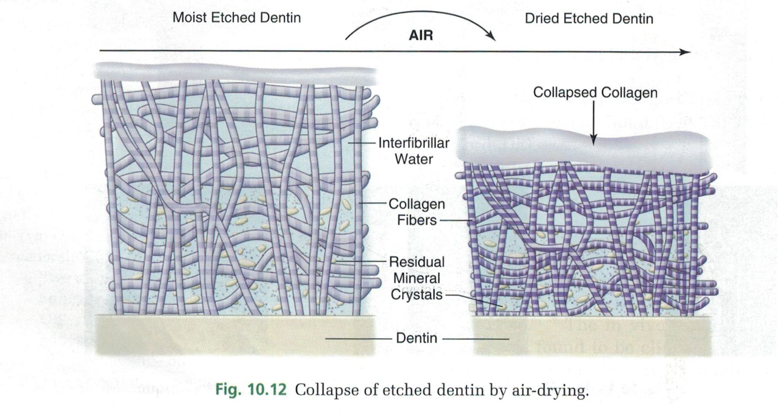
COLLAPSE OF ETCHED DENTIN BY AIR DRYING

Slide 34
Three step etch and Rinse Adhesives (fourth generation)
Components: Etchant gel + primer (bottle I) + adhesive (bottle II)
They include three essential components that are applied separately and sequentially:
1. Phosphoric acid—etching gel that is rinsed off.
2. Primer containing reactive hydrophilic monomers in ethanol, acetone, or water

Slide 35
3. Unﬁlled or ﬁlled resin bonding agent.. It contains hydrophobic monomers such as BisGMA, frequently combined with hydrophilic molecules such as HEMA.
CLINICAL STEPS-
Step I: Application of etchant gel (37% phosphoric acid) for 15 seconds on the tooth surface
Step II: Rinse the etchant off thoroughly and blot dry the substrate (moist bonding technique)

Slide 36
Step III: Application of primer [bottle I) on the substrate
Step IV: Application of adhesive (bottle II) on the substrate
Step V: Light cure
Brand names
1. All-Bond 2 and All-Bond 3 (Bisco, Inc, Schaumburg, IL)
2. OptiBond FL (Kerr Corporation)
Bond strength -17-30 MPa

Slide 37
Two step: Etch and rinse adhesives (ﬁfth generation)
Components: Etchant gel + Primer and adhesive present in a single bottle
A separate etching step still is required.
CLINICAL STEPS-
Step I: Application of etchant gel (37% phosphoric acid) for 15 seconds on the tooth surface.
Step II: Rinse the etchant off thoroughly and blot dry the substrate (moist bonding technique)

Slide 38
Step III: Application of primer and adhesive (single bottle) on the substrate
Step IV: Light cure
Brand names
1. Prime & Bond NT (DENTSPLY Caulk)
2. Adper Single Bond 2(3M ESPE]

Slide 39
2. Self etch adhesives
An alternative bonding strategy is the self-etch approach that involves the omission of a separate etching step.
The elimination of the etching procedure has the following advantages:
Clinician friendly procedure as it reduces the number of steps during bonding.
Less technique sensitive procedure. It overcomes the problem of over dry or over wet.

Slide 40
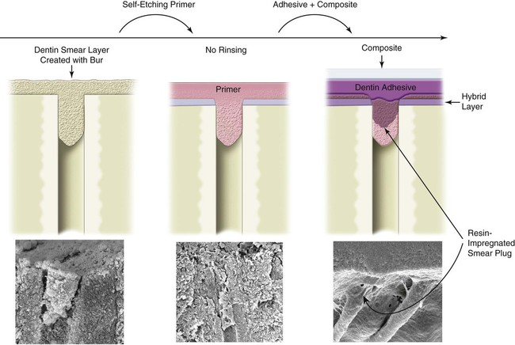
BONDING TO DENTIN USING A SELF ETCH PRIMER

Slide 41
Two types of self-etch adhesives are available:
Two component——self-etch adhesive (sixth generation)-
Two step- two component- self etch adhesive
One step – two componenet- self etch adhesive
2. Single component—one step: self-etch adhesive (seventh generation)

Slide 42
1. Two component—self-etch adhesives
A. Two step- two component – self etch adhesives:
These are also described as nonrinsing conditioners or self-priming etchants.
Mechanism of action-
These acidic primers include a phosphonated resin molecule that performs two functions simultaneously:
a. Etching and priming of enamel and dentin
b. Incorporating smear plugs into the resin tags

Slide 43
CLINICAL STEPS-
Step I: Bottle I -(conditioner + primer) application on the tooth surface. Wait for 10 seconds and no need to rinse the substrate
Step II: Bottle II—(adhesive) application on the tooth surface
Step III: Light cure
Brand names-
1. Clearﬁl SE Bond (Kuraray, Iapan)
2. AdheSE (Ivoclar—Vivadent)

Slide 44
B. One step- Two component- self atch adhesives:
Concept-
They comprise of a two bottle system containing the conditioner, primer and adhesive resin which has to be mixed before applying to the bonding substrate.
CLINICAL STEPS-
Step I: Dispense and mix one drop each from bottle I [conditioner + primer) and bottle II—(adhesive)
Step II: Apply on the tooth surface (no need to rinse the substrate)
Step III: Light cure

Slide 45
Brand names-
XenoIII (Dentsply)
One up Bond (Tokuyama)

Slide 46
2. One step: Single component- self-etch (seventh generation)
Concept –
Continuing the trend toward simpliﬁcation, no-rinse self-etching materials that incorporate the fundamental steps of etching, priming, and bonding into one solution have been introduced.
Conditioner + primer + adhesive = single bottle

Slide 47
Mechanism of action-
In contrast to conventional adhesive systems that contain an intermediate light-cured, low-viscosity bonding resin to join the composite restorative material to the primed dentin—enamel substrate, these one-step self-etch or ‘all-in-one’ adhesives contain uncured ionic monomers that contact the composite restorative material directly.

Slide 48
Brand names
1. AdheSE One F (Ivoclar Vivadent)
2. Adper Easy One (BM ESPE)

Slide 49
Biocompatibility of dentin adhesive systems
Dentin adhesive systems are well tolerated by the pulp—dentin complex in the absence of bacterial infection.
But in some cases, adverse reactions may be caused by:
1. Bacterial invasion of the pulp, either from the tooth preparation or from an existing carious lesion or a faulty restoration.
3. Pressure gradient caused by excessive desiccation or by excessive pressure during cementation.
4. Traumatic injuries.
5. Iatrogenic tooth preparation—excessive pressure, heat, or friction.
6. Stress derived from polymerization contraction of composites and adhesives.

Slide 50
Microleakage
It is the passage of bacteria and their toxins between restoration margins and tooth preparation walls.
if a dentin adhesive system does not adhere intimately to the dentin substrate, an interfacial gap eventually develops, and bacteria are able to penetrate through this gap
Clinically, microleakage becomes important when one considers that pulpal irritation is more likely caused by bacteria than by chemical toxicity of restorative materials.

Slide 51
Nanoleakage
The term nanoleakage has been used to describe small porosities in the hybrid layer or at the transition between the hybrid layer and the mineralized dentin.

Slide 52
Amalgam bonding systems
These were introduced to seal underlying tooth structure and bond amalgam to enamel and dentin.
Bonding agent - 4-methyloxy ethyl trimellitic anhydride (4-META) based systems were used frequently as amalgam bonding agents.

Slide 53
Bonding mechanism
1. Although good bonding to the tooth structure occurs, micromechanical bonding at the interface of amalgam and the bonding system is poor
2. Most debonding occurs by fracture along this interface. As no chemical bonding occurs at this interface, it is important to develop micromechanical bonding.

Slide 54
3. To accomplish this, the bonding system is applied in thicker layers (10-50 um) so that amalgam being condensed against the resin adhesive layer forces the fluid components of amalgam to squeeze into the unset bonding adhesive layer and produce micromechanical laminations of the two materials .
Bond strength-
Macroshear bond strengths for joining amalgam to dentin are relatively low (2-6 Mpa)

Slide 55
Summary
Reliable bonding of resins to enamel and dentin has revolutionized the practice of operative dentistry. Even as the materials continue to become better and easier to use proper attention to the technique and good understanding of the bonding process remains essential for clinical success.

