Slide 1
Casting defects

Slide 48
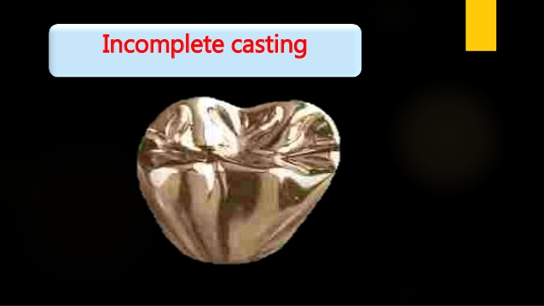

Slide 60
Thank You!!!!!

